Slide 1
Big Tech & Fintech: Competition, Innovation, Regulation?
Nicolas Petit
Joint Chair in Competition Policy, RSC & LAW
FBF annual Conference, 2022

Slide 2



Slide 3

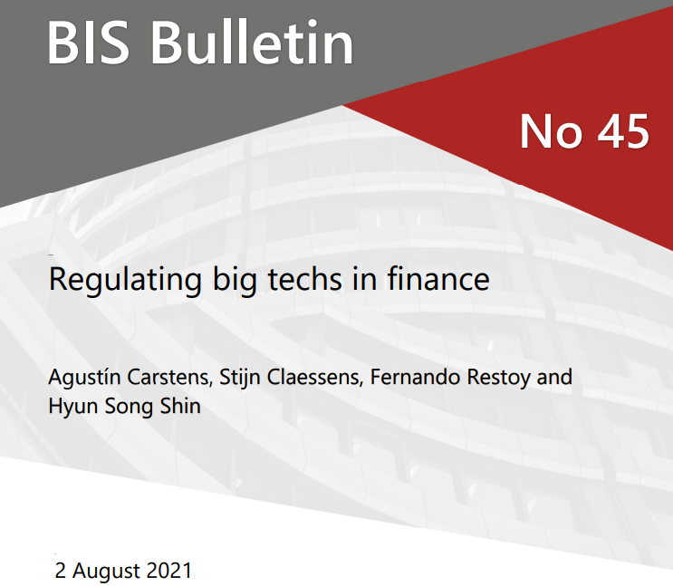
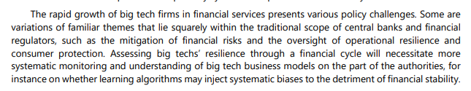
"We cannot allow that platforms that already have scale (…) shut down entrants by withholding or delaying access to the data that is necessary in order to provide a relevant payment service."

Slide 4
Menu
Big Tech Diversification?
Fintech Entry?
Incumbent Response?
An EU Textbook Case of Well-Designed Regulation?
Conclusions
Notes:
Big Tech Diversification in Banking, Finance, and Payments?
Fintech entry
Incumbents’ Response to rising Competition and Innovation?
Fintech Entry as Textbook Case for Well-Executed Regulation?

Slide 5
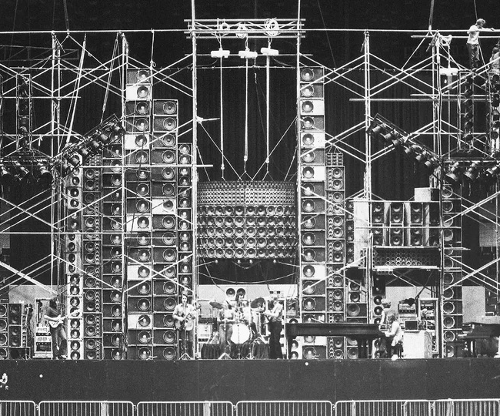
Disclaimer
Uncertain ratio of noise to evidence
‘Big tech banking’
‘Web3’
Notes:
I am a competition lawyer
I have studied digital platforms for a while
I have supported more active enforcement of competition law against them
But not regulation
Big questions
Very high level

Slide 6
1. Big Tech Diversification
Pay
Cloud
Loans & Credit
Crypto
Ecosystem growth
Adjacency
Cooperation
Notes:
To date, Chinese Big Tech firms have made bigger inroads into financial services markets than their US counterparts

Slide 7
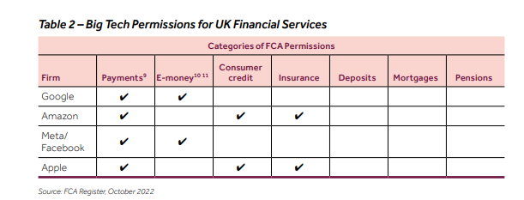
FCA, Oct 2022

Slide 8
Regulation: push & pull factors?
PSD2
  DMA
Access to account rule (XS2A)
But focus on technical services out of PSD2 scope (ACM Market Study, Dec 2020)
Art. 5(2) ban on combination of data across properties (ex GOOG Pay and BNPL?)
Art 5(7) tying ban (ex. AAPL condition app store access to checkout service?)
Art 6(2) ban of use of 3rd party data in competition w/ them (ex APPL using Pay data to offer credit card services?)
Art 6(5) self preferencing ban (ex AAPL ranking its own wallet higher in app store?)
Art 6(7) equivalent interoperability w/ gatekeeper service (ex AAPL preventing equal access to NFC technology for contactless service?)
Notes:
Big Tech work as technical service providers to the banks and payment card schemes, which hold PSD2 licences.
Benefit from Art. 3, j). Exclusions. PSD2 does not apply to “services provided by technical service providers, which support the provision of payment services, without them entering at any time into possession of the funds to be transferred, including processing and storage of data, trust and privacy protection services, data and entity authentication, information technology (IT) and communication network provision, provision and maintenance of terminals and devices used for payment services, with the exclusion of payment initiation services and account information services;”

Slide 9
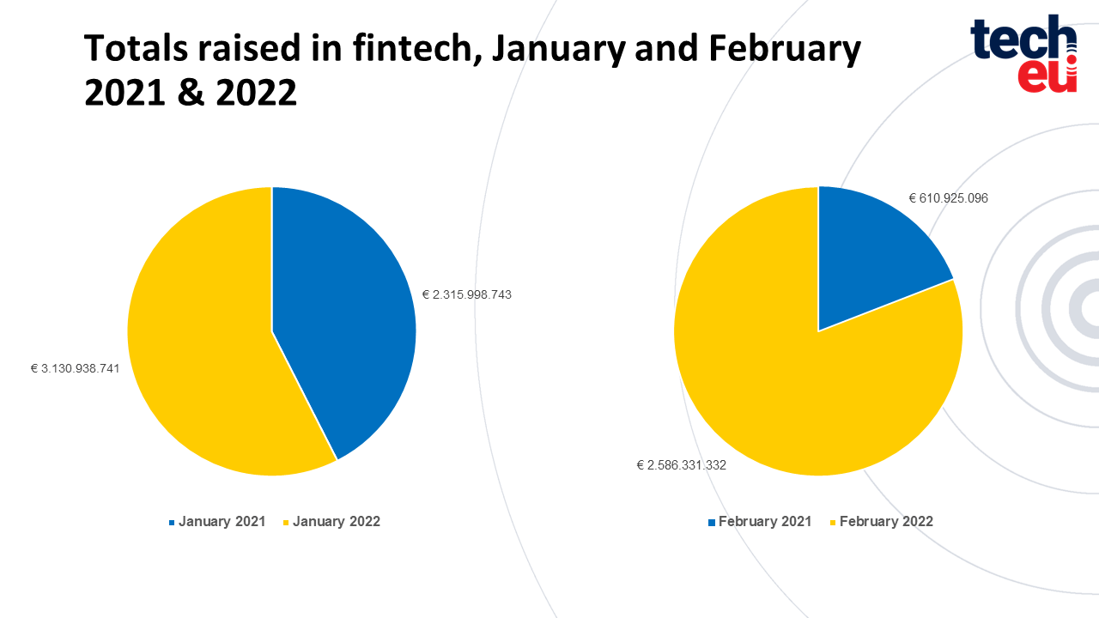
2. Fintech Entry
Notes:
A Fintech firm is a firm that develops digitized financial product innovations
Well-known Fintech firms include Stripe and Klarna
Even if big firms, fintech firms are not (yet) considered Big Tech firms.
For example, the Fintech firm Stripe has a market capitalization of 95 billion USD
The investment in Fintech is enormous
“In 2021, Tech.eu tracked more than 750 financing deals for European fintech companies, sometimes multiple rounds per company, adding up to a nearly €26 billion in investment. The biggest round hit almost €900 million, while a whopping 63 of them were over €100 million.”
“The money is still flowing in 2022. In the first two months of this year, investors already ploughed €5.7 billion into fintech firms, far surpassing the €2.7 billion invested in January and February of 2021.”
In Fintech today, everybody is trying to solve a specific problem, for a specific industry or market segment

Slide 10


Slide 11
Directions
Payments
Forex
Factoring
Asset allocation
Credit scoring
Expense management
high fees
high costs

Slide 12
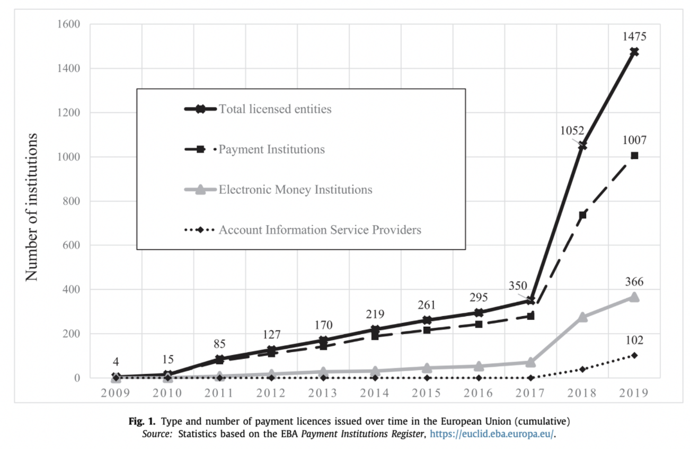
Polasik et al., 2020

Slide 13
3. Incumbent Responses
2 types of incumbents
  Banks
  Payment schemes
Different economics
  Banks av ROE 6-7% bf pandemic
  Cards schemes av ROE well above 25%

Slide 14
Banks
Mixed track record on innovation
  Goldman Sachs => failure of online retail effort Marcus
EU constraints (Enria, 2021)
  Profitability < US, esp since financial crisis
  Lending > US
  Labor market regulation > US
  Concentration < US
Limited strategic options
  High CACs (eg, Revolut)
  Constraints on consolidation
Strategic partnerships, JVs & some M&A
Focus on cost efficiency
  Cut back / middle office costs
  Migrate retail customers online
  Fintech for cost optimization and compliance
Less clear long term strategy
  Calls for reciprocity
  But hesitation twds advertisement
Notes:
Last Oct, Goldman Sachs Group Inc.’s six-year foray into consumer banking -- the unit dubbed Marcus - was recasted, after years of sinking billions of dollars
The economics of banks are hard
The profitability of the banking sector is historically low in Europe, compared to the US. Return . Amplified since the financial crisis, by virtue of lower interest rates, a history of higher lending w/ smaller capital markets, less financing through IPOs, and heavy branch structure and labor regulation
Banks face less strategic choice than fintech, by competing on paying high interest to acquire customers, because it affects the bottom line
And there are constraints on consolidation
So, this has given rise to a strategy of partnership w/ fintech firms
Banks tend to partner w/ fintech companies
We can think of BBVA acquisition of neo bank simple
Intesa partnership w/ thought machine for isybank
When they do this, they do partner w/ more mature companies that can navigate the cybersecurity and data risk
That being said, if we try to think about what’s going on, the focus is really on cost efficiency, cost killing, and operations optimization
The banks appear to have a less set out vision of their future
They call for reciprocity w/ Big Tech in using data and assets
But at the same time, they’re reluctant towards advertisement

Slide 15
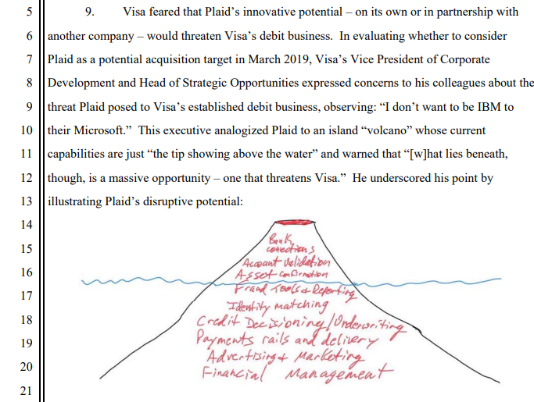
Card networks
Rise of account 2 account or P2P payments
For how long can business resist?
Very complicated tech and infrastructural stack
Coalition w/ aligned interests?
  Issuing banks keep supporting system
  Big tech are not challenging
  Lots of M&A w/ fintech
Notes:
The second category of incumbents are the payment scheme or card networks
They too, should be taking disruption straight in their face
But less concerned
The system has a lot of stability
Duopoly or triopoly w/ multiple layers of complicated financial infrastructure
Even banks don’t get it
Issuing banks are happy collecting fees
Big tech are sharing in the interchange fee
And exit opportunity for fintech

Slide 16

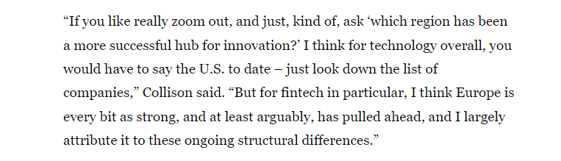
4. EU’s Textbook case of Well-Designed Regulation?
Stripe CEO, P. Collison, 13 Oct, 2022
Notes:
In a recent interview, Stripe CEO, Patrick Collison cited the EU’s 2015 payment services directive (PSD 2), which has allowed for the open-banking trend in which banks are sharing more data and access with fintechs, and the Single Euro Payments Area created by the European Central Bank that allows for cashless euro payments anywhere in the EU. “Those are creating very compelling new opportunities in the free market and this broader fintech landscape”
The PSD2 is famous for its introduction of the concept of ‘open banking’ (Zachariadis and Ozcan, 2016) and the second Payment Services Directive (PSD2), and particularly of its novel access allowance to bank accounts for a new category of entities providing payment services – Third Party Providers (TPP), including non-bank entities (Drasch et al., 2018).

Slide 17
Traditional Regulation Challenges
How it’s told
How it went?
Regulatory capture
Risk reflex regulation
Asymmetry of information
Disabling provisions
  Optimal pacing
  Incrementalism
  Multilateral colloquia
  Experimentation freedom
Notes:
Following financial crisis, a very good time to regulate when incumbent players possess limited political capital to purchase regulation, and supportive public opinion
Many regulatory initiatives around 2013 – 2015 like CRD (credit requirement directive) IV with provisions that are aimed at reshaping bank boards' composition, functioning, and their members' liabilities
PSD2 in 2015
At the same time, knee jerkism was avoided, due the incremental process followed
Regulation built incrementally on years of experience in cases before agencies (EC) and courts, allowing issues to ‘brew’, helping identify tradeoffs, and providing options for lawmakers
The EU was furthering the process started with the Single Euro Payments Area (SEPA) programme and the first Payment Services Directive (PSD1)
And the EC had developed substantial expertise in payments services through a variety of cases agst interchange fees and credit cards
The flaws of asymmetry of information that so often plague regulation where overcome by a multilateral colloquia
Many regulators oversee banking and finance, w/ often redundant interests
And courts are in the fold too
This has created a possibility of high diagnosis accuracy of bottleneck identification in value chain
Last, few provisions in existing law prevent business model experimentation for small entities and outside of lending and interest bearing activities

Slide 18
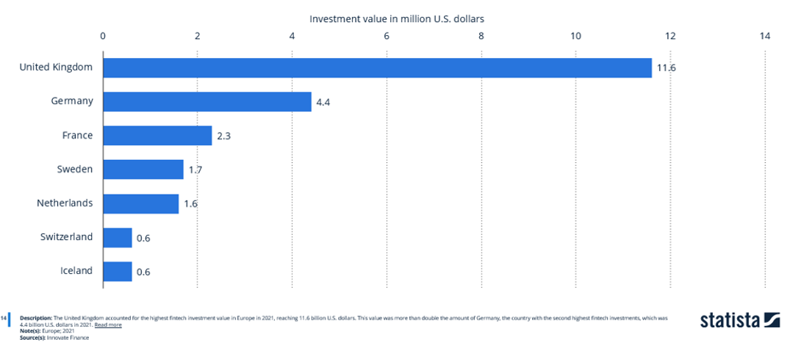
Mixed Evidence across Regions
Success story of PIX in Brazil?
Higher impact of digital platforms entry in China?
Notes:
Success always depends on what we’re looking at
So, much more entry in the UK than in the EU
Pix was rolled out by the Banco Central do Brasil in Nov. 2020, was built for efficiency and financial inclusion. It now has 107.5 million registered accounts, more than half of the country's population. O
According to central bank data, Pix payments volume is already equivalent to 80% of debit and credit card transactions.
For instance, in China the two big tech payment firms jointly account for 94% of the mobile payments market (Graph 1, right-hand panel).

Slide 19
5. Summary
Big tech => diversify in support of ecosystem expansion;
Fintech => target high fees & high costs segments;
Banks => focus on enhanced cost efficiency;
Rate of innovation => inverse correlation w/ performance of domestic banking and financial system (eg, China)

Slide 20
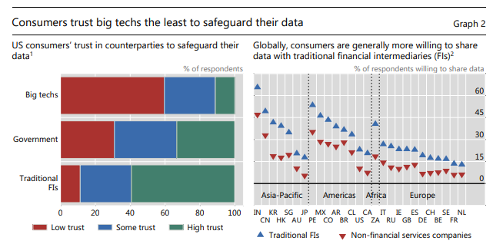
In lieu of a conclusion, 4 propositions
Every digital firm wants to do banking, but no one wants to be a bank
So far, big tech banking is a small scale thing
Banks stuck with the problem of un-monetized ‘trust’ (or ‘data’)
Payment schemes might be waiting in the dark for the blue ocean of Web3
Notes:
Besides, there are some areas where we do not see entry, like for example, derivatives and structured products, exchanges, clearing houses, market infrastructure, asset management, etc. The issue for big tech appears to be really to focus on their core business users and end users, not other stakeholders. A related question is whether there is a clear avoidance of industry segments, and territories where regulation is very heavy.
Data: banks have a lot. Not so much a barrier to entry. But hard to leverage it for value creation. Ads an obvious target. And a large market That’s what generates trust.

