Slide 1
The Web of Science bibliographic database & Sage Research Methods platform EUI Library 16 April 2024

Slide 2
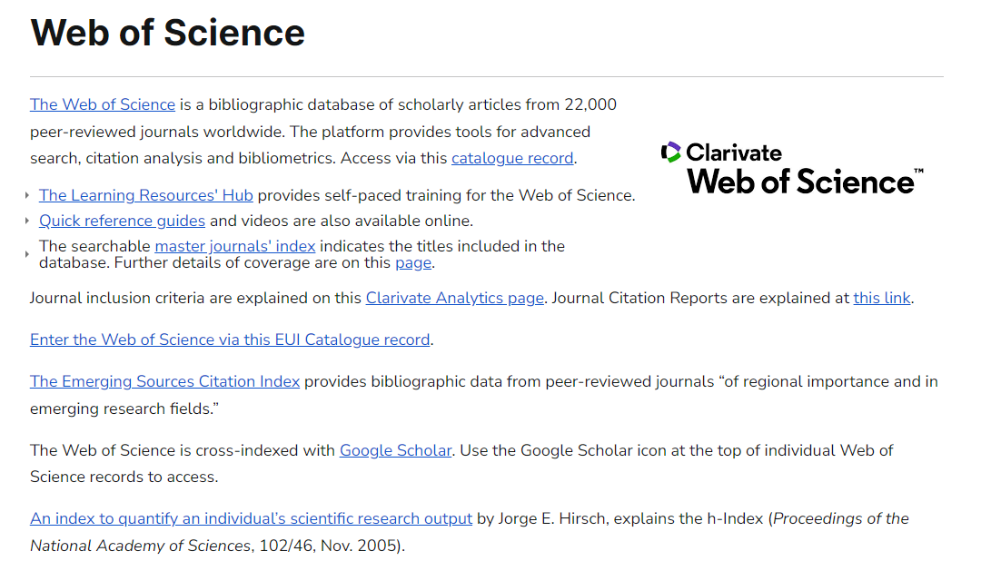
https://www.eui.eu/Research/Library/ResearchGuides/Economics/WebofScience

Slide 4
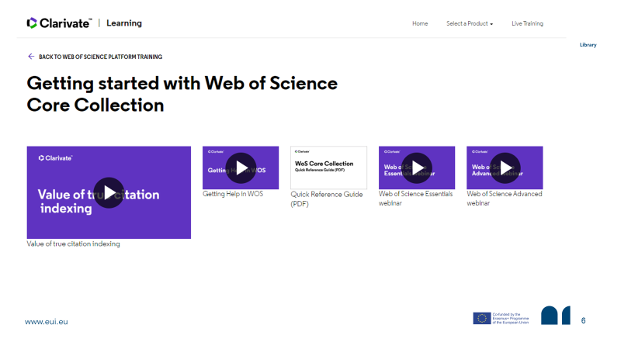
https://clarivate.com/webofsciencegroup/support/wos/wos-core-collection/#guides

Slide 5
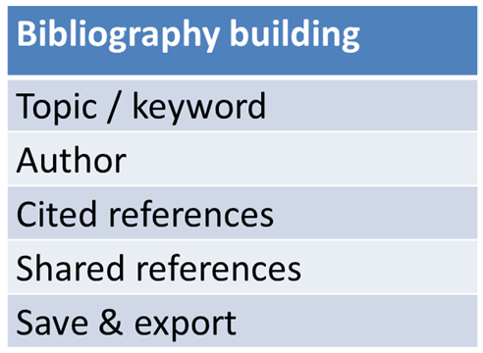
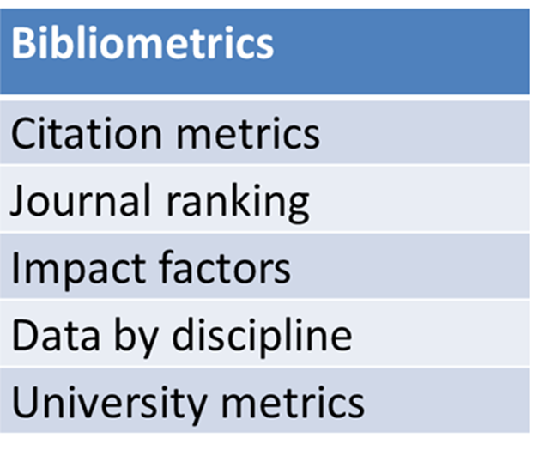

Slide 6
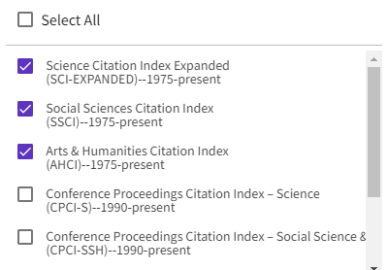
Bibliographic metadata from approx. 22,000 refereed journals
Coverage from circa 1900 to 2024
Social Sciences Citation Index (SSCI)
Arts & Humanities Citation Index (AHCI)
Titles of non-English journal articles translated
Abstracts of non-English language articles available in English from 1990

Slide 7
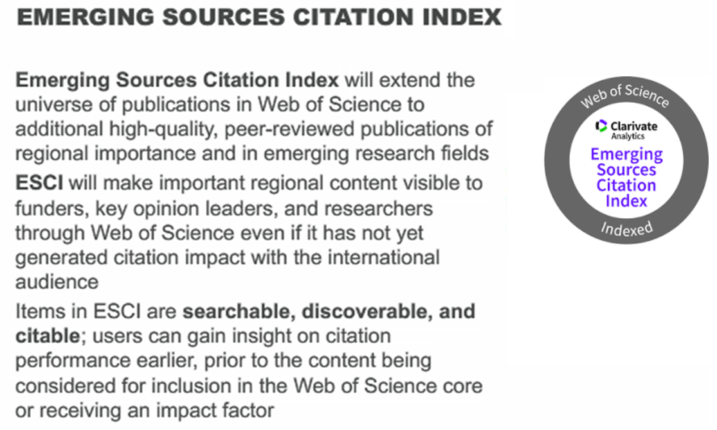

Slide 8
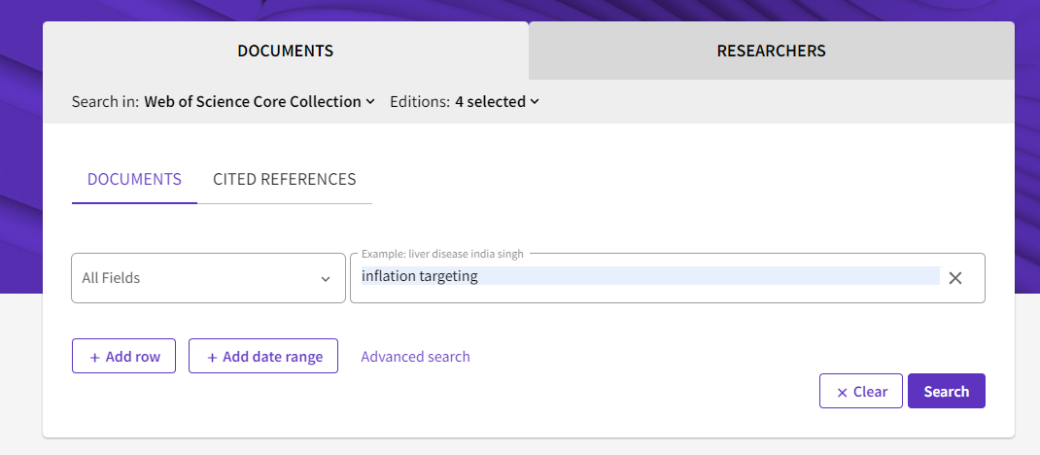
Consolidated search field
Multiple expandable search fields
Refinement of results by left-menu facets

Slide 9
Selecting databases
Social Sciences Citation Index
Arts and Humanities
Emerging Sources Citations

Slide 10
Search operators
“ ” | Searches exact phrases, eg: “competition policy”
AND | Finds records containing all terms, eg: integration AND subsidiarity
OR | Finds records containing any of the terms, eg: Italy OR Italia
NOT | Excludes records containing certain words, eg: communal NOT communism
NEAR | Finds records containing terms near each other, eg: inflation NEAR/3 monetary
* | Use for prefixes, suffixes and spelling variations eg: *liberal* will also find ‘neoliberal’, ‘liberalism’
? | Use to retrieve words with the replacement of 1 character in the word, eg: wom?n includes women, woman
$ | Retrieves zero or one character, eg: disease$ includes only diseased, diseases

Slide 11
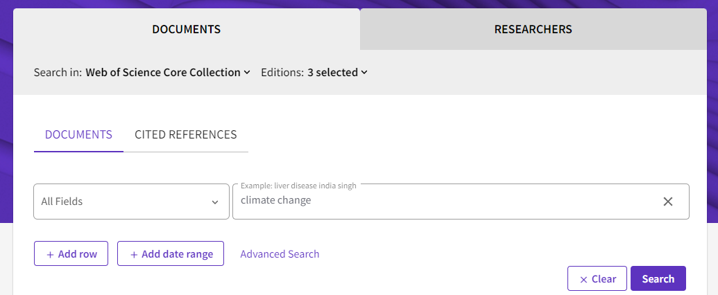

Slide 12
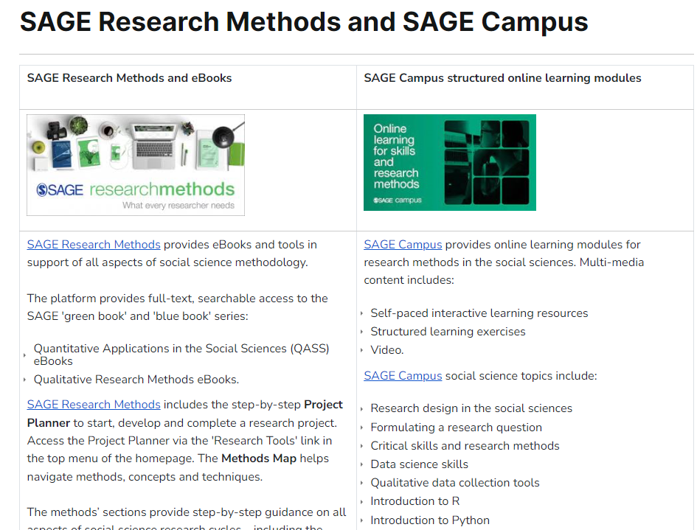

Slide 13
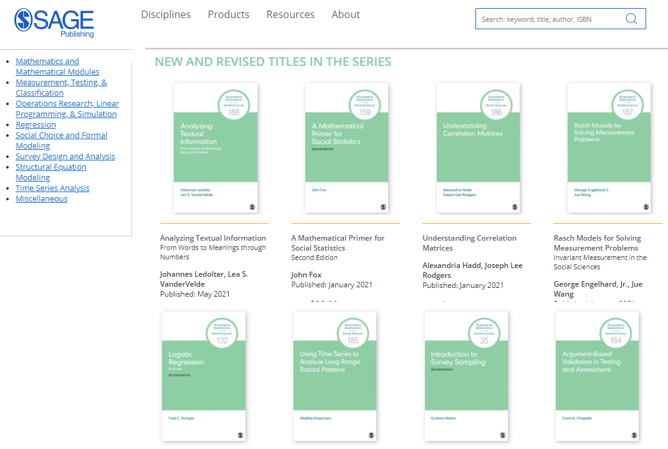

Slide 14
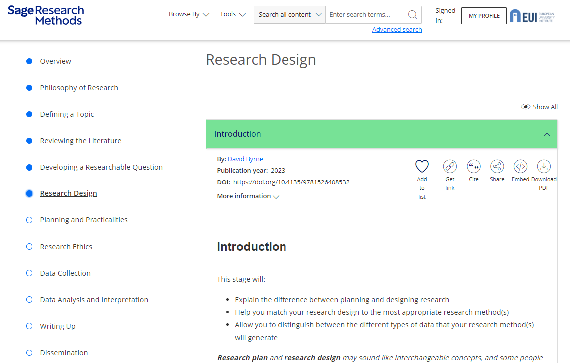

Slide 15
The Web of Science bibliographic database & Sage Research Methods platform EUI Library 16 April 2024

