Slide 1
EUI
The European University Institute

Slide 2
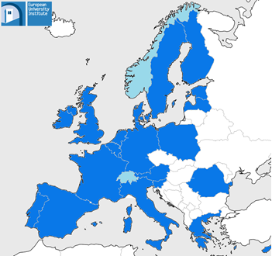
About the EUI
International organisation set up in 1972 by the six members states of the European Communities: Benelux, France, Germany (FRG), and Italy.
Currently 21 contracting states.
Research university focusing exclusively on doctoral and postdoctoral studies and advanced research.
EUI Contracting States
EUI Associate Member States

Slide 3
Doctoral Programme
Full-time academic programme
Fully-funded: 4 year funding

Slide 4
Doctoral Programme
Structured, specific departmental requirements
Year 1
Year 3
Year 5
Year 2
Year 4
Thesis defence.
Award of the Doctorate.
Laying the foundations for the doctoral work.
Structured programme of taught courses and/or seminars defined by each Department.
Each department defines content of activities, seminars, workshops, and research missions .
Each department defines content of activities, seminars, workshops, research missions and/or exchanges.
Completion of the thesis, job market activities.
Interdepartmental courses and academic skills training
Submission of thesis outline (requirements vary across Departments)
Delivery of 1/4 of thesis
Delivery of 2/3 of thesis
Submission of full draft of thesis
Conferring Ceremony
A Master of Research or Master of Laws (M.Res/ LLM) degree is awarded upon completion of the M.Res or LLM requirements during the first year of the doctoral programme.

Slide 5
Doctoral Programme
Teaching and doctoral supervision are core activities of EUI faculty.
Researchers and faculty are guided by Academic Regulations and a Code of Supervision.
Quality assessment of supervision:
89.4% of doctoral researchers are either very satisfied (53.6%) or satisfied (35.8%) with their supervisors. (Anonymous Supervision Assessment Questionnaire - Survey 2014-2015)

Slide 6
Doctoral Programme
Wide range of courses, workshops, services and activities designed to support academic and professional development:
Academic literacy in other disciplines through interdepartmental courses
Writing and presentation skills
Teaching skills and practice
Research and publication skills
Generic academic skills
Teaching training and placements to gain university-level teaching experience
Exchange Programmes.

Slide 7
Doctoral Programme
ECO Research Themes
Analysis of Labor Markets; Behavioral Economics; Business Cycle Analysis; Economics of Education; Evolution and Design of Institutions; Experimental Economics; Financial Crisis; Fiscal and Monetary Policy; Gender Economics; Growth Policies; Health Economics; Inequality and Social Insurance; Information and Contracts; International Macro; Measuring and Modeling Financial; Volatility; Monetary Economics; Political Economy; Quantitative Economics; Time series Econometrics and Forecasting.
HEC Research Themes
The shaping of modern Europe in comparative, interdisciplinary, transnational and/or global perspective (15th-20th Century); Intellectual History and History of Science; History of State, Economy, Society, Gender and Ideology; Colonial and Post-Colonial History; History of European Integration.

Slide 8
Doctoral Programme
LAW Research Themes
European Union Law; International Law; Legal Theory; Legal Informatics; Information and Communications Technology Law; Labour Law; Social Law; Competition Law; European Private Law; Transnational Law; Comparative Public and Constitutional Law; Regional and Global Economic Law; European and International Human Rights.
SPS Research Themes
Transformation of Government and Democracy; Social Change in Europe and its Implications for Society, Politics & Public Policy; Comparative Study of Public Policy; Political and Social Structures and Behaviour; International Relations and Security; Social and Political Theory; Political Economy.

Slide 9
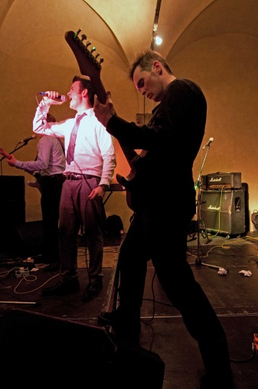
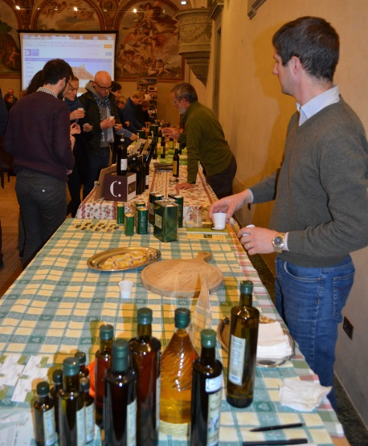
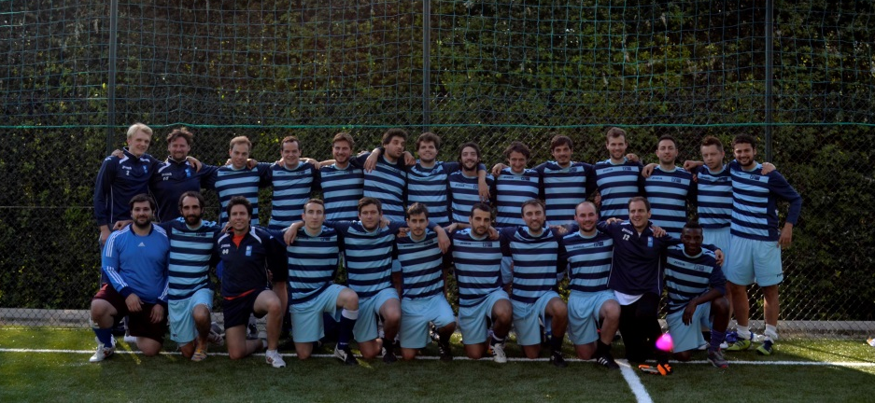
Extra-curricular Activities
Sports, music, art, culture, food—researchers and their families are welcome to participate in or propose a wide range of extra-curricular activities.

Slide 10
A Community of Scholars
The EUI academic community is inclusive, international and multi-disciplinary. We host scholars from more than 60 countries.
586
Full-time Researchers (Ph.D. & LL.M.)
96
Full and part-time professors
78
Postdoctoral Fellows
129
Senior and Visiting Fellows

Slide 11
Doctoral Programme
Very high completion rates: 80% of all researchers admitted to the Ph.D. programme defend their thesis (since 2000).
69% of EUI alumni are employed in an academic position.
12% work in an international organisation.
30% are employed in senior positions, such as full professors.

Slide 12
Career Path
Career path of ECO Alumni in 2014 (cohorts 2000-2014)

Slide 13
Career Path
Career path of HEC Alumni in 2014 (cohorts 2000-2014)

Slide 14
Career Path
Career path of LAW Alumni in 2014 (cohorts 2000-2014)

Slide 15
Career Path
Career path of SPS Alumni in 2014 (cohorts 2000-2014)

Slide 16
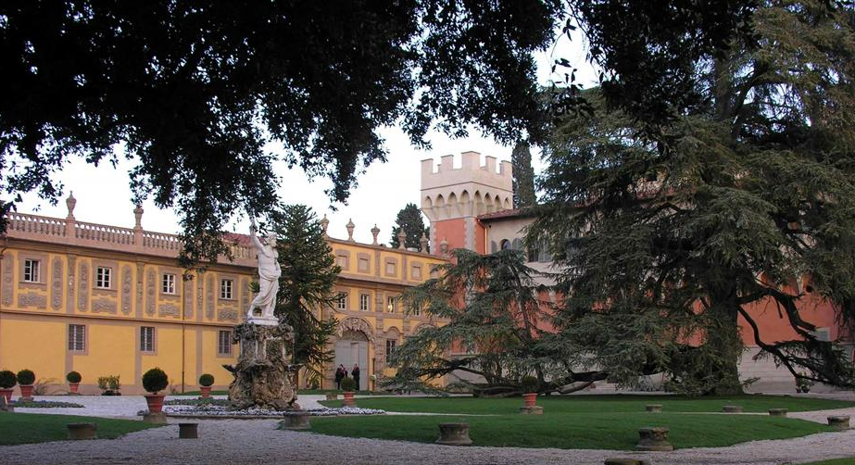
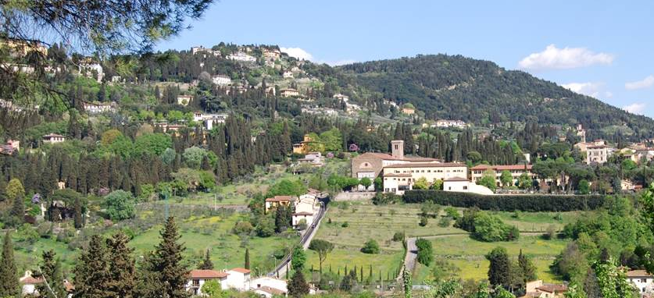
EUI Campus
EUI Campus is spread over numerous historic buildings in the Tuscan hills between Fiesole and Florence.

Slide 17
Why Choose the EUI ?
Exclusive focus on doctoral and post-doctoral studies.
One of the world’s largest doctoral and postdoctoral programmes with an international research community of nearly 1,000 scholars.
Fully-funded four-year Ph.D.

Slide 18
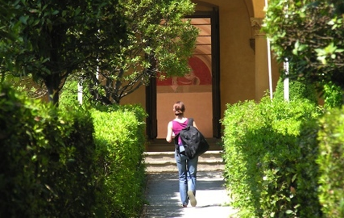
Why Choose the EUI ?
High completion rates.
Excellent career prospects in academia, international organizations, the public and private sectors and NGOs.
A research-intensive environment with opportunities to get involved in cutting-edge research and global research networks.

Slide 19
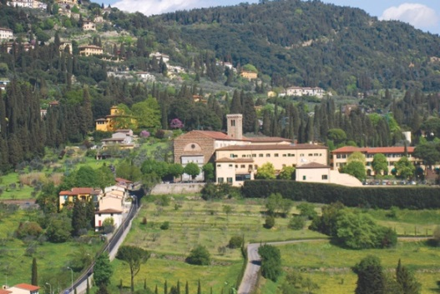
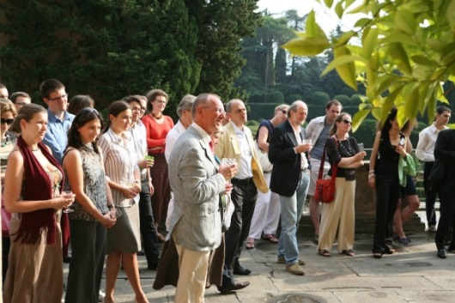
Why Choose the EUI ?
A world-class research library, the Historical Archives of the European Union and many other excellent research facilities.
Joint exchange programmes with major European and North American universities and funding opportunities for research missions abroad.
Academic skills training and wide range of extra-curricular activities.

Slide 20
Application & Selection Schedule
2 November
31 January
February
March
4-7 April
Mid-April
Opening of application process
Deadline for applications
Processing of applications / preselection
Interviews at the EUI
Decisions about admissions
End of
August
1 September
Registration
Introductions and start of the academic year
Selection Criteria:
Academic record
Quality of the research proposal
Potential supervision
Language abilities
GRE (mandatory for economists)

Slide 21
Get in Touch
Admissions Office:
Email: applyres@eui.eu
Tel: +39 055 4685 373
www.eui.eu
www.eui.eu/PhD

