Slide 1
Risk Management Training

Slide 2
Risk Management Process
Supporting process
Internal process
Planning
Reporting
ADDED VALUE
Strengthen planning
Facilitate reporting
Enable monitoring
Risk management

Slide 3
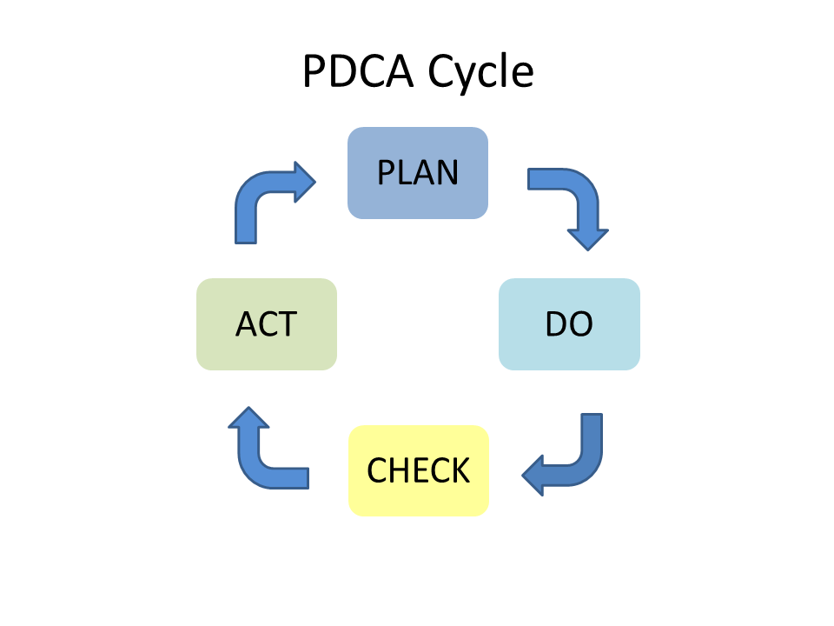
EUI Risk Management Framework
Based on ISO 31000:2018
PDCA approach
RMF - single document:
Risk Management Policy
Risk Management Process
3 Annexes
Responsibility
President
CRO – SG*
Risk owner/ contact points (optional)
All members and non-members
Management Team
Tools
Central Risk Register
At corporate level
At unit level
Submission template
Cloud-based solution
Use Excel
* President Decision No. 12/21 regarding the administrative organisation of the EUI

Slide 4
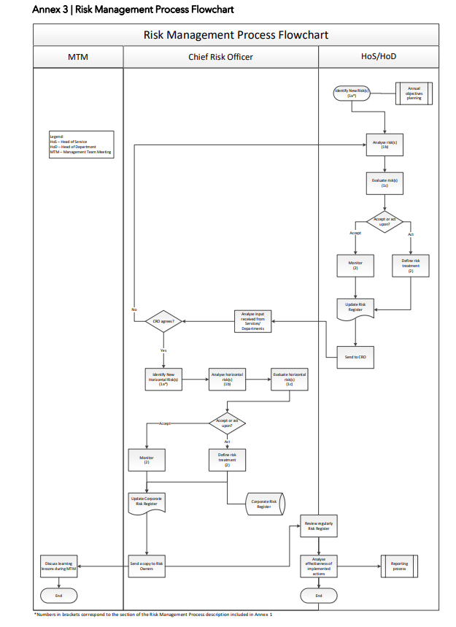
EUI Risk Management Framework
Timing
Corporate: once per year with annual planning
Unit: continuous, CRR update once per month
Evaluation of Risk Management Process
Corporate: once per year with annual reporting
Unit: once per year with annual reporting
Role of CRO
Additional exercise
Superpower

Slide 5
Central Risk Register (CRR)

Slide 6
Risk ownership/ID risk
Risk: The effect of uncertainty on the achievement of objectives*
Risk owner: Head of Unit responsible for the risk.
Abbreviations 18+1
Unique number
Identification year
Choose your unit
Every risk must have an owner
Unique identification of every risk example: IAO/1/2019
* Risk management - Guidelines ISO 31000:2018

Slide 7
Central Risk Register (CRR)

Slide 8
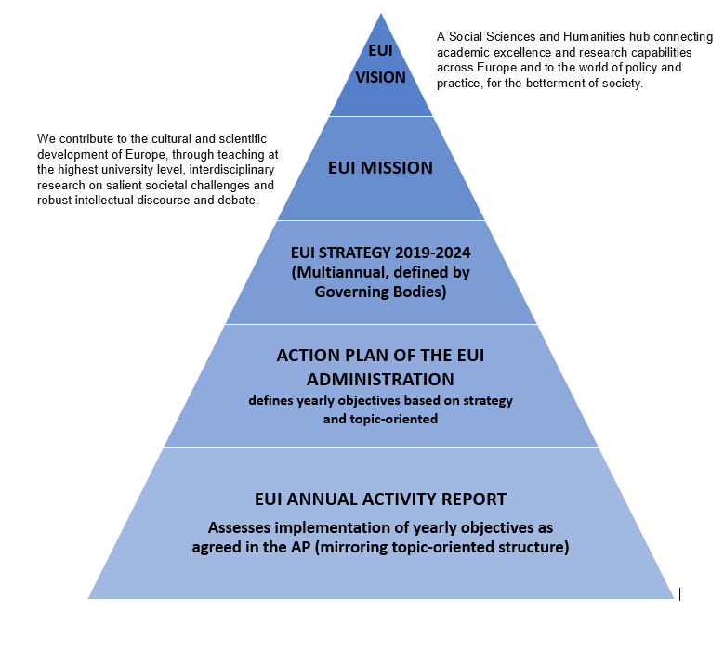
Unit’s objectives
Risk: The effect of uncertainty on the achievement of objectives.

Slide 9
Central Risk Register (CRR)

Slide 10
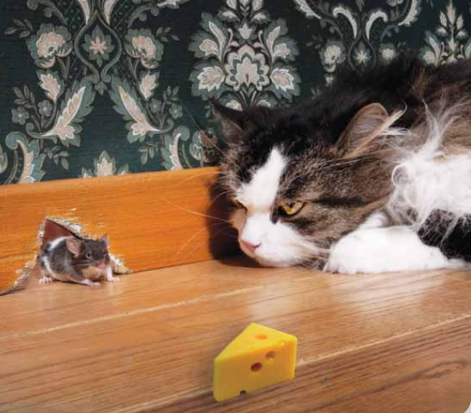
Risk definition
RISK = EVENT + THREAT + IMPACT

Slide 11
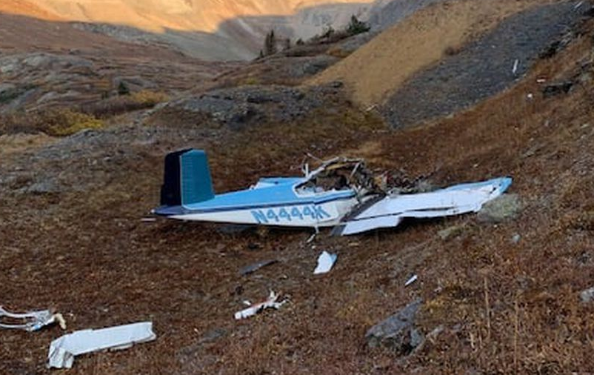
Risk definition
RISK = EVENT + THREAT + IMPACT
Risk: Plane crash
“Failure to take-off correctly (EVENT)
because of adverse weather conditions (THREAT)
resulting in potential death (IMPACT)”.

Slide 12
Risk definition
RISK = EVENT + THREAT + IMPACT
Example 1: Risk: Lack of human resources
No human resources
Frequent changes in faculty members and gaps in teaching continuity EVENT
Frequent changes in faculty members and gaps in teaching continuity due to long recruitment processes THREAT
Frequent changes in faculty members and gaps in teaching continuity due to long recruitment processes causing limited variety and quality of the doctoral programme IMPACT.

Slide 13
Risk definition
Useful hints
Forward looking exercise risk ≠ issue
Linked to objectives
EVENT – THREAT – IMPACT event ≠ threat
Useful phrases:
… due to … … caused by… because of… (THREAT)
… following … causing … resulting in … (IMPACT)
Starting point: your activities - EVENT
Use of bold font for description of EVENT
Be precise

Slide 14
Central Risk Register (CRR)

Slide 15
Risk analysis - Inherent risk
Without controls
Untreated
Assess Impact (I) and Likelihood (L) 1 to 5
Risk assessment calculated automatically (I x L)
Don’t touch grey columns

Slide 16
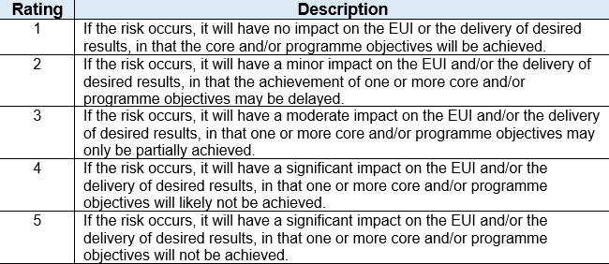
Risk analysis – Inherent risk
Risk rating
Likelihood
1-5
Impact
1-5

Slide 17
Central Risk Register (CRR)

Slide 18
Risk analysis - Existing controls
Control: measure that maintains and/or modifies risk*
include, but are not limited to, any process, policy, device, practice, or other conditions and/or actions which maintain and/or modify risk
Typical examples:
Financial controls, segregation of duties, delegation of authorities
Guidelines, procedures, manuals, standard forms
4 EYE principle
Window, door, lock,
Academic Programme,
Approval (signature), authorisation
Existing controls
Use “Alt” + “Enter”
* Risk management - Guidelines ISO 31000:2018

Slide 19
Central Risk Register (CRR)

Slide 20
Risk analysis - Residual risk
With controls
Assess impact and likelihood 1 to 5 – apply criteria
Risk assessment calculated automatically
Don’t touch grey columns
Residual risk assessment column – reference point

Slide 21
Risk analysis
Useful hints
Inherent risk > Residual risk
Ideal
Inherent risk = Residual risk
Check (quality of) controls
Inherent risk < Residual risk
?
Stop damaging (reputation of the) EUI

Slide 22
Central Risk Register (CRR)

Slide 23
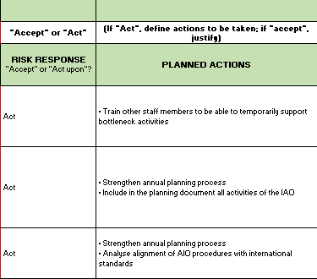
Risk evaluation/treatment
Accept or Act?
Act:
Mitigate
Avoid
Share Planned actions
Transfer
Exploit/Enhance
Accept Justify and Monitor

Slide 24
Risk evaluation/treatment
Common traps – high cost
Analysis of trend – risk vs cost

Slide 25
Risk evaluation/treatment
Common traps – unrealistic picture
Analysis of trend – risks over time

Slide 26
Risk evaluation/treatment
Useful hints
Zero risk not possible
When “Act”, weigh future benefits against costs
Costs > future benefits, choose “Accept” the risk
Not all Planned Actions have to be successful
When “Act”, Be SMART
Whatever you chose, justify your decision

Slide 27
Risk evaluation/treatment
Useful hints
SMART
Specific ≠ “strengthen our efforts”
Measurable ≠ “excellent, exceptional”
Assignable ≠ “EUI will”
Relevant ≠ “N/A”
Time-bound ≠ “in future”

Slide 28
Risk Management
Good practices:
Keep it simple
Be able to justify your assessments
Internal process – not external
You are risk owner / an expert but not your risks – Share them (register)
Input from everybody

Slide 29
Thank you

