Slide 1

Innovating Big Tech Firms and the Digital Economy
Professor Nicolas Petit
CCI, 10 Sept 2021
@CompetitionProf

Slide 2
Outline
Scene setting
Insights from past research
Policy implications
Recent developments

Slide 3
Big Tech & the Digital Economy
Notes:
I spent the past three years writing a monograph on the 6 tech giants Google, Facebook, Amazon, Netflix, Microsoft and Apple. Firms known as FAANGs.
And now, the discussion is all over the place. Cases in the EU, the US and India, follow each other like night the day.
The intuition behind the book came in reading. The trigger was a disconnect between daily talks from the tech community about broad based levels of competition amongst FAANGs, value and jobs creation, and productivity increases and innovation. And on the other hand, the mainstream press, focusing on metrics of tech bigness, conglomeration and monopoly.
Relatedly, and perhaps more importantly, I was intrigued by the little attention paid to dynamism. Big tech’s market share durability was seen as a sign of market stasis, and limited interest went into understanding frantic trying, testing and turnaround moves of big tech firms. In other words, while I found interesting to discuss the fact that Facebook had a dominant share for 10y, I found equally interesting to ask: is Facebook the same firm today as it was 10y ago?

Slide 4
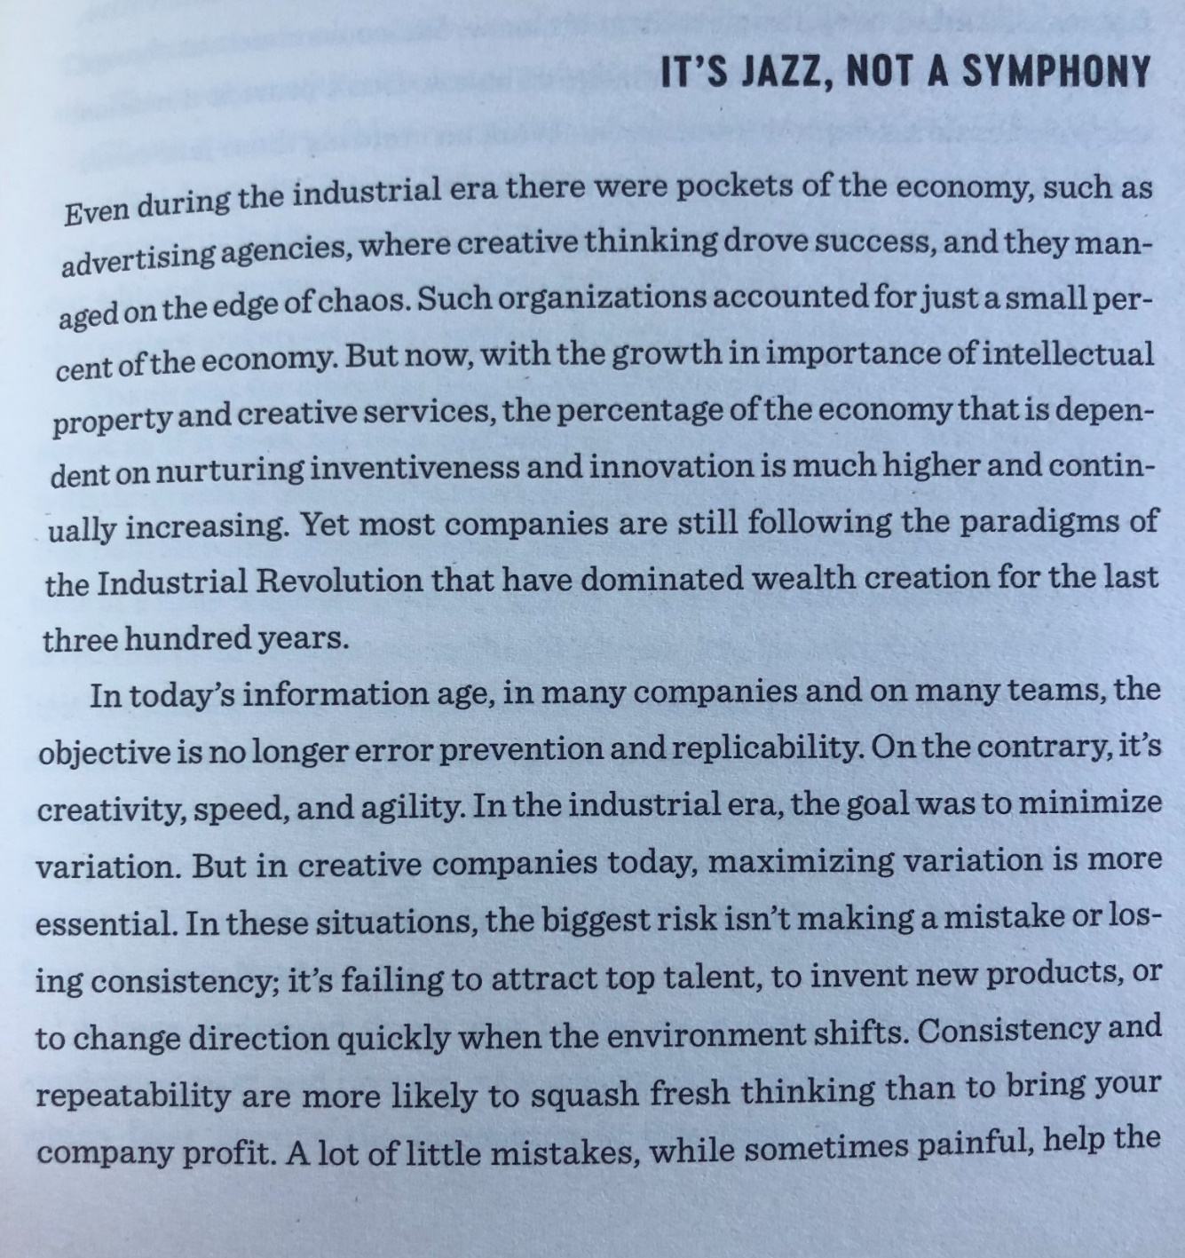
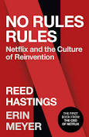

Slide 5
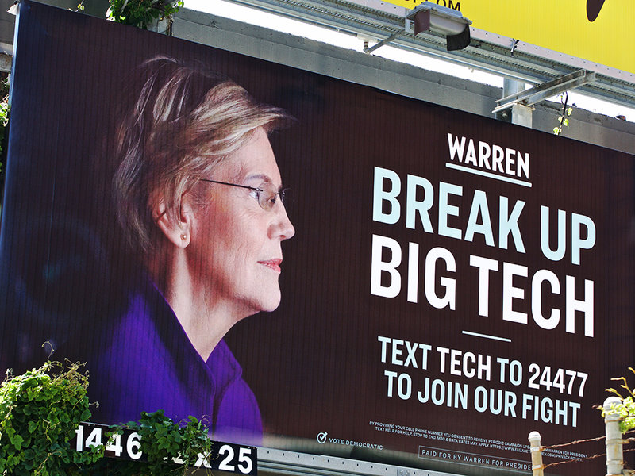

Variations around the same (SCP) theme
Neo Brandeis
Chicago (and post)
Notes:
On the one hand a group called Neo Brandeisian, or antitrust 2.0 or hipster antitrust or Transformationalists focus on bigness, that is size and number of players in an industry, and guard against concentration. The Group is mostly one of activists, pundits, and public intellectuals, later joined by lawyers Lina Khan and Tim Wu, and has lured economists like former CETs, consulting academics, etc. Some are making way into Gov. This literature has attacked the consumer welfare standard, and argues for a broad mandate for antitrust, including the protection of political and economic liberties, controlling the influence of private firms over the political process, etc. It provides no end based framework for evaluation.
On the other hand, I stumbled upon a known group, concerned about conduct that is likely to reduce economic welfare, and that counsels involvement of courts on a case by case application. This group is split between those favoring a lax approach and use a predictable set of theory based efficiency possibility theorems, unable to account for the possibility of empirical change introduced by the nature of technology, and unable to understand emergent order properties. This is the old Chicago school. And a group that would like to do more without however, clearly explaining why, and falling prey to Nirvana fallacies.
So my readings left me in crass ignorance. That was a pretty sterile discussion, and an intellectual impasse.

Slide 6
Institutional evidence
Cremer et al
Furman et al
ACCC
Stigler Center
US Antitrust Subcommittee House Report
Research based policy?
Policy based research?
Notes:
Not always clear whether this is “policy based research v research based policy”
Ambiguity has an impact
“socially-conditioned” policies are more likely
Policy implementing focus tends to extend the scope of government intervention
Mulligan and Shleifer (2005b) argue that, by specializing in such “policy-implementing” solutions, the civil law system tends to expand the scope of government control to new activities when a need arises.

Slide 7
Narratives, analogies, and metaphors
Big is bad
Data is the new oil
Platforms as new railroads
Data portability = number portability

Slide 8
Moligopoly?
Hypothesis
Test
Data & indicators
Proof
Model building
Notes:
HYPO:
So in 1942, Schumpeter wrote about the possibility of competition w/o competitors
The moligopoly hypo starts from this idea. Or to be more explicit of a possible coexistence of strong monopoly positions on the one hand and intense interfirm oligopoly competition on the other, at least for some of the FAANGs
And the hypothesis is the following: blindness to some big tech competition might not be a question of ideology, but of methodology. Put differently, focus on rivalry might obscure significant levels of competitive pressure
TEST: when you work on a HYPO, you need a testable proposition to validate or invalidate it. Here, the logical way to test the hypo is to check whether experts – not lay persons - unaccustomed to the methods of applied antitrust and regulatory economics do not, on average, characterize big tech firms as monopolies.
DATA: to operationalize the test, I have analyzed all the yearly filings (“10- K”) of the 6 tech firms before the US Securities and Exchange Commission (“SEC”). 10K filings provide decontextualized data on the nature of competition at firm level. In addition to this, I have looked at company profiles and industry analysis from 17 vendors of market research, business analysis, or competitive intelligence firms (hereafter, “market research firms”). I have run some machine learning textual analysis with a computer scientist to obtain document frequency, term frequency and collocation score.
Now, before you jump to object here, let me say that top executives must sign off on their disclosures accuracy under severe penalties, and studies find countervailing incentives to downplay competition and other negative factors.
The dataset shows 2 things. One: the coexistence of structural monopoly with “cognitive” oligopoly. The regularities displayed in 10- Ks and market research competitor analysis call attention to the possibility of latent and complementary levels of competition, that FAANGs perceive and act upon. Two there is significant heterogeneity amongst big tech firms. Levels of oligopoly competition currently unaccounted for vary at firm level. The spider charts above show you that some firms like Amazon and Google seem to take more competition from other FAANGs than others.
With this background, I went back to the drawing board. From a qualitative standpoint, 6 empirical regularities characterize Big Tech, with significant differences at firm level:
1 Diversification
2 Discontinuity
3 Long termism
4 Growth
5 Exploration
6 Flexibility

Slide 11
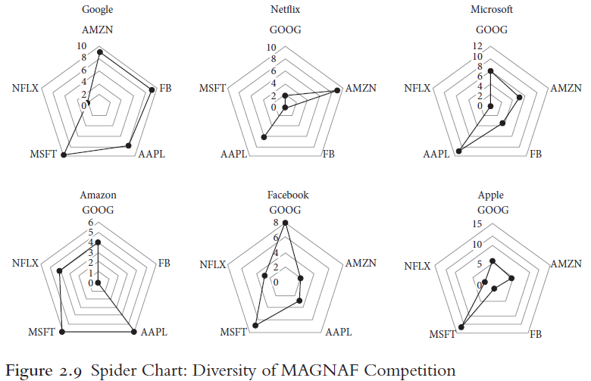

Slide 12
Regularities
Diversification
Discontinuity
Long term
Growth
Exploration
Flexibility

Slide 13
Theory
Monopoly and oligopoly
Multidimensional competition
Dynamic
Reconfiguration of channels of competition
Broad spectrum competition
Notes:
And I asked myself a hard question: how can we model the game of moligopoly competition when these 6 features are present.
- To start, one must accept that each enjoys a monopoly in an origins market.
- But at the same time, big tech firms are the players of a dynamic oligopoly game in other markets. Examples abound: payments, messaging, streaming video, productivity applications, hardware tablets, cloud computing, mobile phones, wearables, voice assistants, AR, VR, driverless cars, you name it.
- Now introduce technology, and in particular digital
Due to the modularity, combinatorial or repurposive nature of digital technology – it can be combined with cars, handsets, cultural content, etc. to create richer apps – big tech firms oligopoly competition occurs under a “perceived” discontinuity risk on their market power in the monopoly market.
Put simply, users might fly to the next application, and the monopoly becomes a ghost town. Home assistants, for example, could sound the death knell of keyboard based search market. They cannot ignore it, and must partake in oligopoly competition in untipped markets. Due to network externalities, increasing returns, and tipping, the oligopoly game is finite. And it is stochastic, resulting in distinct and indeterminate payoffs, players, and rules in the next repetition of the game. Scholars like David Teece call this “deep uncertainty”, by contrast to risk.
Now like in a prisoners dilemma, the upshot is to create powerful incentives for big tech firms to cheat— read compete— intensely at each repetition. Again because of network externalities, increasing returns, and tipping effects, the short- term strategy for each big tech firm is to compete by indirect entry. And the boundary conditions of each repetition are unknown, leading to substantial investments in cheating.
Bottom line: big tech firms pursue exploration, flexibility, and growth strategies in untipped markets. When successful, the observed outcome is one of big tech diversification, and the reconfiguration of existing channels of competition.
So for example, Facebook recently announced a pair of connected glasses w/ Ray Ban

Slide 14
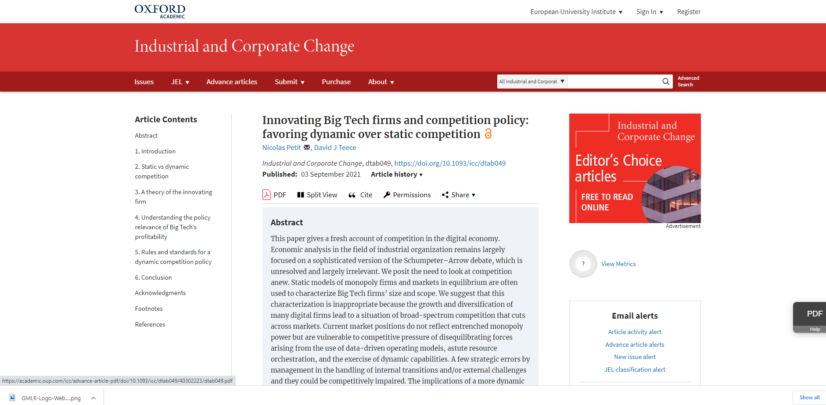
Follow-up work (Petit & Teece, 2021)

Slide 15
Priorities
Enforcement focused on tipped markets
  But, lost efficiency of single firm market share
  And pressuring, not regulating monopoly rents
Agnosticism toward
  conduct or transaction by both incumbent and new firms in untipped markets …
  … w/ exception of conduct or transaction that maintains monopoly in tipped market
Notes:
The general point is this because competition can take the form of competitive pressure, not just rivalry, and still create well known benefits to consumers, antitrust analysis of Big Tech companies should focus on retaining that pressure even if there is no direct rivalry.
In digital industries, economic forces discounted in received theory produce socially beneficial incentives on monopoly firms to compete by indirect entry in untipped markets, when they understand that their monopoly rents in tipped markets are under pressure.
This has two policy implications. First, antitrust should focus on maintaining competitive pressure in (monopoly) markets that have tipped, and apply more forgiving rules towards the leveraging of market power in (oligopoly) untipped markets.
Second, antitrust should adopt tools that allow fact finders to draw a better line between tipped and untipped markets, complementing inferences of monopoly power drawn from structural methods of market definition and evaluation of market power.
I will focus on the first one here. There is a complicating factor in antitrust keeping the pressure on tipped markets w/ monopoly rents. Antitrust in digital markets should not necessarily seek to promote rivalry — it is often socially inefficient in markets with increasing returns to adoption on the demand side. But there is a solution, that is antitrust should try to maintain a pressure equivalent to it in tipped market. In particular, by maintaining pressure on monopoly rents, antitrust creates an uncertainty equivalent to rivalry that produces powerful incentives on established big tech firms to invent new products and introduce market- shifting innovations in untipped markets
One way to create pressure on incumbent big tech firms without losing the efficiency of large market shares consists in limiting the monopoly rents in the tipped market, so as to incentivize them to pursue indirect entry and competition in untipped markets
We can immediately park the control of exploitative conduct, bc this is an area where US antitrust agencies will never go, and will be at best a marginal policy at the EU level..
By contrast, indirect antitrust limitation of monopoly rents is more within the tradition.
Now, to see how this could work, the economics of multi sided markets help. I cannot go too much into the technicality, but the book formulates a pro enforcement, and novel, application of multi-sided market theory.
The last is a presumption against horizontal mergers in tipped markets. There is no consumer welfare benefit in allowing firms in a tipped market to merge with a horizontal rival, thereby increasing the share of output on which it earns a rent.
You need to envision an overlooked normative application of the economic theory of multisided markets. The theory of multisided markets says what: changes to a price structure can lead to increased output. But the normative and forgotten implication is that adjustments to a firm’s price structure (not levels) can lead to reduced output. So one possibility is to use antitrust rules to allow market conduct that change the price structure in ways that reduce the output served by the monopoly firm and on which it takes a rent.
So one possibility to do this is to use the rule of reason to assess market power conduct by users on the inelastic (money) side of a tipped market. Or one possibility would be to use a strict rule for the platform market power conduct towards the inelastic side. In other words, those who pay should pay less; And conversely, antitrust might select a stricter per se or quasi per se prohibition rule to treat market power conduct by users on the elastic side. In other words, those who do not pay should never get more.
Apple.
Using the rule of reason to assess cartels on the inelastic side would allow for instance copyright holders on the money side of a platform to decrease the fees paid to the platform. This is what happened in the BMI case in the US20,000 artists had granted to collecting societies ASCAP and BMI the right to negotiate blanket licenses to copyrighted material to CBS and affiliated stations. CBS challenged the arrangement under Section 1 of the Sherman Act as illegal price fixing. The Opinion correctly refused to treat copyright owners’ concerted action as price fixing, and dealt with it under the rule of reason.
By contrast, in Expedia, the Court rightly applied a per se rule to conduct on the subsidy side, that might have raised the subsidies to user participation, resulting in more output served by the platform, and more rent. Here, two firms had formed a joint venture to create an online travel agency. On that market, intermediaries called Global Distribution Systems (“GDS”) charge fees to airlines, bus, and rail suppliers on the money side, and pass through benefits to online travel agents on the subsidy side (and sometimes retail travel agents). Had the joint venture been allowed to proceed, this might have resulted in bigger market power to travel agents, more subsidies to them, in a GDS market already very concentrated.

Slide 16
Substantive antitrust rules and tests
Indirect antitrust limitation of monopoly rents
  Multisided market theory revisited
  Broadcast Music, Inc v CBS, Inc [1979] 441 US 1.
  EPIC, Spotify and others v Apple?
Presumption against horizontal mergers in tipped markets?
  Google/Yahoo, 2008
  Microsoft/Intuit, 1995

Slide 17
Intervention threshold: tipped v untipped?
Definition
  One firm has “emerged as winner” in a market where there is “strong positive feedback” (Varian & Shapiro)
  “inertia” (Bresnahan & Yin)
  “important feature of a tipped market is … very little incentives for both the dominant firm and the ousted firm to further invest in innovation” (Prüfer & Scotchmüller, 2017)
Notes:
So one needs a formal definition of a tipped market, that can be put to practice.
Now caution: we might not need a watertight definition, of pure scientific certainty. In fact, as when we define dominance or when we think about why ice is slippery, we accept that we cannot reach scientific certainty.
I’ll give you high level definitions, and then a more technical one.
At a fairly high level, a tipped market is one where a product, firm or standard has ”won the game”, so uncertainty has disappeared and there is a stable equilibrium or near equilibrium condition. When the market has tipped, is when you see a platform like Uber roll out rewards, advantages and so on. Or when you experience ad saturation and over targeting on ad markets. Your smell test is when your brand becomes a verb: you Uber, Airbnb or Waze.
The more technical definition is a market, product or application in which a large enough installed base lead has been gained that new consumers are more likely to join the service with the leading installed base than a rival regardless of superiority of the rival, thereby giving rise to the familiar demand-side network externality and associated feedback loop effect. When that effect has developed and is durable even in the face of price cuts or innovation by rivals, then I would describe the market at “tipped” for at least some non-transitory period of time.
Tipping is the contrary of a fragmentation or a split market (two firms is unstable, though note Bresnahan).
A dominant position is not equal to tipped (it’s actually larger), tipped is equal to dominance (type 1 errors with dominance: 100% share but lots of efforts, no inertia; and measurement complexities bc no price or output to put a price or measure on – see Werden comment). And dominance as market power, means little growth. Tipped is compatible w/ growth. Growth evidence cannot be brought forward/
Shelanski: ”a market in which a large enough installed base lead has been gained that new consumers are more likely to join the service with the leading installed base than a rival regardless of superiority of the rival, thereby giving rise to the familiar demand-side network externality and associated feedback effect. When that effect has developed and is durable even in the face of price cuts or innovation by rivals, then I would describe the market at “tipped” for at least some non-transitory period of time. Where switching costs are low and interoperability between alternative services exists, one provider might have a lead but I would not describe the market as “tipped” because consumers can either obtain the same network benefits elsewhere (due to interoperability) or quickly recreate those benefits on the network of a superior entrant (due to low switching costs).”
Varian and Shapiro: “Information Rules defines this on page 176: "When two or more firms compete for a market where there is strong positive feedback, only one may emerge as a winner. Economists say that such a market is tippy, meaning it can tip in favor of one player or another."

Slide 18
A concrete tipping test
Intuition: with “lucky demand conditions” (Tirole, 2015)
Question: what is the firm doing to expand demand?
  « Not much » allows an inference that tipping point crossed
  « A lot » allows an inference that tipping point not crossed
Degree of effort on the firm’s expenditure side
Investments in growth hacking, customer acquisition, or content creation
App store: need disaggregated data
More at https://promarket.org/2021/04/06/measure-test-tipping-point-digital-markets/
Notes:
What is often lost is that tipping has a behavioral implication. Supply is “lazy.” Around the tipping point, a snowball effect kicks in: The winner records user growth, without having to expend much effort. This effect, in turn, arises because demand is “sticky.” The winning firm can raise price or maintain a sluggish attitude to innovation, yet benefit from what Jean Tirole called “lucky demand conditions” in relation to utilities. The firm that gets ahead continues to get increasingly ahead, without needing to worry about demand echoing John Hicks’s classic statement that “the best of all monopoly profits is a quiet life.”
With eyes away from monopoly shares and towards inertial behavior, we can move closer to a concrete test of tipping. What is the firm under inquiry actually doing to expand demand? If the answer is “not much,” the market has likely crossed the tipping point. If the answer is the firm hustles to grow demand, the market might not yet have crossed the tipping point. The question then consists of identifying data points suggestive of firm effort.
A key challenge is that tech firms’ financial reporting often does not break down expenditure at the product, service, or application level. The large marketing expenditure reported by Apple every year, for example, says little about how and where Apple spends these dollars. If we want to assess the effort Apple puts into in the App Store, we need data specific to the App Store. A way forward for antitrust decision makers is to require disaggregated data of firms under investigations.
There is every reason to believe that tech firms have disaggregated data at their disposal. A quick search in the job openings that tech companies post on LinkedIn is illustrative. We learn for example that Apple runs an App Store “Team,” and other smaller related “teams” (like the “App Store editorial design team,” the “App Store Business Operations team,” and the “App Store Engineering R&D team”), with their own employees, and also likely budget and resources.
A starting point for a decision maker would thus be to ask large digital firms for organizational data, and focus the investigation on the resources spent in the segments, divisions, units and teams with direct involvement into the product, application or service under inquiry. This, in turn, would allow a finer grained understanding of a firm’s degree of effort over markets suspected of tipping. Besides, the obtained data might provide useful qualitative tidbits. For example, if the App Store team’s hiring expenditure is primarily aimed at hiring app reviewers, rather than marketing experts and content developers, this could indicate that Apple is more in demand maintenance mode than in demand expansion mode.

Slide 19
Antitrust analytics
Other units of analysis
  Rivalry, technology, and managers
Rent type
  Schumpeterian v Ricardian v Naked Monopoly
Capabilities
  Sensing, seizing, and reconfiguring
Ecosystems
  Long term welfare
  Recontracting behavior
Sector specificity
  Not all industries work on same clock or are at same developmental stage
Notes:
There’s an additional dimension of competition, that has not been thought about in any serious way, but I don’t mean to dismiss more traditional forms of competition; complements v substitute
Peer group” analysis” of firms in similar industries who compete for economic growth, technological leadership and executive talent
Microsoft, Adobe, Alphabet, Amazon, Apple, Cisco Systems, Facebook, IBM, Intel, Oracle, Qualcomm, Salesforce
Antitrust has no interest to firm change
Saying that Qualcomm or Facebook hold a 100% share of a market since 10y is true, but irrelevant. The relevant question is: is QC or FB the same firm as it was ten years ago, or has it enjoyed the quiet life
This in turn leads to disinterest for rent type: supra competitive prices allow an inference of monopoly profits, where understanding if the rents are the products of change brought by innovation, good business judgment, and smart timing, would allow to differentiate come from monopoly rent, that is by control of entry conditions
A deeper understanding of dynamic capabilities would help assess the firm potential to change
We like to say state of the art and empirical
But the firm remains a blackbox
No room for capabilities
David and I are trying to build tests of sensing, seizing and transforming
Last, competition likes to think of itself as horizontal in nature, but if it considers change, it must understand that not all firms operate at the same clock, and that not all are at the same stage of development. For example, some operate w embryonic and others v mature institutions (recontracting issue). Regulatory environments are very different.

Slide 20
Recent developments and core ossues
Burden of proof
“Killer acquisitions”
Gatekeeping definition
Essential facility
Entitlements for content providers
Probabilistic antitrust
Breakups (US)
In app payments, and bypass

Slide 21
Hard Policy Qs
If a breakup of big tech is doable, is it socially beneficial?
When do platform rents become unjustified, and require Gov intervention?
Is a competitive oligopoly of large and growing mega firms optimal?
Is a business model based on targeted ads socially bad, and should there be conditions on its operation?
How to promote product quality improvement and horizontal diff toward more privacy friendly offerings in digital services?
Is algorithmic technology value-free?
Should States build domestic big tech capabilities, and how to avoid industrial policy problems?
How to create clusters like the Silicon Valley?
Notes:
How bad are these problems compared to everything else, and side effects of adressing them?

Slide 22
Beyond activism and demonisation
Late Ken Arrow, ICC, 1996
Interesting voices in economics profession
Disequilibrium, and competition as diffusion of innovation
Large and diversified firms needed for invention
Firm as an “information base”, and valuable asset
Holmstrom https://www.youtube.com/watch?t=8655&v=wn9p-xavq94&feature=youtu.be
Pakes https://scholar.harvard.edu/files/pakes/files/ar-helicopter-4-2-2021.pdf
Teece and others https://papers.ssrn.com/sol3/papers.cfm?abstract_id=3229180
Notes:
Debate captured by activists

Slide 23

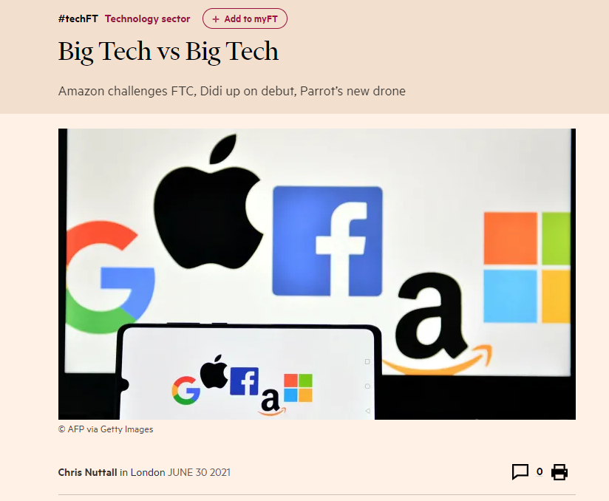
Movements in the press (Feb, 2021)

Slide 24
Resources
https://truthonthemarket.com/2021/07/15/antitrust-statutorification/
https://podcasts.apple.com/us/podcast/world-war-tech/id903171979?i=1000511708102
https://promarket.org/2020/11/19/big-tech-platforms-indirect-entry-antitrust/
https://papers.ssrn.com/sol3/papers.cfm?abstract_id=3229180
https://global.oup.com/academic/product/big-tech-and-the-digital-economy-9780198837701?cc=it&lang=en&
https://www.ft.com/content/2e33a29f-b619-4623-82af-2ad352bba898
Notes:
Re

