Slide 1
The Digital Markets Act (DMA)
@CompetitionProf
Transatlantic Webinar: EU and US approaches to regulating competition in online platforms
Prof. Nicolas Petit
28 Nov, 2022

Slide 2
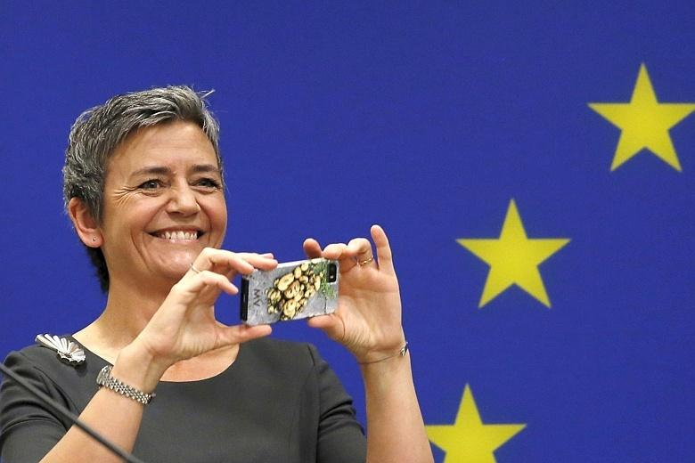
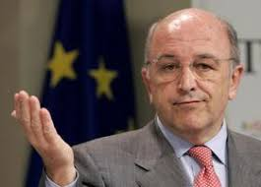
Say cheese! On track to the good days
Seriously? 5 years for an antitrust case?
I told her so

Slide 4
Competition Enforcement as a Cost of Doing Business
Policy awakening
Vestager 2018, ‘[t]he principles [the competition rules] set out are valid for every market, for the ones we know today and the ones we’ll see in the future. And that's why dealing with digital markets isn't really about new rules.’
EC proposal, Dec 2020
Lighter, faster, stronger
Per se law: no market definition, market power investigation, no balancing
Evidence light: focus on firm, not market or industry, proxies or qualitative assessment
Strict deadlines: 45 days for designation, 6 months to comply w/ obligation in art 5, 6 and 7
Status declaration regime: // Israeli law
Notes:
Cremer Report 2019
Impact Assessment, June 2020 => ex ante regulation + NCT
EC proposal, Dec 2020
EP and Council adoption, July 2022

Slide 5
The DMA: a ‘Competition Hand in a Regulatory Glove’
Notes:
Text: nominally a regulation
Substance: no pricing regulation, line of business restrictions, or access regime like regulation. But more than business conduct, or exclusionary conduct. Has nothing to do with regulation of network industries w/ natural monopolies
Spirit: hybrid goals of contestability and fairness. No fault approach. Called ex ante in Europe. Punitive like competition law, but some remedies are disclosure, like designation or auditing of algorithms. Adversarial like competition law. NCT discarded

Slide 6
Targeted Legislation
Core Platform Services (10)
Gatekeepers
Online intermediation services, online search engines, online social networking services, video-sharing platform services, number-independent interpersonal communication services, operating systems, cloud computing services, online advertising services, web browsers and virtual assistants
Undertaking of a certain size, art (3(2) a))
Turnover (EU) > €7,5 Bi or Market cap > €75 Bi
CPS in 3 Member States
And which in at least 1 CPS has a large audience, art (3(2) b))
End users > 45 Mil MAU in the EU
Business users > 10 000 YAU in the EU
For > 3 years (3(2) c) of
Notes:
Two filters.
1. One, there must be a CPS.
CPS are services that constitute important gateways
10 are listed
CPS defines the ambit, that is where the boundaries should be drawn in terms of product and services areas
2. The gatekeeper focuses applications of the law on a subset of very problematic situations from a fairness and contestability standpoint
The dual filter reveals an ambivalent problem
Is the DMA against exogenous properties inherent in some services of the digital economy? Or is the DMA more concerned with some firms endogenous characteristics?
Concretely, the answer 2 to this question gives more leeway to the Commission to recast designation vis some firms or some CPS? Answer 1 gives less leeway to the Commission to selectively apply the law.
A focus on services also allows to see whether monopoly in one and competition in the other, beyond the gatekeeping

Slide 7
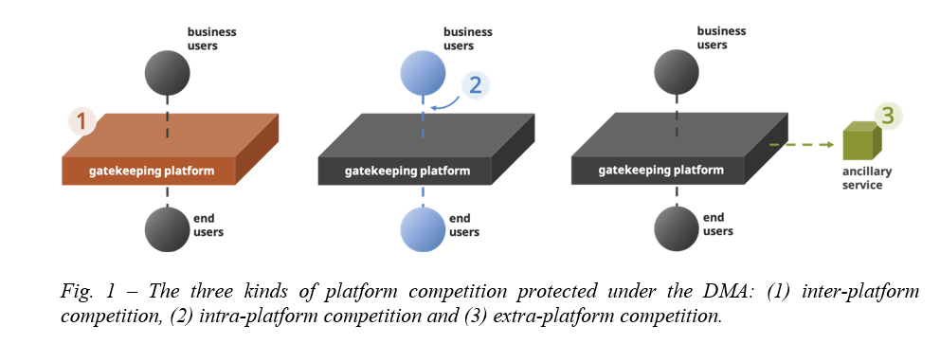
DMA’s Safe Competition Spaces (1, 2 & 3)
Source: Moreno & Petit, 2022
Notes:
Inter platform competition (1)
Intra platform competition (between business user) (2)
Extra platform competition (3): banks, logistics companies, or creators

Slide 8
19 Obligations
Apply wrg to each CPS listed in designation decision art 5(1)
Limited clustering
Self executing v further specifiable obligations
Update by delegated act + system to avoid circumvention provided for at Art 13
No tie btw gatekeeper affected CPSs, art 5(8)
Established legal practice
No combination of personal data w/o specific consent, art 5(2)
DE ongoing Facebook Case
No self preferencing in ranking, indexing, and crawling, art 6(5)
Recent EU Google Shopping case

Slide 9
Personal views on DMA
Focus on indirect limitations to monopoly rents in tipped markets ✓
Sector-specific competition law ✓
Excess restrictions on big tech’s exit from monopolized markets? ✗
Awareness needed towards risk of over-regulation of incipient tipping 

Slide 10
Open Questions
Practice => What counts as a business user for a virtual assistant (eg, Siri) or as an end user for a cloud service (AWS)?
Policy => What indicators to determine whether the DMA has been a “success”?
Law => What is/are the concrete objectives that the DMA tries to achieve?
Notes:
Speed
Amount of litigation

