Slide 1

Gatekeepers, Superstars, or Disruptors?
A Study of Rents in Digital Industries
Sotirios Georgousis, Bowman Heiden, and Nicolas Petit
11 January 2023

Slide 2
Introduction
Economic theory of profits and rents: monopoly power, Ricardian rents, and Schumpeterian rewards.
Hypotheses and tests of rents that underpin the substantial and persistent profits of digital firms.
Evidence of monopoly power hypothesis?
Evidence of Ricardian rents by big tech firms?
Evidence of Schumpeterian rewards in digital sub-industries?
Policy interventions in a context of coexisting monopoly power, Ricardian rents, and Schumpeterian rewards.

Slide 3
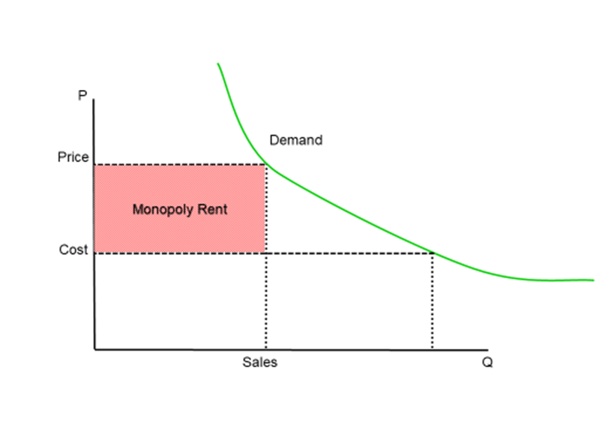
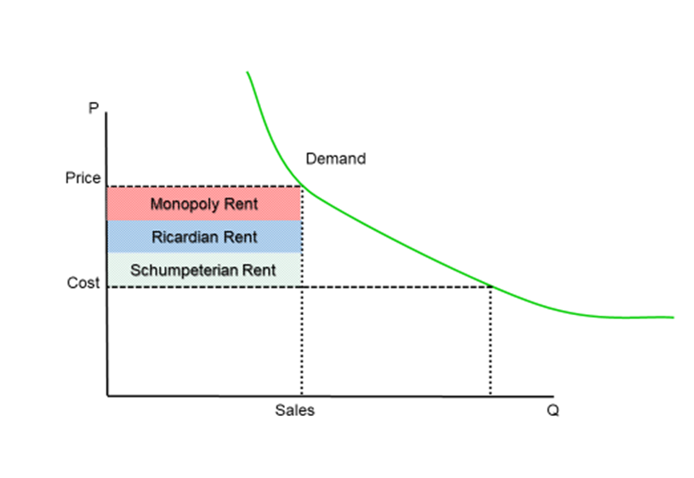
Multi-modal theory of economic rent

Slide 4
Testing for multi-modal rents
Monopoly power
Limited entry
Ricardian rents
Rent differentials amongst digital firms
Rents persisting with increasing industry output
Rent maintenance in the face of decreasing prices
Schumpeterian rewards
Firm level differences in levels of reallocation to invention through R&D and earnings retention choices

Slide 5
Testing for monopoly power
Entry
Markups
Notes:
We’ve got to tests for monopoly power. Entry and markups
One way to think about whether digital firms enjoy monopoly rents consists in asking: what should we observe if there were monopoly rents? The textbook monopoly model gives the answer. A monopoly correlates with persistent rents in the long term owing to a restriction of entry.
Thus, the hypothesis: digital firms possess monopoly rents if entry is limited.
Control of entry can be achieved by systematic elimination of short term entrants in product market AND by prevention of long term entry of potential competitors. Unfortunately, there is no systematic data source on entry in product markets. Like for output, a problem of observation arises: we cannot observe systematically if digital firms enjoy short term monopoly rents.
But we are not completely in the dark. Long term potential competition prevents monopoly rents. Above cost prices with long term potential competition are something else.
The main source of competitive pressure arises in the long term, as indirect, or potential, competitors disrupt incumbents with new or improved products (Bresnahan and Greenstein, 1999).
So we should try to observe whether there is entry of potential competition in the long term. And the intensity of that entry will give us insight the obsolescence rate of long term rents. By getting information on existence and intensity of potential competition, we’re interested in knowing if the firm can control long term entry.
We’re trying to develop a test for a statistical argument that is easy to understand. Industries that display an accumulation of firms over time have a bigger pool of potential competitors, and a higher potential for monopoly disruption. Similarly, industries that display a stable pool of firms, but with a change in the composition through entry and exit, tend to rejuvenate their pool of potential entrants, eliminating losers, and bringing in new challengers.
As the space of potentially competitive firms increases, the likelihood of actual competition in the long term grows.
The US Census Bureau data BDS dataset collects data on business dynamism, together with a useful analytics tool. The tool provides information on the number of new firms - that is additions to existing firms - and exiting firms, on a year over year basis since 1978. The BDS provides data at the industry and sub industry (4 digits NAIC) levels.
We focus on the ICT industry in general, which is composed of 11 sub-industries

Slide 6
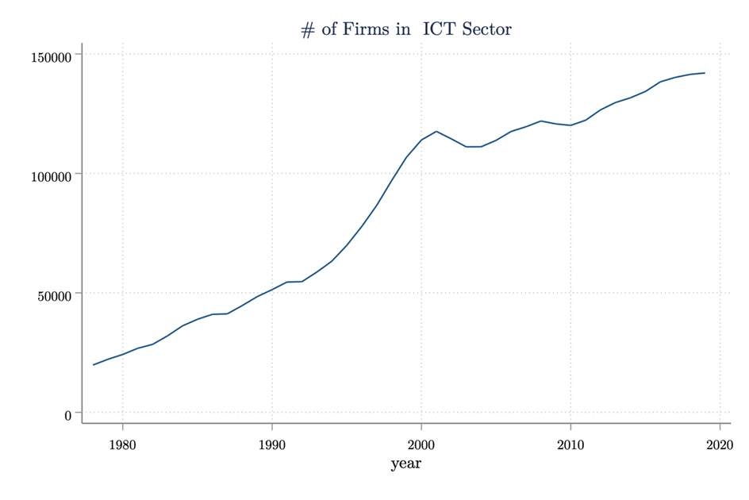
US Census Bureau data BDS dataset
Notes:
To start, the total number of firms in the entire ICT industry grew from 19,801 in 1978 to 142,052 in 2019 (Graph _).

Slide 7
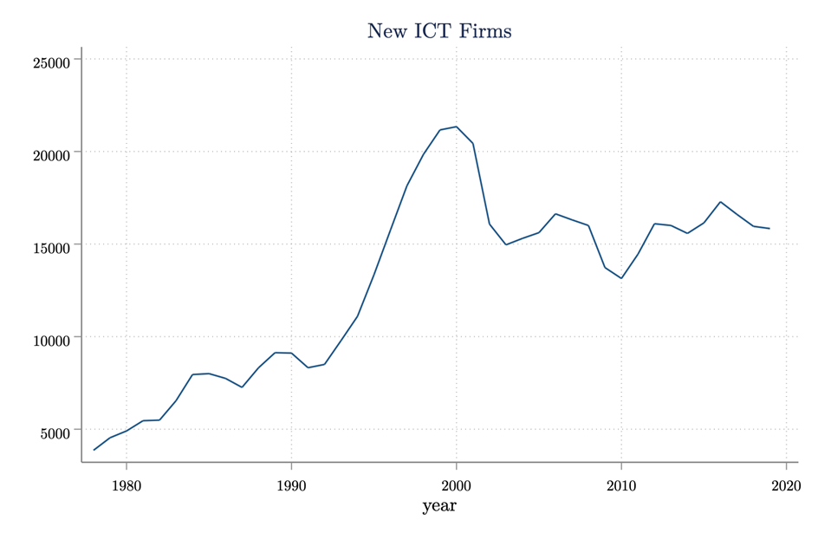
Notes:
And a constant number of new firms has seemed to enter the ICT industry every year since 2000, meaning that the identity of firms in the ICT sector has changed at a stable rate (Graph _).

Slide 8
Notes:
In some sub-industries, like the ‘Communications and Equipment Manufacturing’ sector, the number of firms has steadily declined (Graph _). This is where Apple is

Slide 9
Notes:
In other sub industries, the outlook is the opposite. The number of firms has increased and new firms have entered in growing numbers. One sector subject to this trend is ‘Other Information Services’ in which Facebook is identified

Slide 10
Notes:
Another sector with a similar pattern is ‘Electronic Shopping and Mail Order’ where Amazon is located

Slide 12
Notes:
Computer Systems Design and Related Services (5415)

Slide 13
Notes:
One sector which has not evolved much in terms of number of firms is ‘Other Support Services’, where Microsoft is registered. The sector also appears to keep a relatively stable composition of firms (Graphs _and _)
Observe that an industry-wide trend appears to be the dip in firm addition and creation seen around 2000. The dip corresponds to the collapse of the dotcom bubble. Some sectors recovered more quickly than others.
Besides, one observable tendency that should be confirmed by finer grained observations is that hardware appears to add less firms, and less new ones than software

Slide 14
Markups
Notes:
We follow the modern literature trying to observe markups as an indicator of monopoly rents. We focus on the ratio of sales over the cost of goods. De Loecker, Eeckhout, and Unger (2022)
Compustat contains information over 80,000 active and inactive publicly traded firms. Moreover, there are 3,000 financial items that are reported in annual and monthly frequencies.
Compustat data contains interesting indicators for our study. We can think, in particular, of profit data, Cost of Good Solds (“COGS”), Selling, General & Administrative Expense (“SG&A”),
We can also cross concentration ratios with entry and exit data, as well as the number of firms. The procedure gives insights on whether the amount of competitive pressure at the sub industry level correlates with changes in the cost, profits and investments of the largest firms.
We rely on sales and COGS reported in Compustat bias market power upward because COGS cover only direct inputs to production (such as material and costs of labor). That bias upward could be a good thing in our case, given the standard assumption that large tech firms command monopoly profits. One limitation that De Loecker, Eeckhout, and Unger acknowledged is that the indicator ignored indirect inputs to production reported as SG&A. We follow them in adding SG&A as a measure of overhead, which covers intangible capital often deemed relevant in ICT industries
For each big tech firm, we produce three graphs, I show two here, Google and Apple
the markup for the specific firm compared to the mean markup in the sub-industry,
the markup for the firm we are interested in compared to the maximum markup (highest value) in the sub-industry
the CR4 markup (four highest values) for the sub-industry,
What do we see?
Google’s markup has moderately decreased while the number of market participants has increased.
We see more clearly on the maximum markup graph that as the pool of potential competitors increases, there are entering firms that are either more productive or have a higher market power to specific products.
The data suggests that Google’s ability to be a top “superstar” firm or the strongest monopolist in its sub-industry decreases with potential competition. In fact, Google is only in the CR4 value from 2002 to 2010.
For Apple, we observe a clear trend whereby Apple’s markup rises above the mean, up to the maximum markup in the industry.
The trend correlates with a long term decrease in the number of market participants.
Acknowledging again all the crudeness of our test, in Apple’s case, monopoly rents could be existing. The point is, as the pool of potential competitor decreases, we see that Apple might enjoy increased ability to be a mega superstar or the strongest monopolist in the sub industry. Apple belongs to the CR4 from 2009 to 2021

Slide 15
Testing for Ricardian rents
Total factor productivity
Intra sub industry differentials
Notes:
Ricardian rents could explain large tech firm’s persistent returns in the face of entry in the long term. Recall that a Ricardian rent stems from the inherent productivity of assets, compared to less productive combinations of capital and labor (Ricardo, 1817). We can therefore look at the existence of differential productivity levels within a sub industry as a measure of Ricardian rents.
The trend observed for all firms across their sub industries is a decrease of their TFP. The decrease in TFP correlates with a rise in the number of market participants, except for Apple. So it may be hypothesized that TFP is only coincidentally related to potential competition. In addition, we see that most, if not all large tech firms, operate below the TFP mean in their sub industry. The only exception again appears to be Apple, which benefits until 2000 from a TFP above sub industry level, possibly denoting Ricardian rents. We can infer from this that none of these firms is really a superstar in the modern sense, or a landlord in the Ricardian sense.

Slide 16
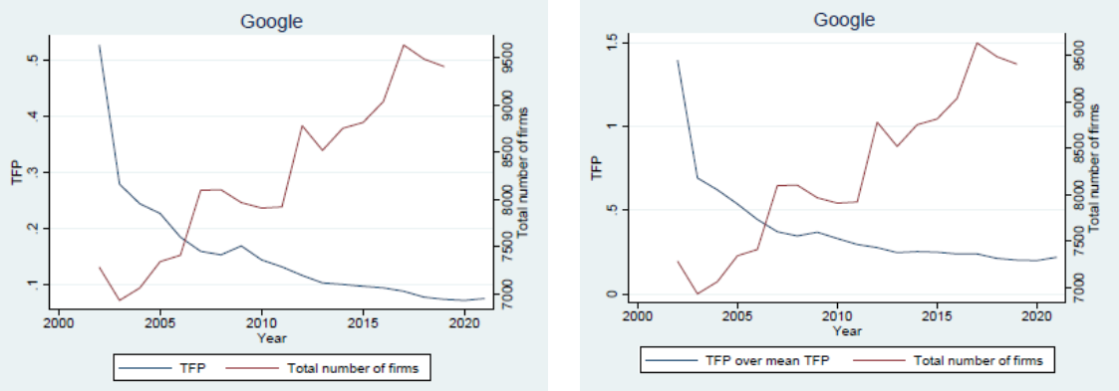
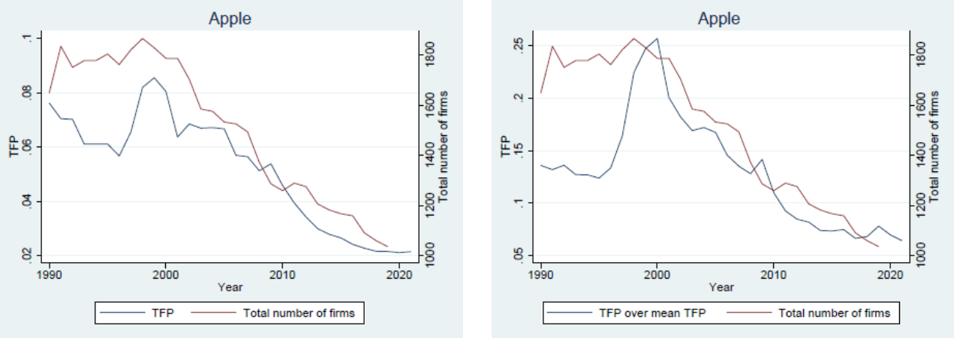
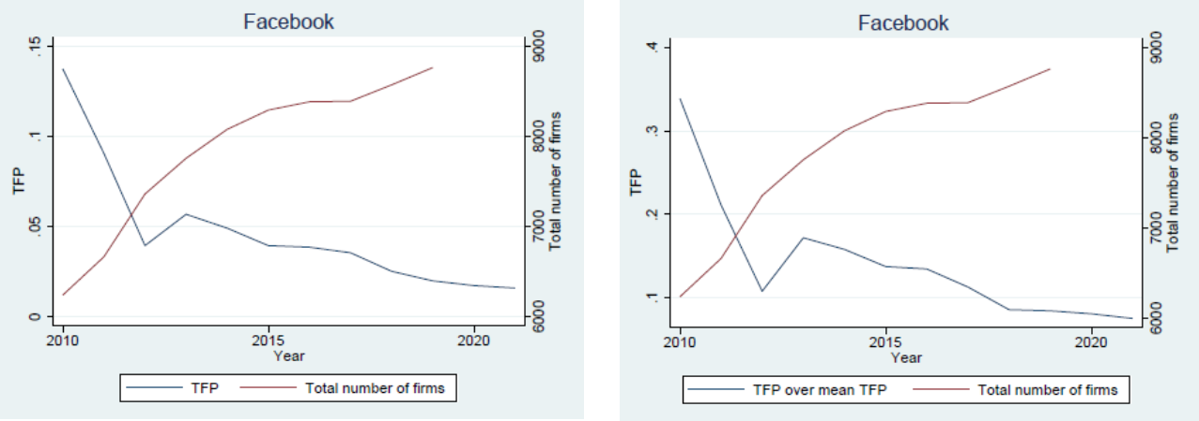
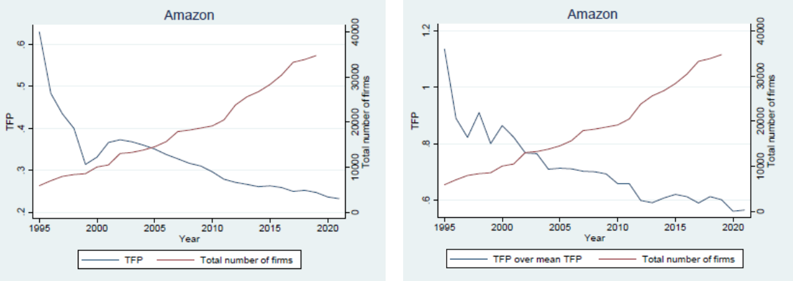

Slide 17
Testing for Schumpeterian rewards
All monopoly rents fall in long term under conditions of free entry, all Schumpeterian rewards dissipate in long term under conditions of free innovation
A profit maximizing monopolist will expend resources to maintain rent in long term; a profit maximizing disruptor will spend resources to renew its rent in the long term
What is monopoly v Schumpeterian spending?
Different types of expenditure
Expenses related to control of entry
Lobbying
Collusion
M&A w/ potential competitors
Expenses unrelated to entry conditions (indeterminate effect)
R&D, retained earnings?
Ratio of monopoly v Schumpeterian spending in each firm?
Data strategy & work still ongoing

Slide 18
Upcoming work
Rate of entry and market participation in industries other than ICT?
Ricardian rents across sub industries?
Schumpeterian rents?

Slide 19
Policy Discussion
In the long-run, companies are all dead
What should policymakers do in the short to mid-term?
How can policy be crafted to enhance welfare given multi-modal rents?
Are persistent Ricardian rents a problem?

