Slide 1


National Funding Opportunies The Netherlands
National and European Funding Opportunities in the Social Sciences
Renée van Kessel
NWO, The Netherlands

Slide 2
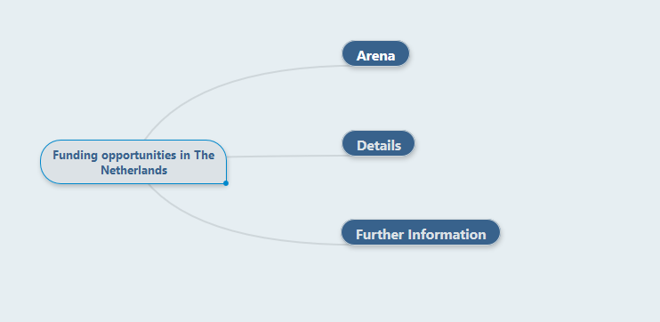


Slide 3

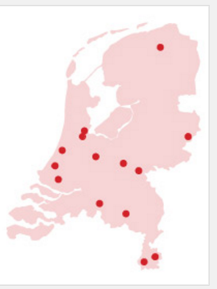
1. Arena
Population: 17 million
Research spending public: 4,5 billion
private: 6 billion
< 2,5 %
Universities: 14
Employees: 48.000
Students: 250.000
Publications: 85.000 per year
Doctorates: 5000 per year

Slide 4
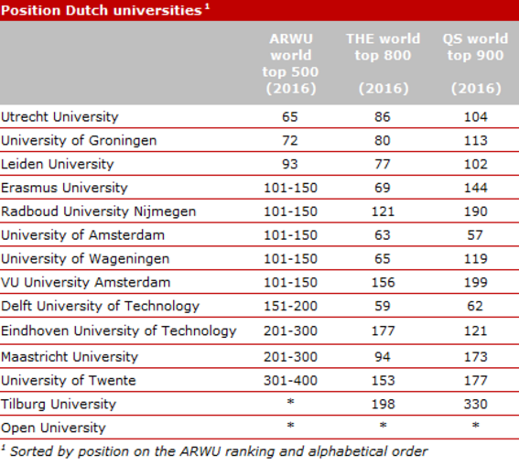
Top 2% in rankings

Slide 5
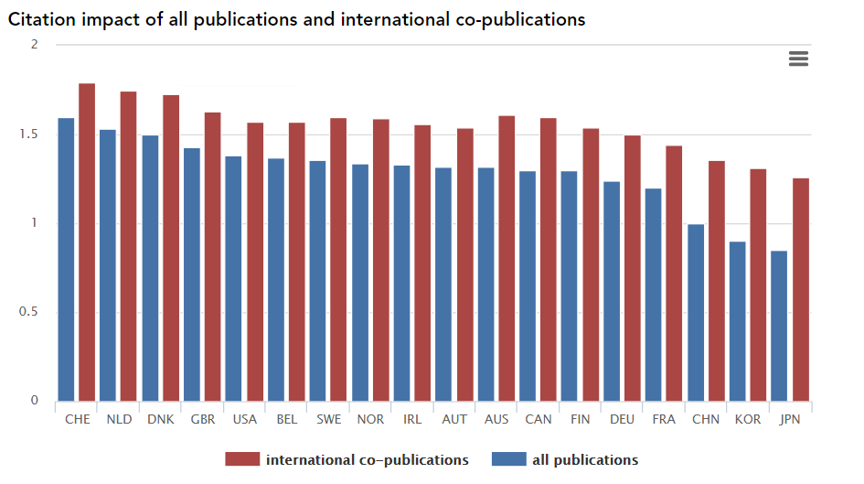
Web of Science 2016

Slide 6

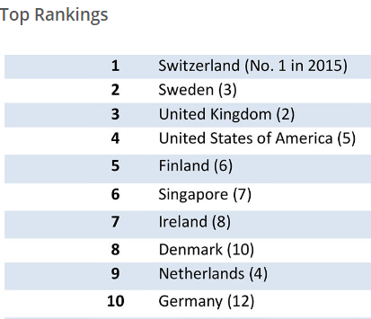
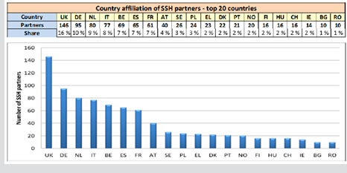


Slide 7
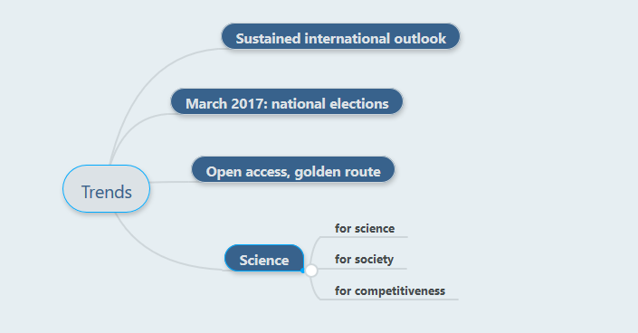

Slide 8

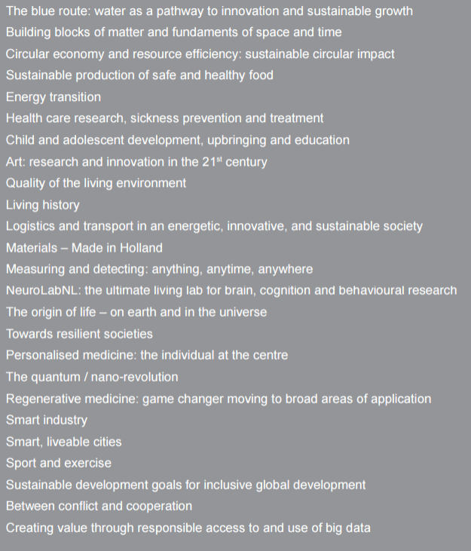
Science for Society
140 overarching scientific questions in 25 routes; a unique bottom-up initiative, driven by the general Dutch public and a vast number of organisations in the Netherlands.

Slide 9
SSH relevant routes
Sustainable Development
Towards Resilient Societies
Between Conflict and Cooperation
Youth, upbringing and education
Brain and Cognition
Smart and livable cities
Energy Transition
Living history
http://www.wetenschapsagenda.nl/?lang=en

Slide 10
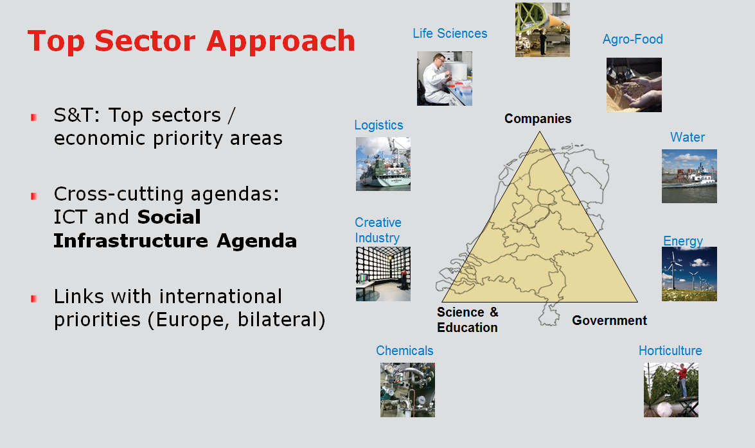
Science for competetiveness

Slide 11
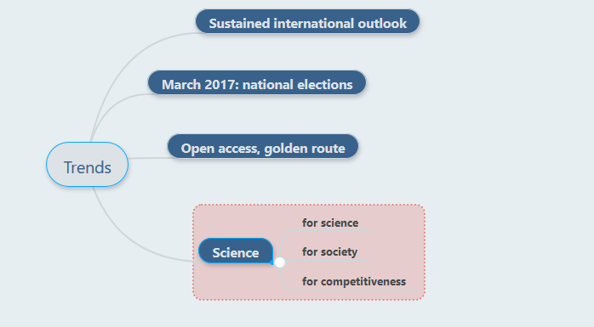


Slide 12
Funding opportunity's in NL
2. Details
Universities
NWO Research Council
EU
other
….Often in combination…..

Slide 13

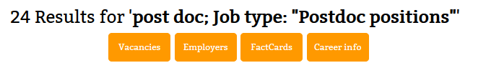
Universities: please check https://www.academictransfer.com/

Slide 14
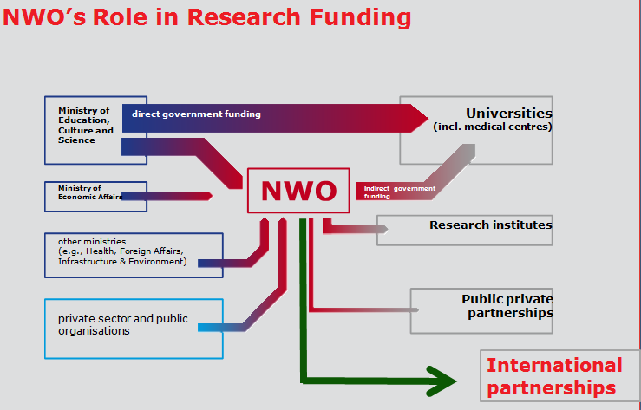
NWO
700 mEuros per year, 120 mEuro to SSH
Talent schemes
Thematic programmes
PPPs
Infrastructure

Slide 15
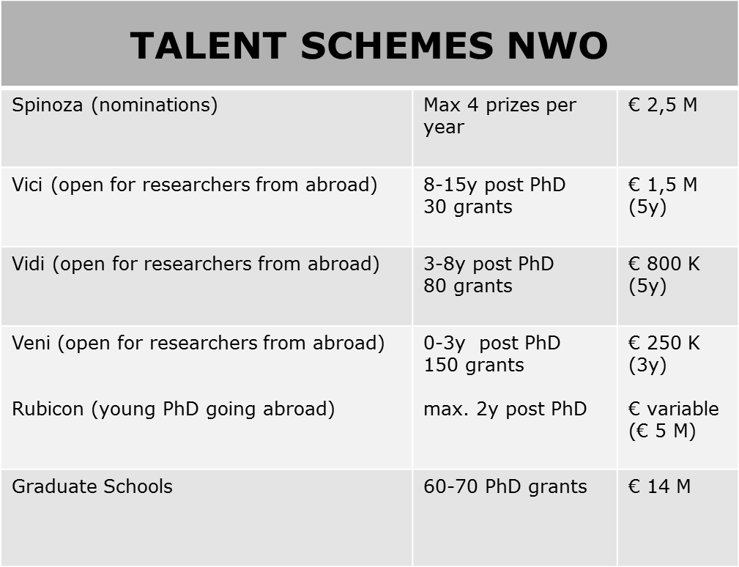
CAREERS
Re
Research Talent (PhD scheme) SS 4 years €250 K
I
Bi-annual International scheme Social Sciences: Open Research Area (ORA)
Success rates 15%....

Slide 16
Criteria
Excellence researcher
Quality, innovative character and academic impact of the research proposal
Knowledge utilisation
Success rate 15%

Slide 17









Thematic SSH programmes and alliances with EU
NORFACE and HERA
http://www.norface.net/
http://heranet.info/
JPI’s
http://jpi-urbaneurope.eu/about/intro/
http://www.jp-demographic.eu/
http://www.jpi-climate.eu/home
http://www.jpi-culturalheritage.eu/
Trans-Atlantic Platform for SSH
http://www.transatlanticplatform.com/
Cooperation with China, India, Brazil
Success rate 20%

Slide 18
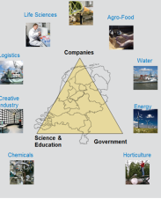


Near future…
Topsector programmes
Social Infrastructure for Topsectors
Dutch Research Agenda
FP 9 of European Commission
– importance of SSH
ERC and national talent schemes

Slide 19
3. Information

Slide 20
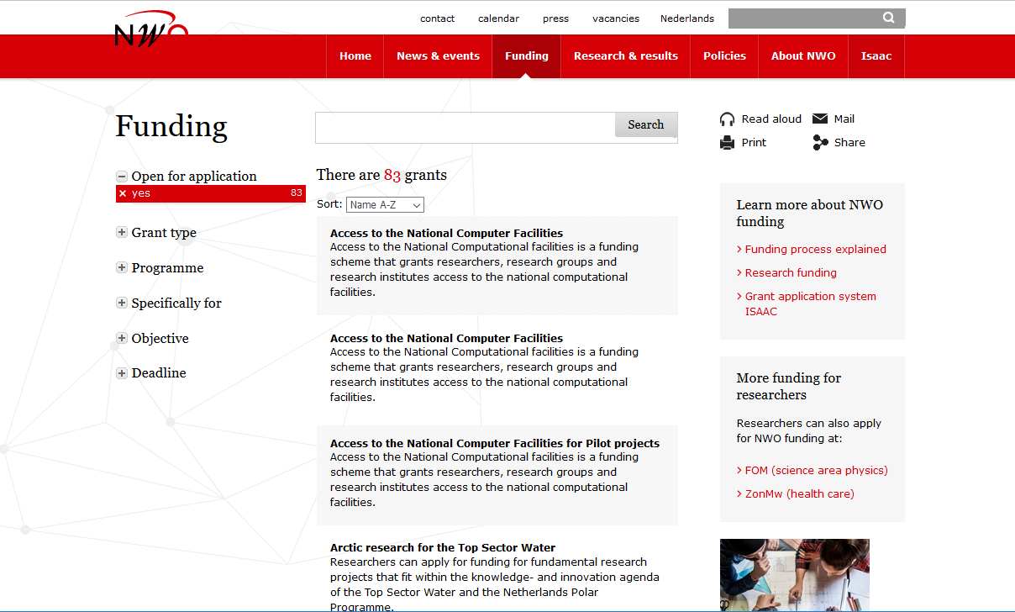
http://www.nwo.nl/en/funding/our-funding-instruments/

Slide 21
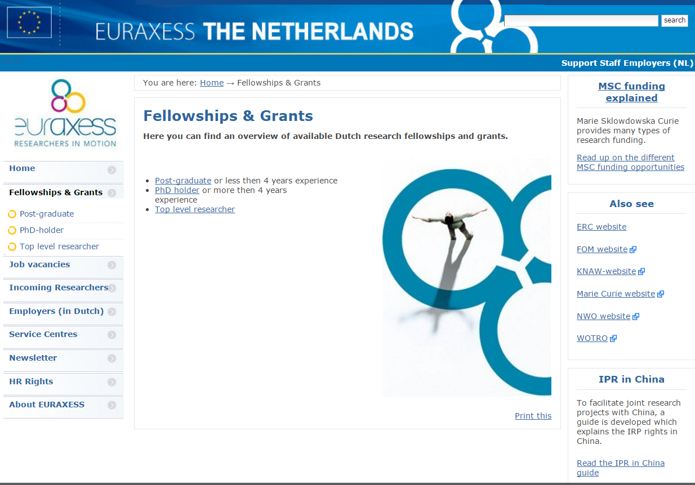
http://www.euraxess.nl/fellowships-grants

Slide 22
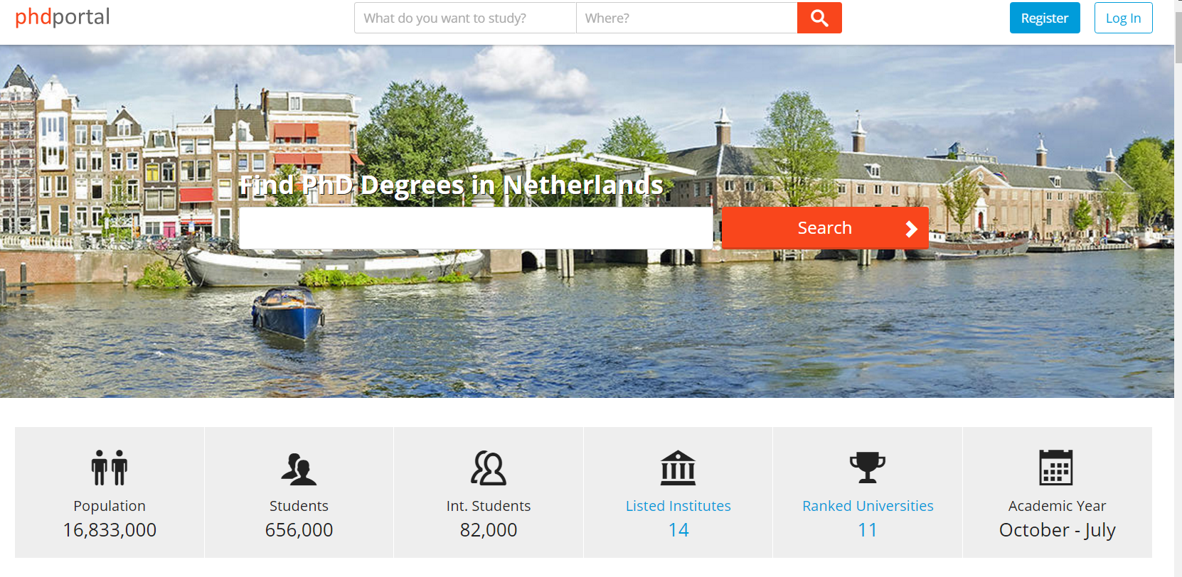
http://www.phdportal.com/

Slide 23
Summary
The Netherlands is an ‘open’ country for research cooperation
Universities welcome talent from abroad
Most NWO schemes are open for researchers from abroad
More research in thematic, societal and international context

Slide 24
Thank you!
r.vankessel@nwo.nl

