Slide 1
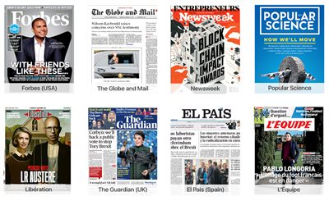
EUI Library News Resources
Thomas.Bourke@EUI.eu
Elena.Brizioli@EUI.eu
Federica.Signoriello@EUI.eu
26 November 2025

Slide 2
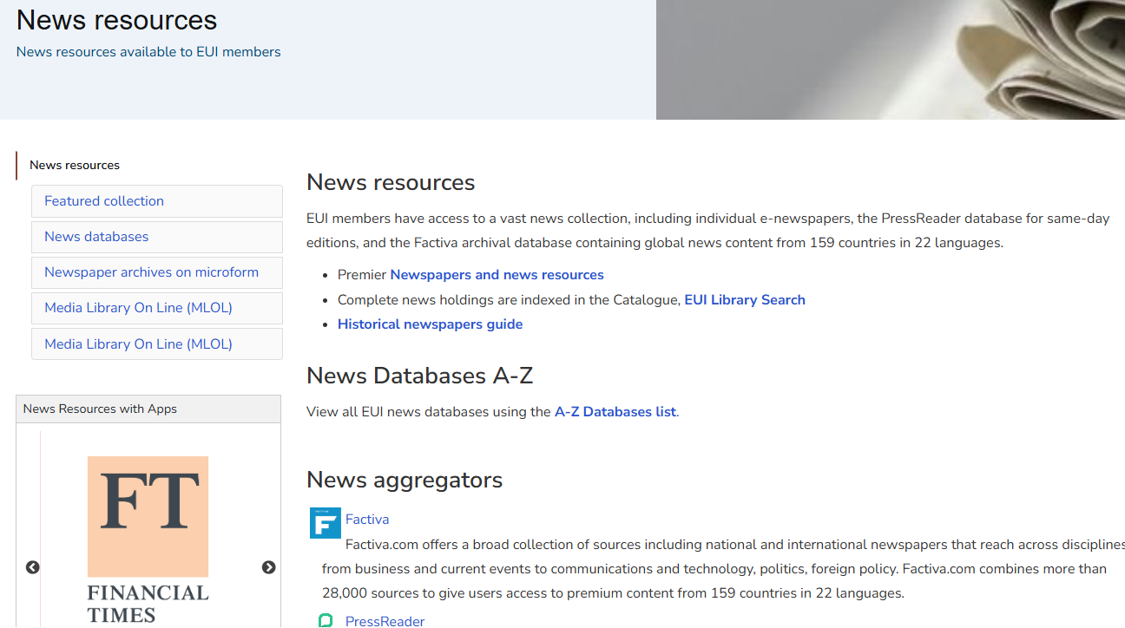




Slide 3
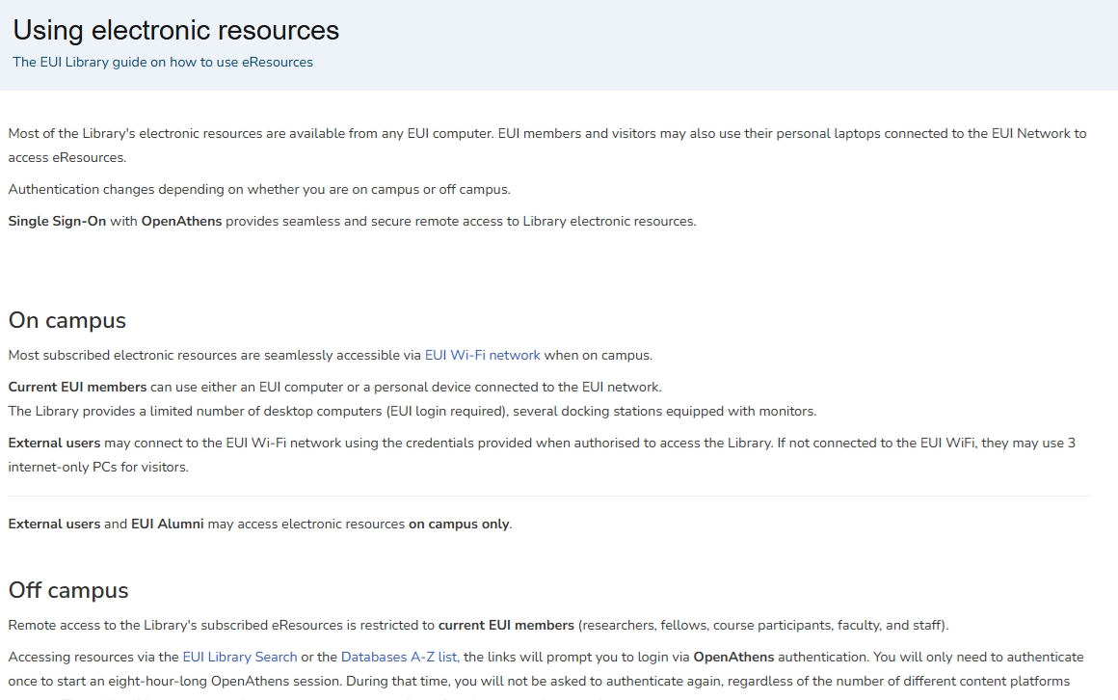

Slide 4
Follow instructions in the Catalogue
On campus
  For most resources, no authentication required.
Off campus
  Use EUI credentials - username and password - to access online resources when off-campus
  Links from the Catalogue will prompt login
  When asked to select institutional affiliation; select ‘European University Institute’ from the list of institutions.

Slide 5
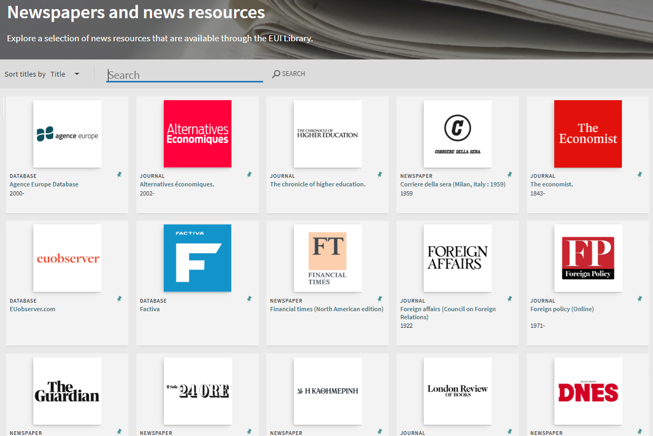

Slide 6
Categories
  Newspapers / gazettes / magazines
  Wire services (news agencies)
  Digital versions of analogue newspapers
  Newspaper websites / news websites
  News aggregators / databases
  Digital ‘primacy’ in 21st Century

Slide 7
Multi-media
  Publishers’ platforms / Mobile app
  Aggregator databases / digital archives
  Microform / CD-rom
  Paper

Slide 8
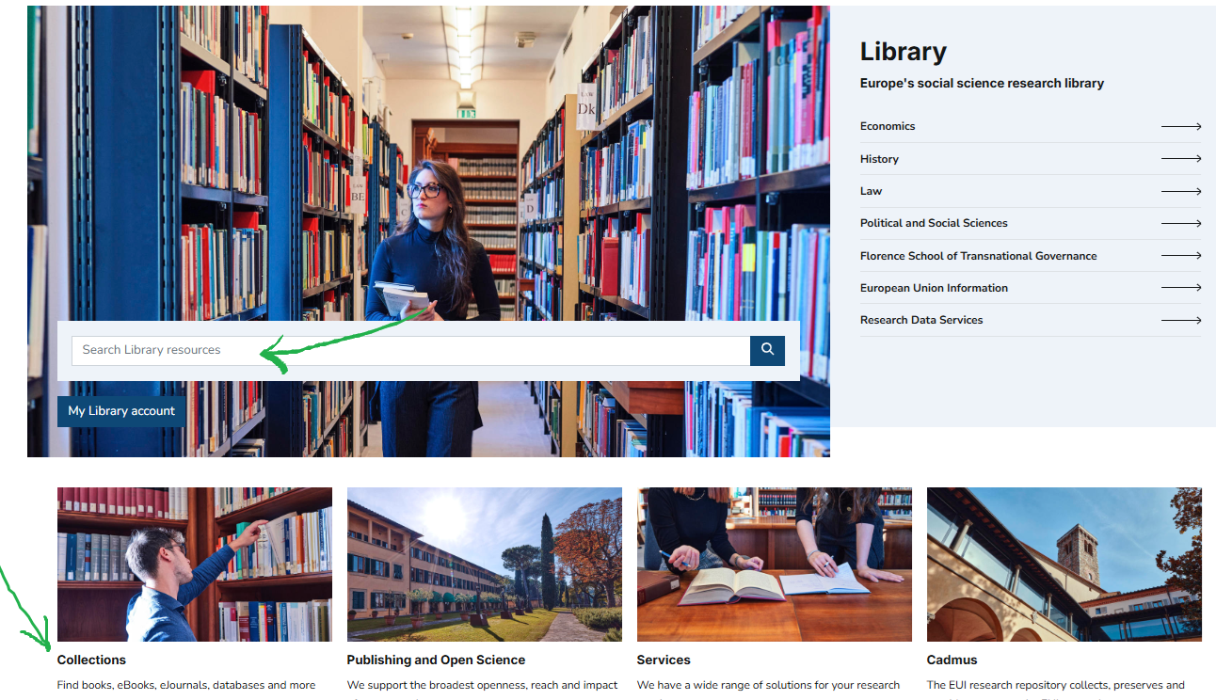


Slide 9
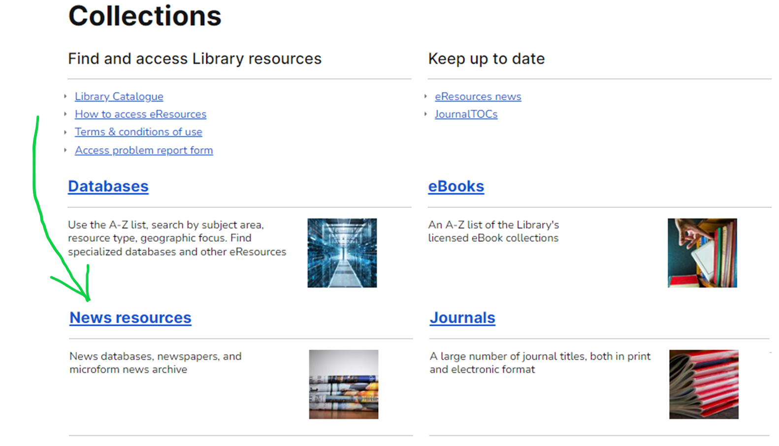

Slide 11
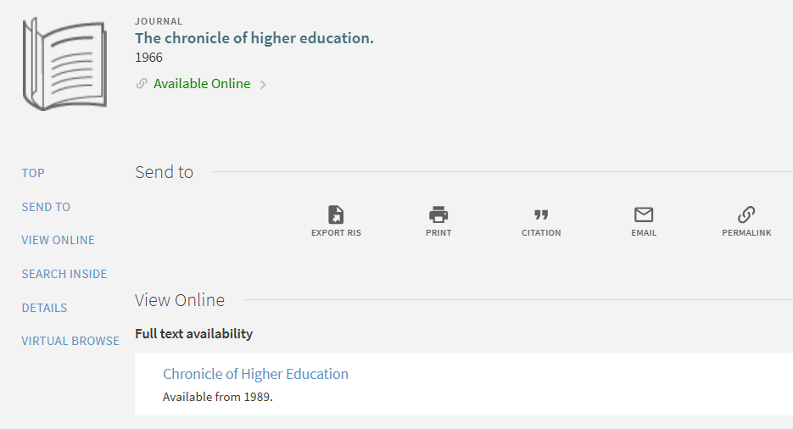

Slide 12
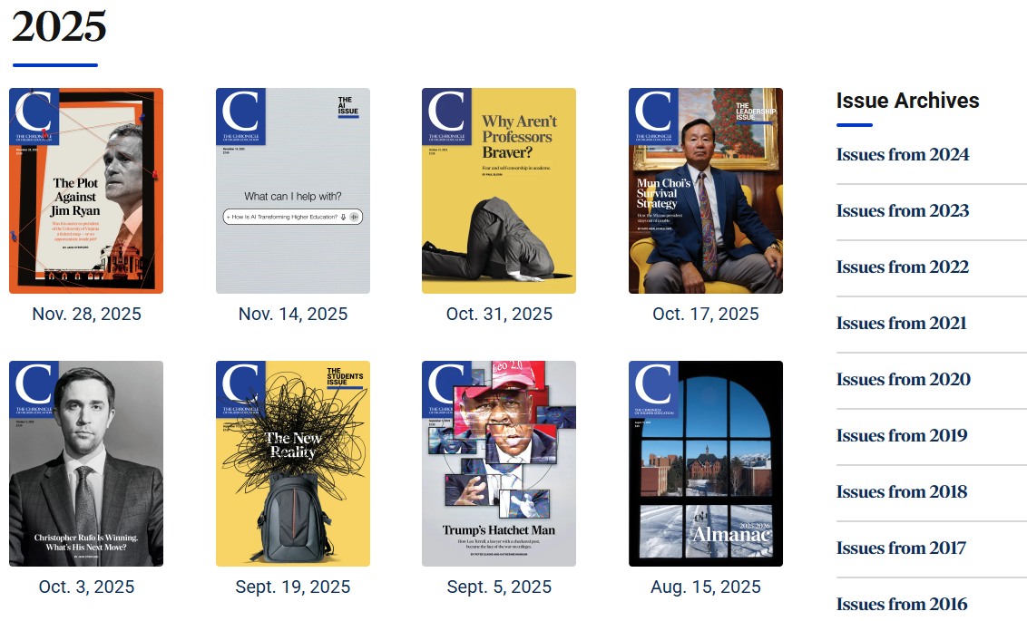

Slide 13

Newsletters and alerts

Slide 14
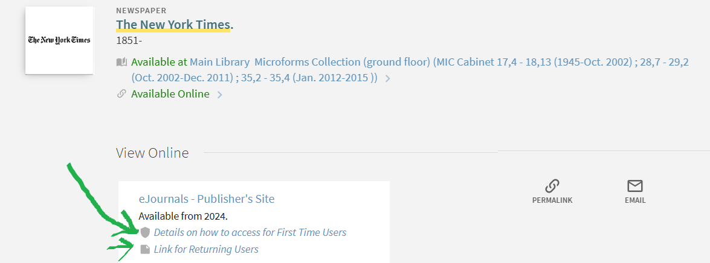


Slide 15
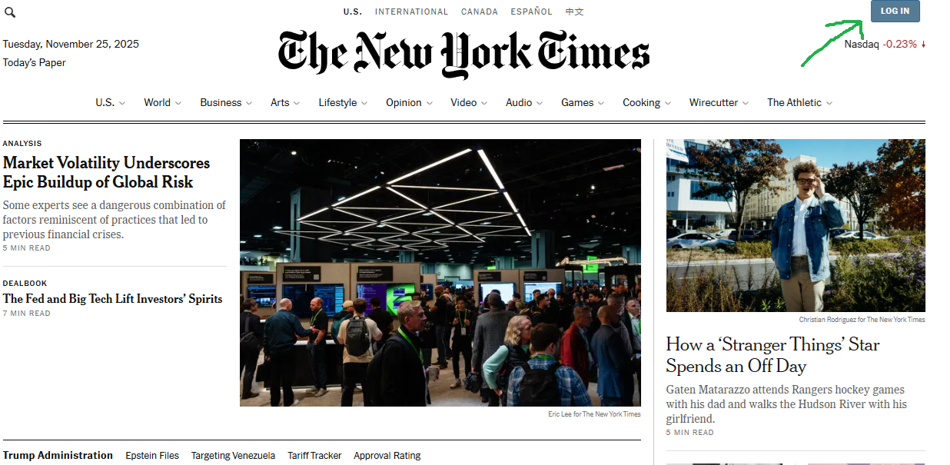

Slide 16
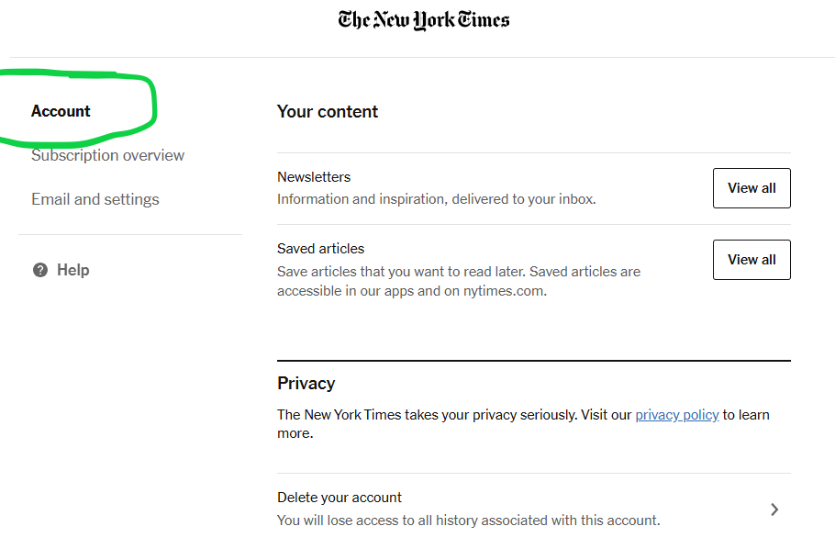

Slide 17
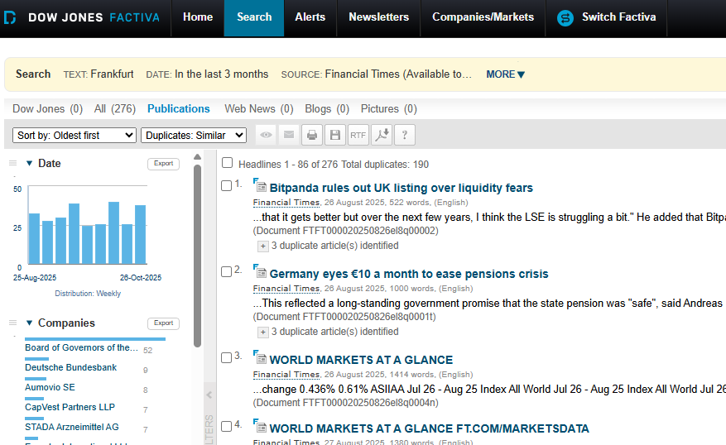

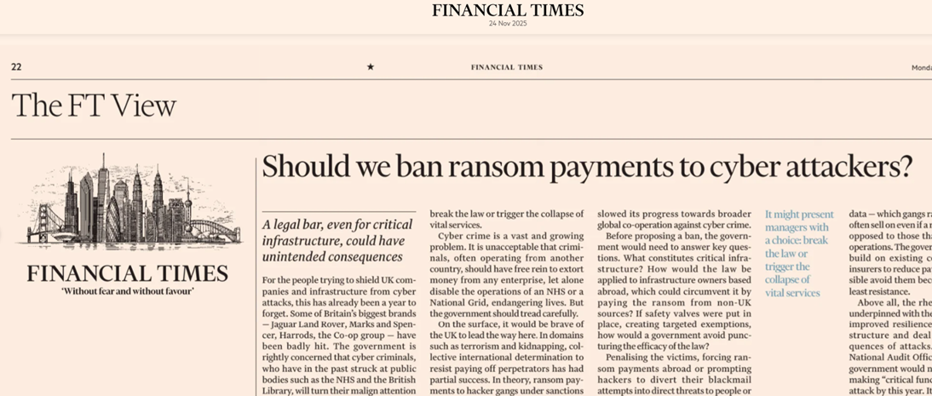
Multiple modes of access

Slide 18
Terms and Conditions of access and use
Subscription resources are for current EUI members only
No sharing of passwords / access
Personal / research use only
No commercial use

Slide 19
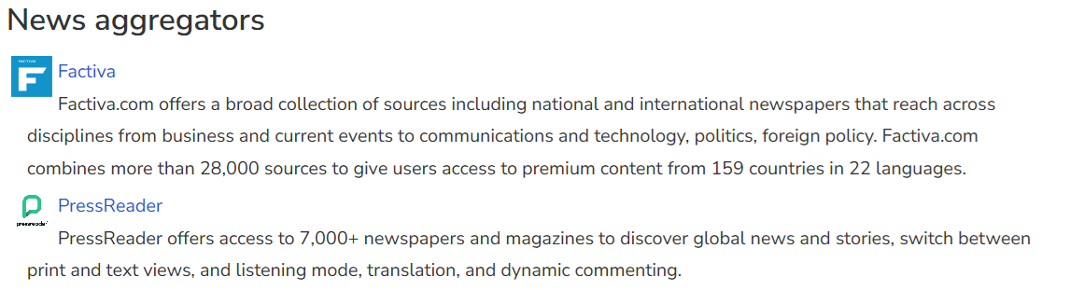

Slide 20
News databases (aggregated)
Factiva | PressReader
Approx. 28,000 international news sources | Approx. 7,000 international news sources
Newspapers, newswires, news releases | General newspapers and magazines
Text only | Page images/layout and text
35-year coverage (varie) | 90-day coverage (varie)
Advanced search | Basic search
Via desktop, laptop | Via mobile app, desktop, laptop

Slide 21
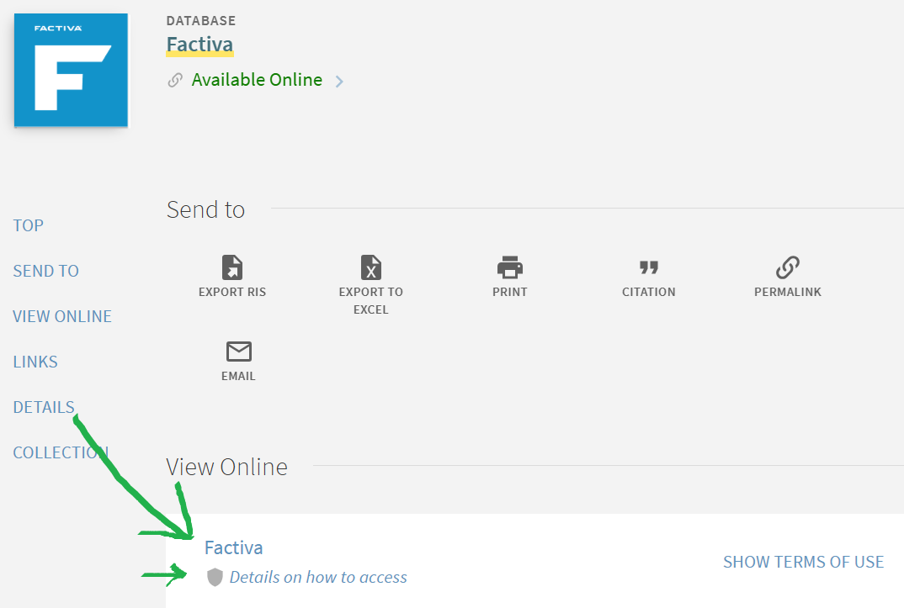

Slide 22
Factiva search operators
Simple search: Eurobonds
All keywords present: Geneva Conventions (AND implied)
Phrase search: “European Data Act”
Any terms in article: Mercedes OR Daimler
Exclude terms: “fossil fuels” –coal
Headline search: hl: “COP30”

Slide 23

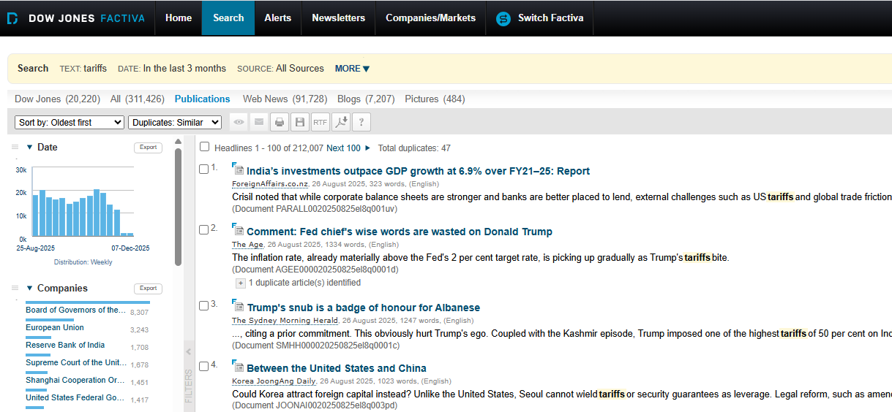

Slide 24
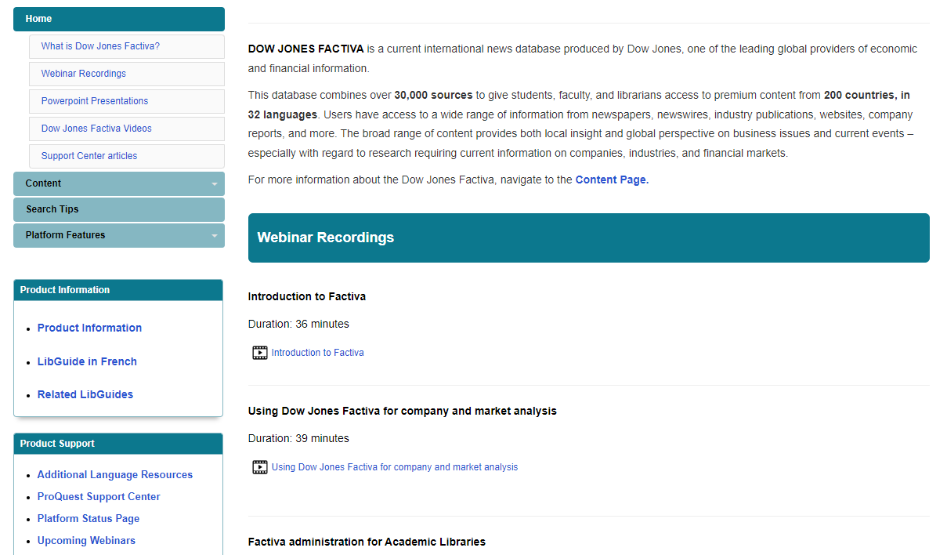
Factiva support

Slide 25
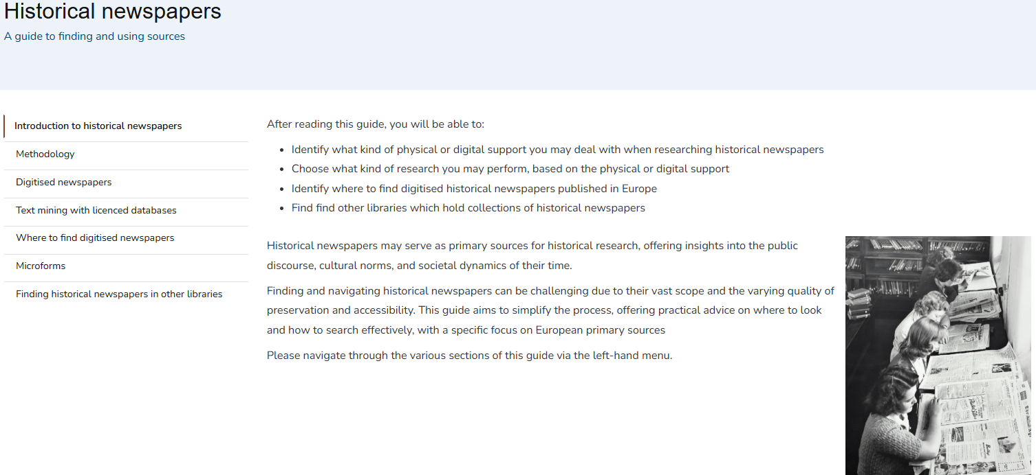

Slide 26
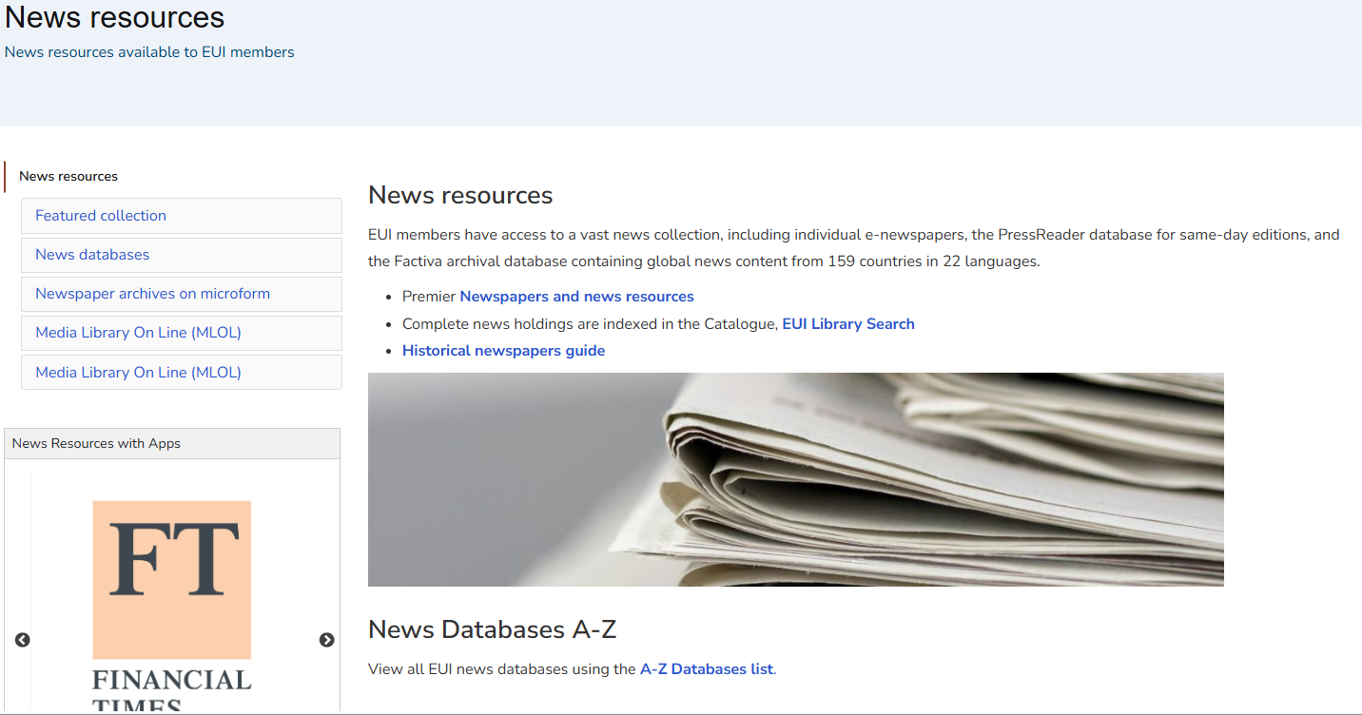

Slide 27
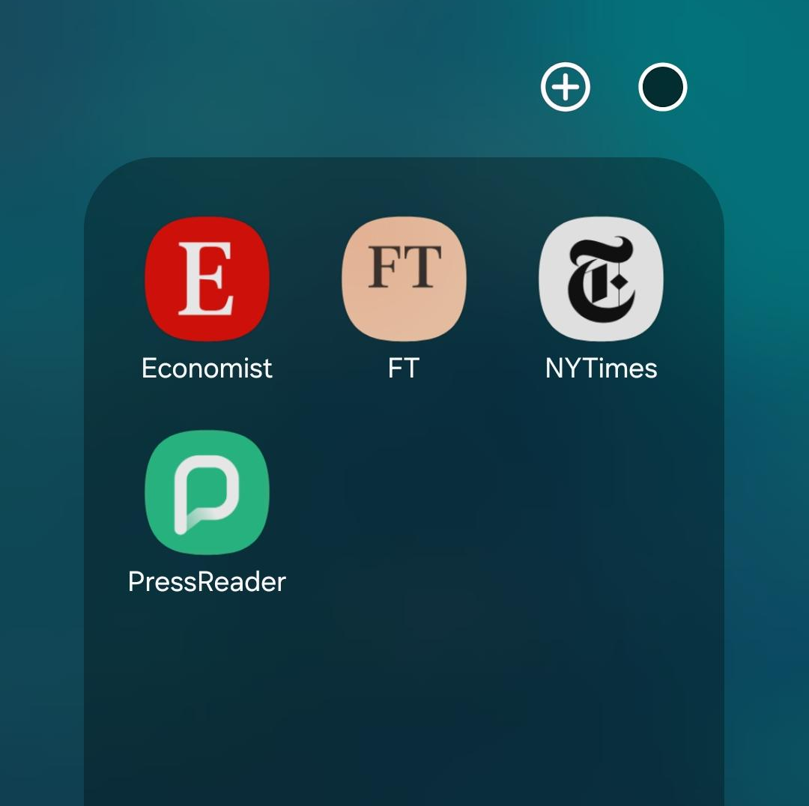
Available Apps
PressReader
FT
NYTimes
Economist
Notes:
PressReader >> The first login to the App must be done on Campus
FT >> The first login to the App can be done from anywhere
NYTimes>> The first login to the App can be done from anywhere
Economist>> The first login to the App can be done from anywhere

Slide 28

Access PressReader via the Catalogue link
Create an account associated with your @eui.eu email
Download the App on your phone/tablet
To have your account associated with the EUI subscription first login to the App must be done on Campus, connected to the EUI WiFi
The first login to the App must be done on Campus
Radiant access is granted for 7 days from the moment you have disconnected from the EUI WiFi. After 7 days you can still access the content via the link provided in the Catalogue. Access via App will be reactivated once back to the EUI or accessing the resource via Catalogue link.

Slide 29

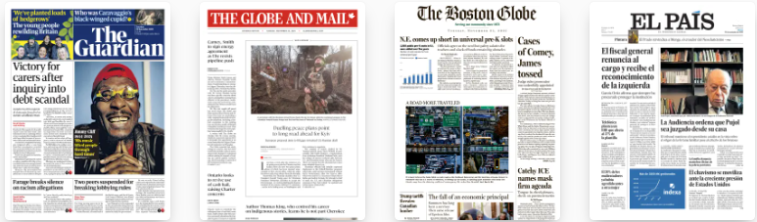


Digital edition is limited to the most recent 3 months of publication
Titles are not stable

Slide 30
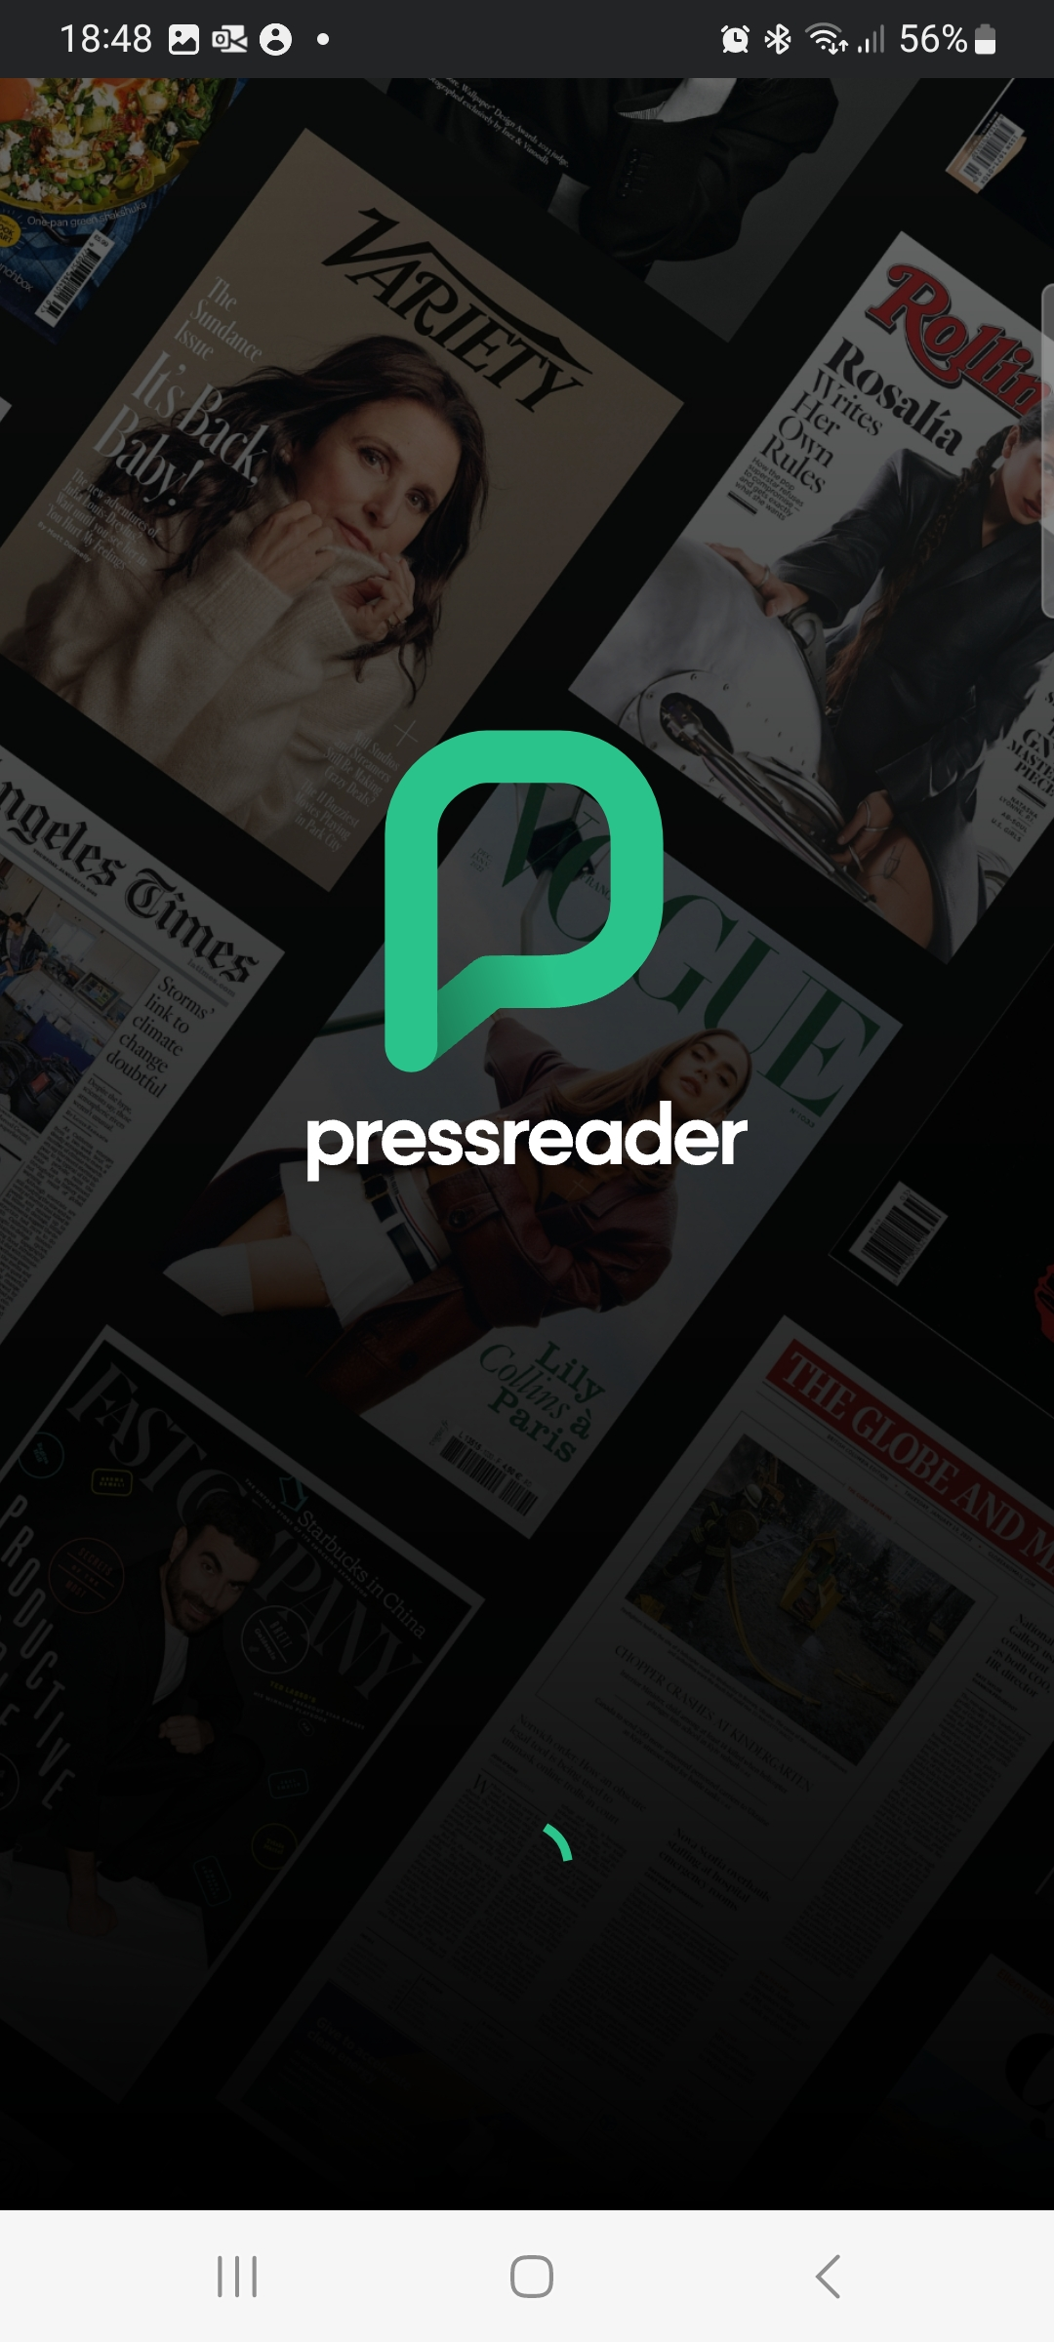
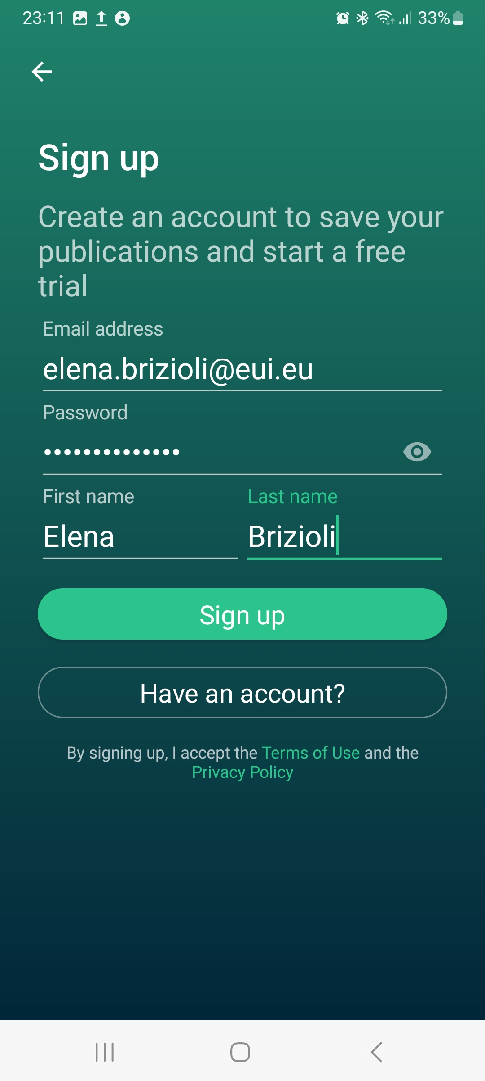
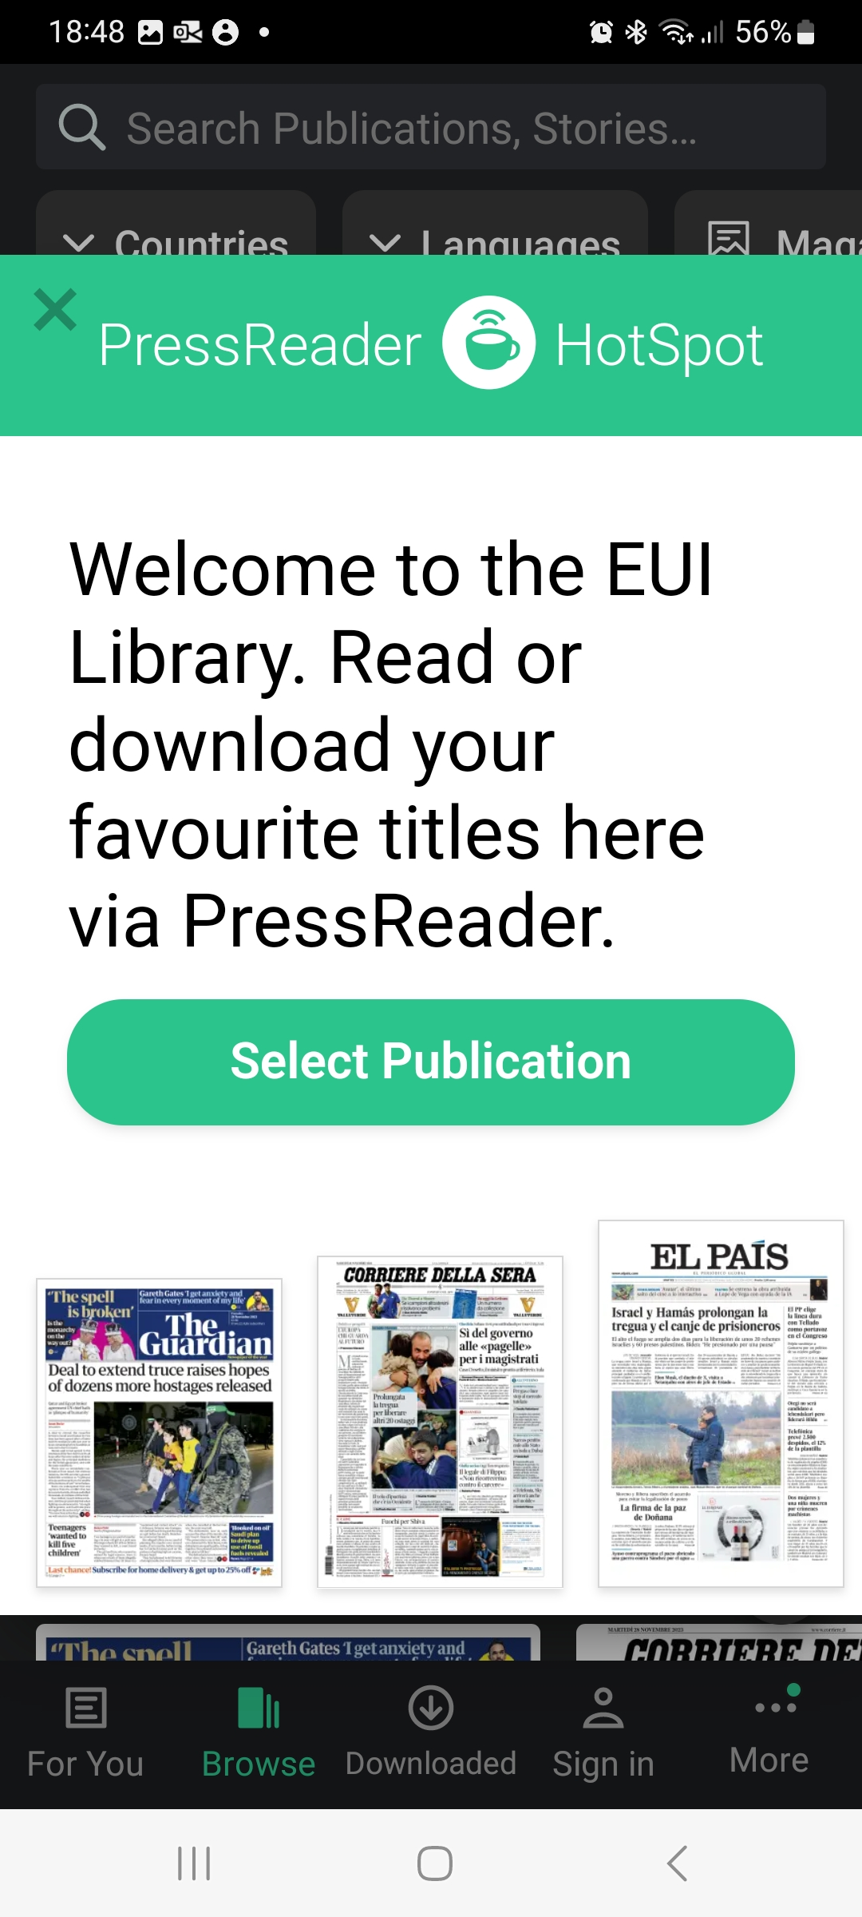
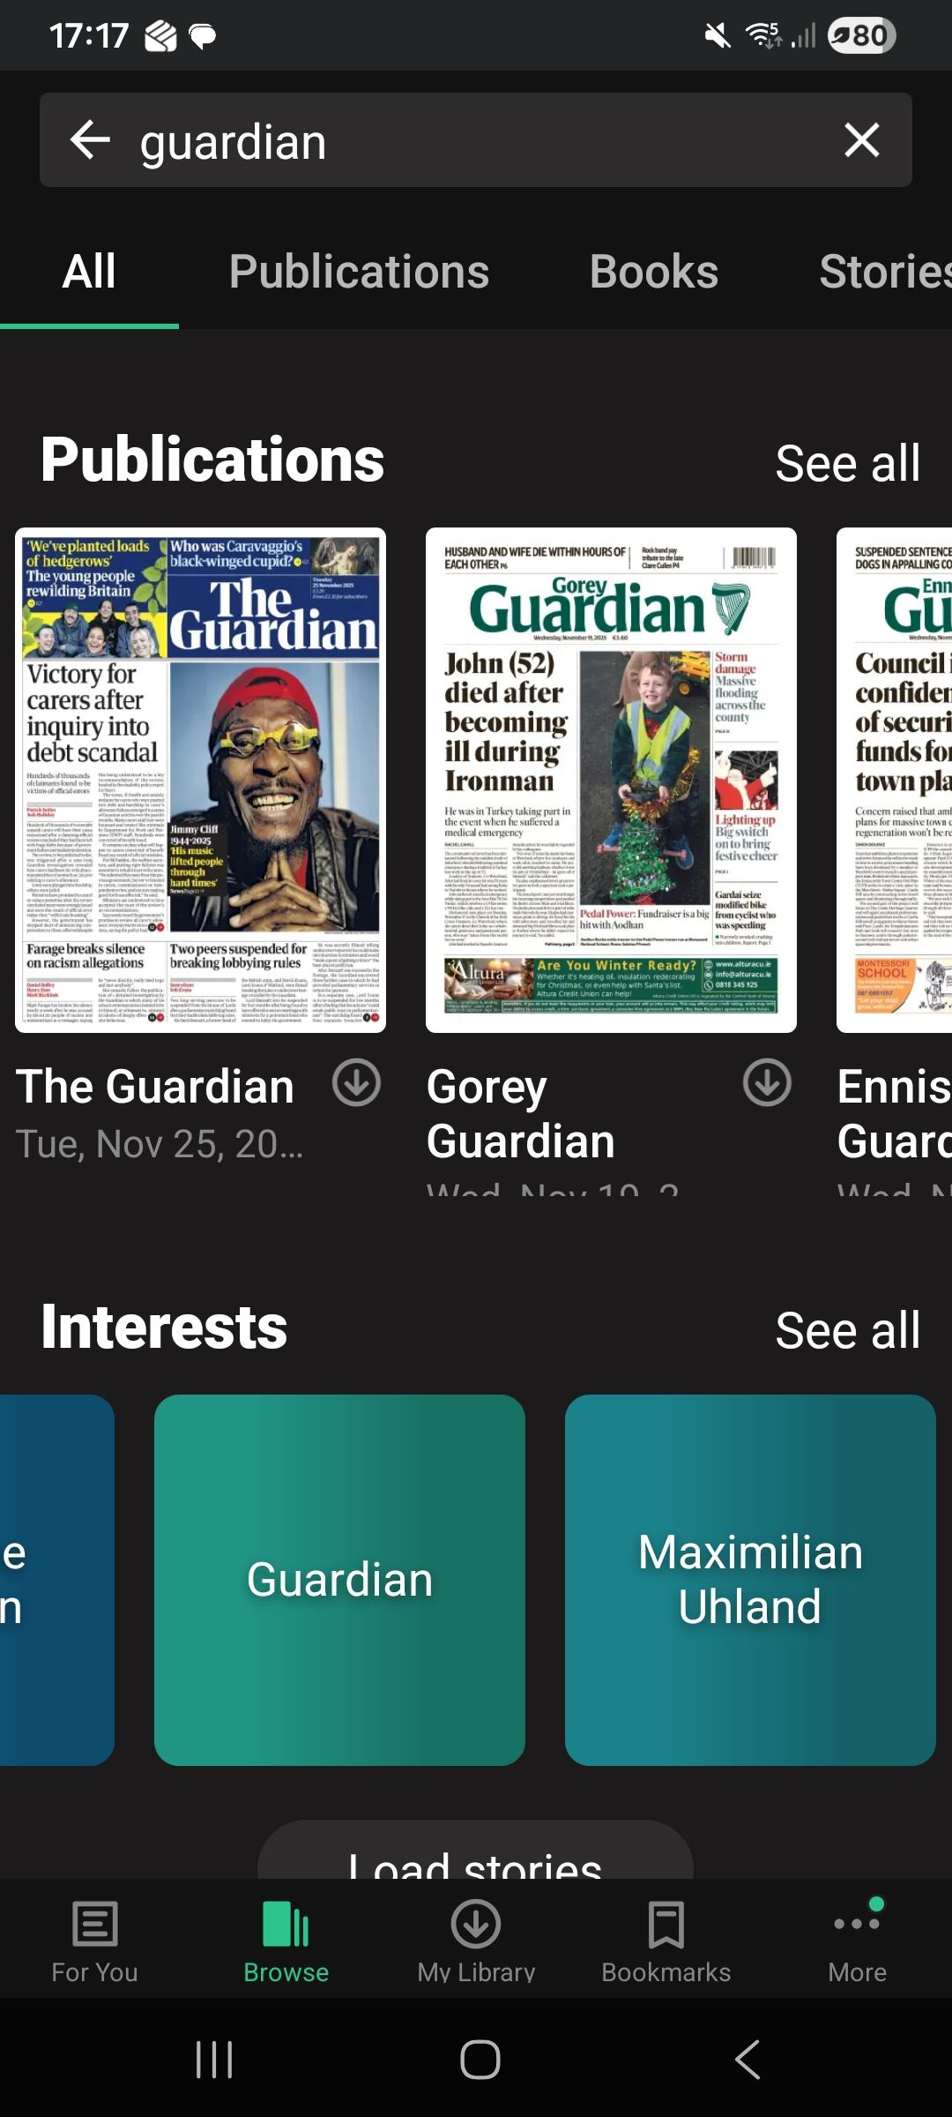
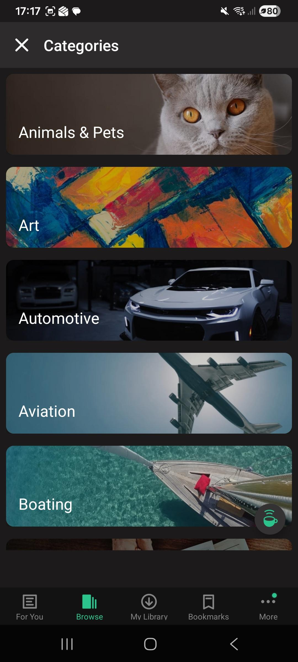
Main features
Notes:
Once downloaded the App, sign in, you will enter the EUI PressReader room
Search the Title you are interested in
Browse by Category
Browse by publications type, language…Country

Slide 31
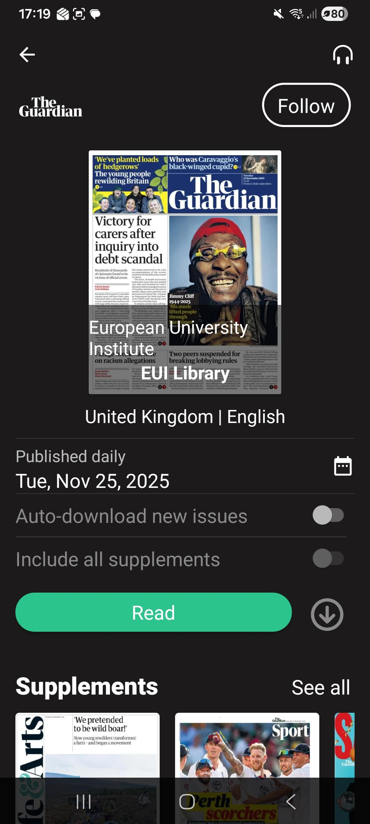
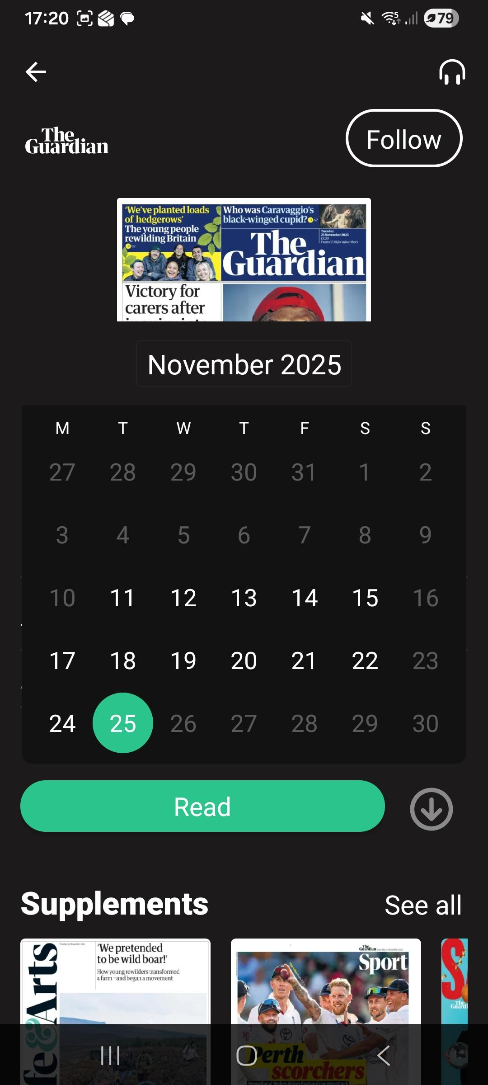
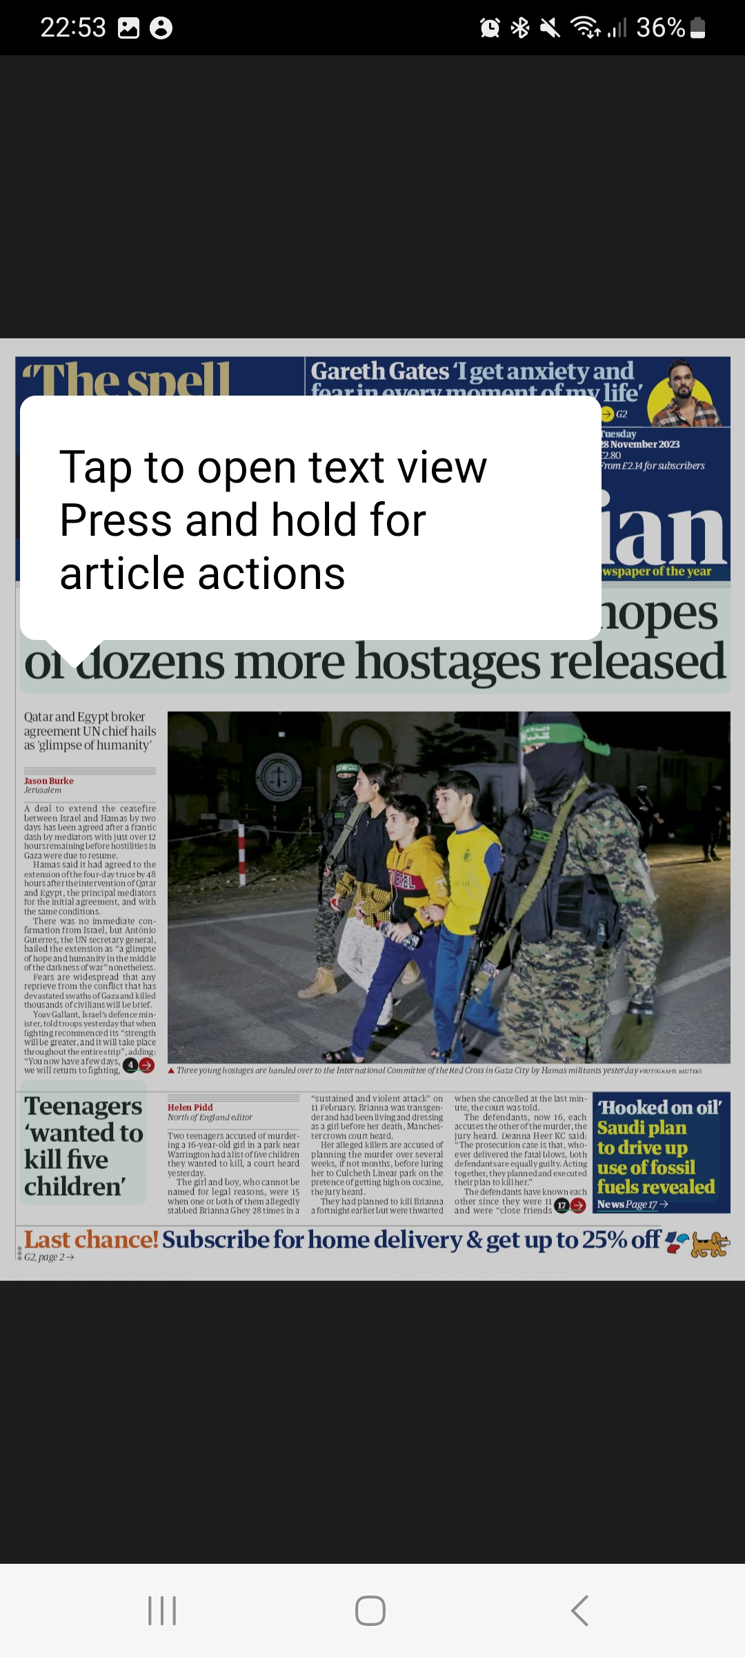
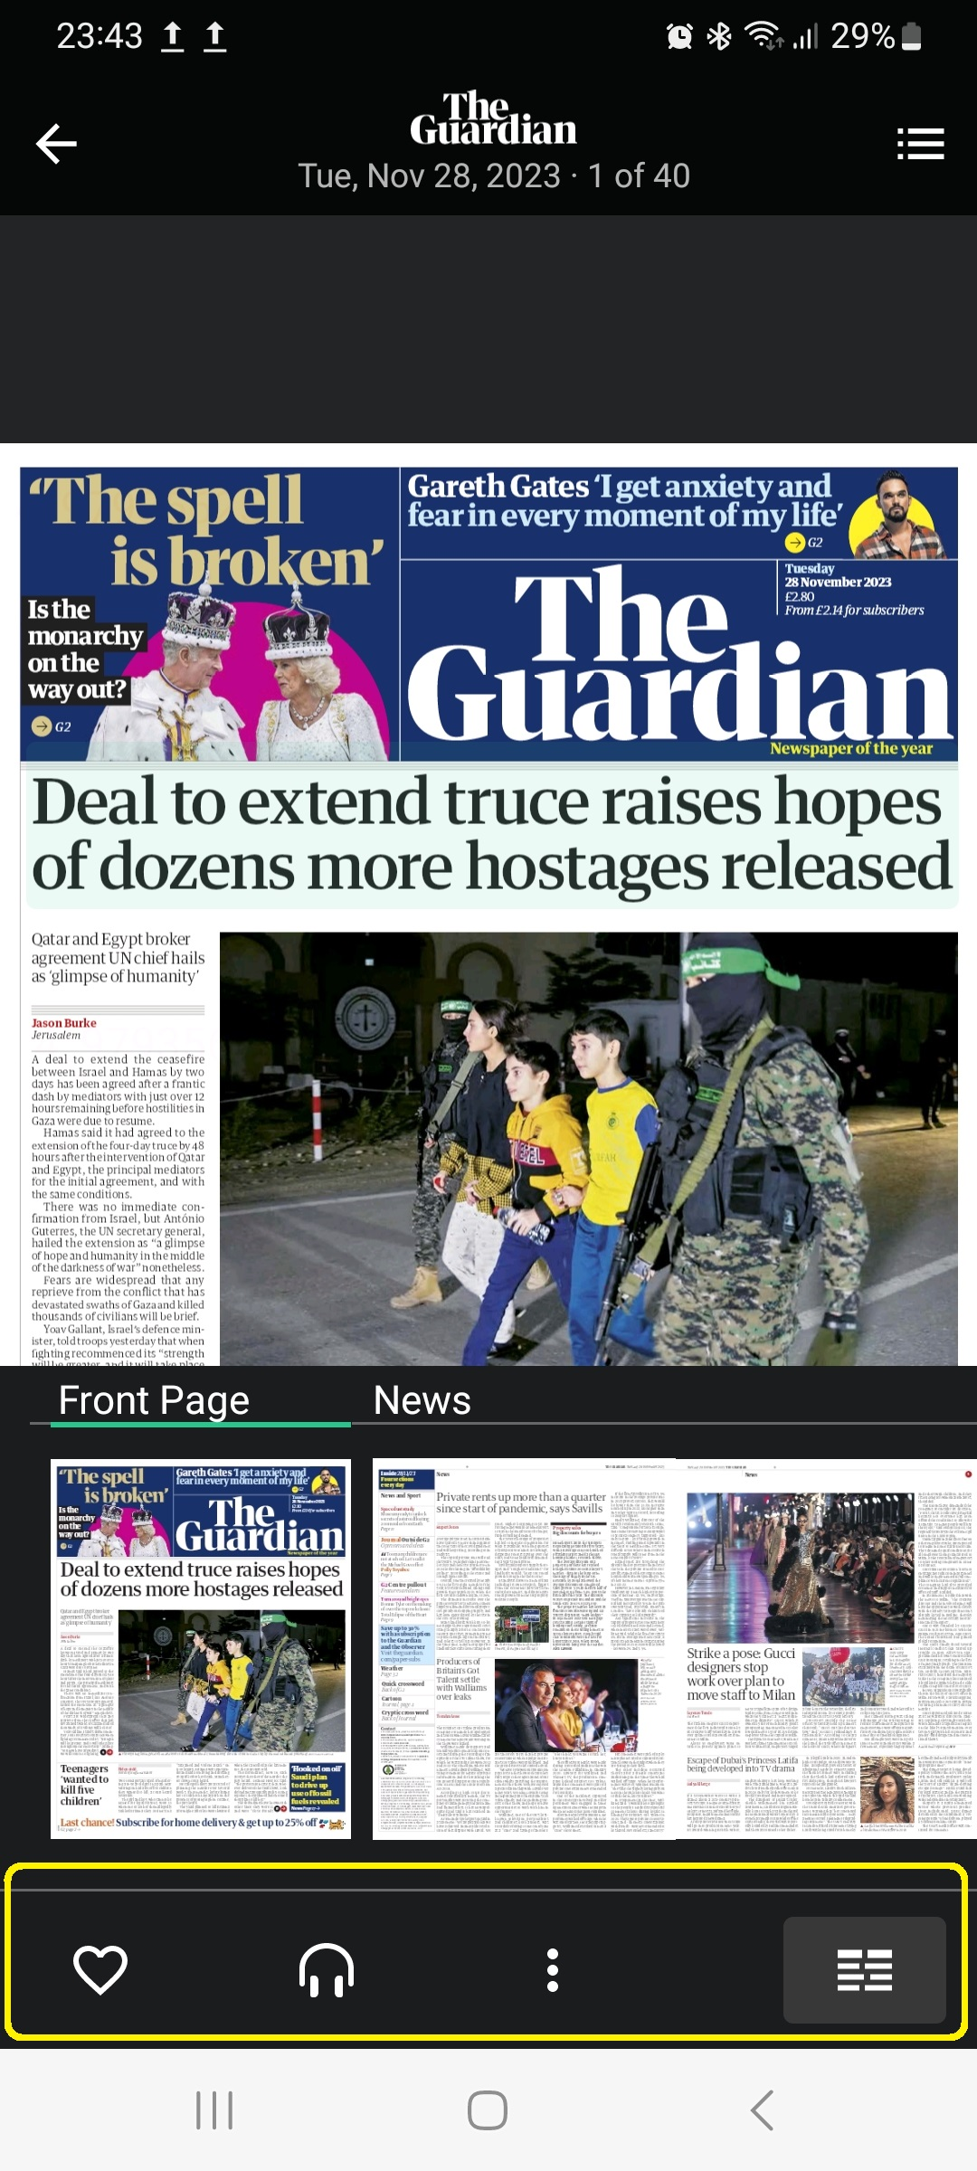
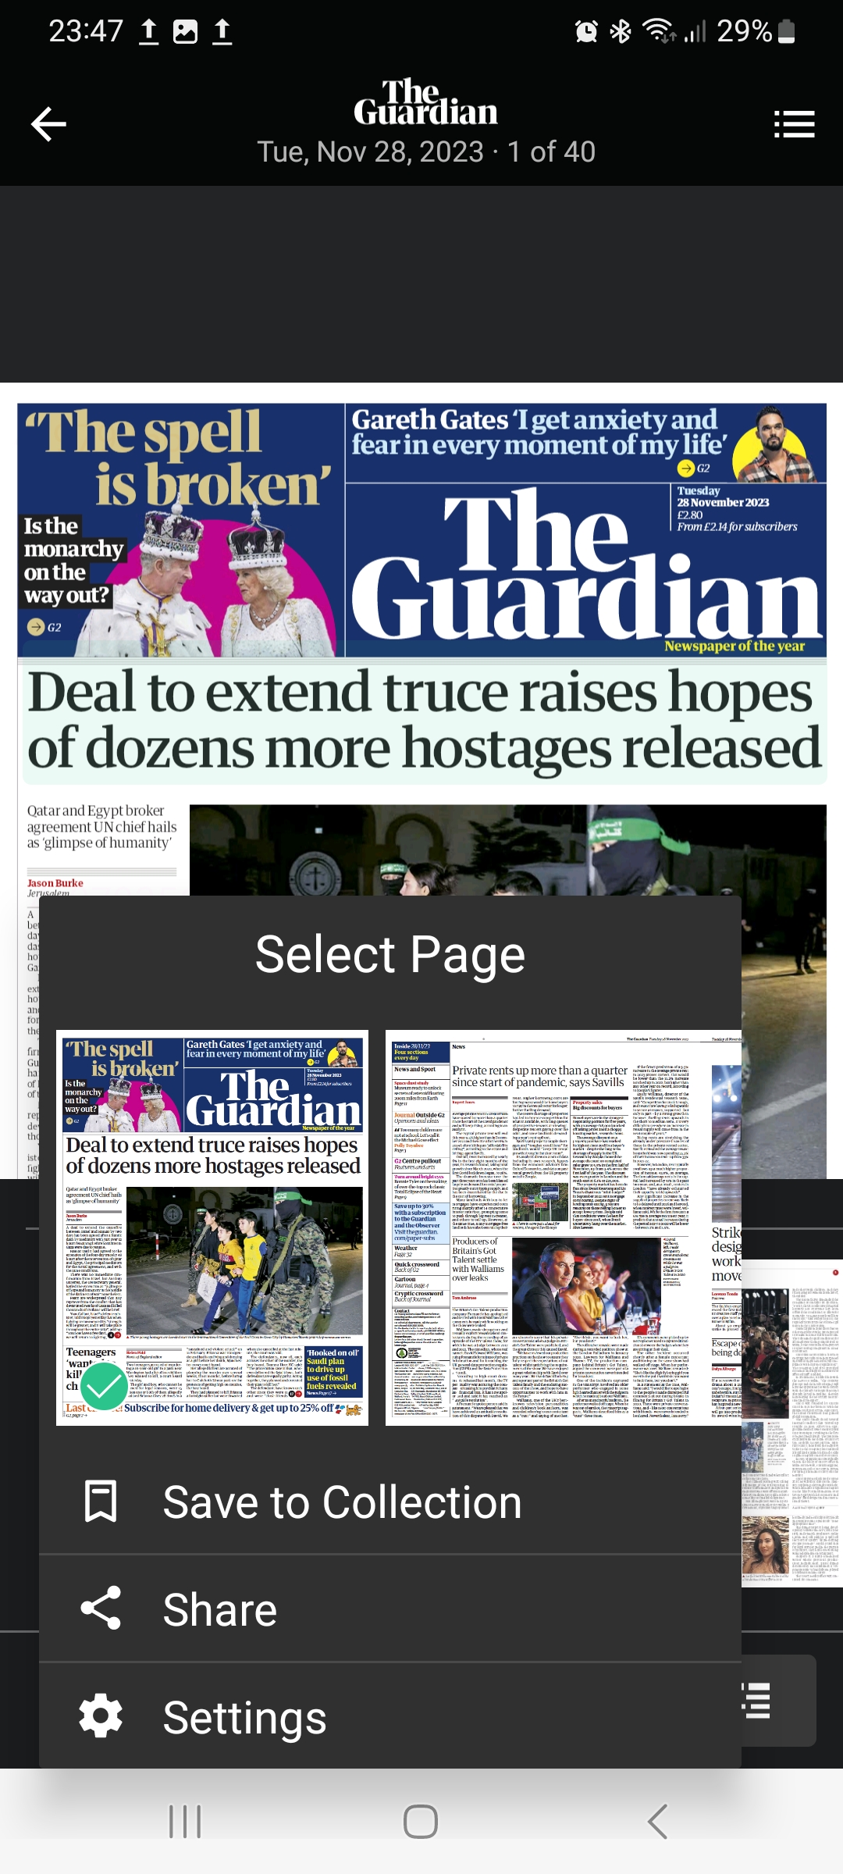
Main features
Notes:
Daily issue
Browse back the calendar to access previous issues, 90 days explained by Thomas
Enter an article
Zoom on it
Settings: Smart zoom, Full screen, highlights in full screen, Postpone sleep
Share: email, whatsApp, Instagram, Bluetooth...

Slide 32
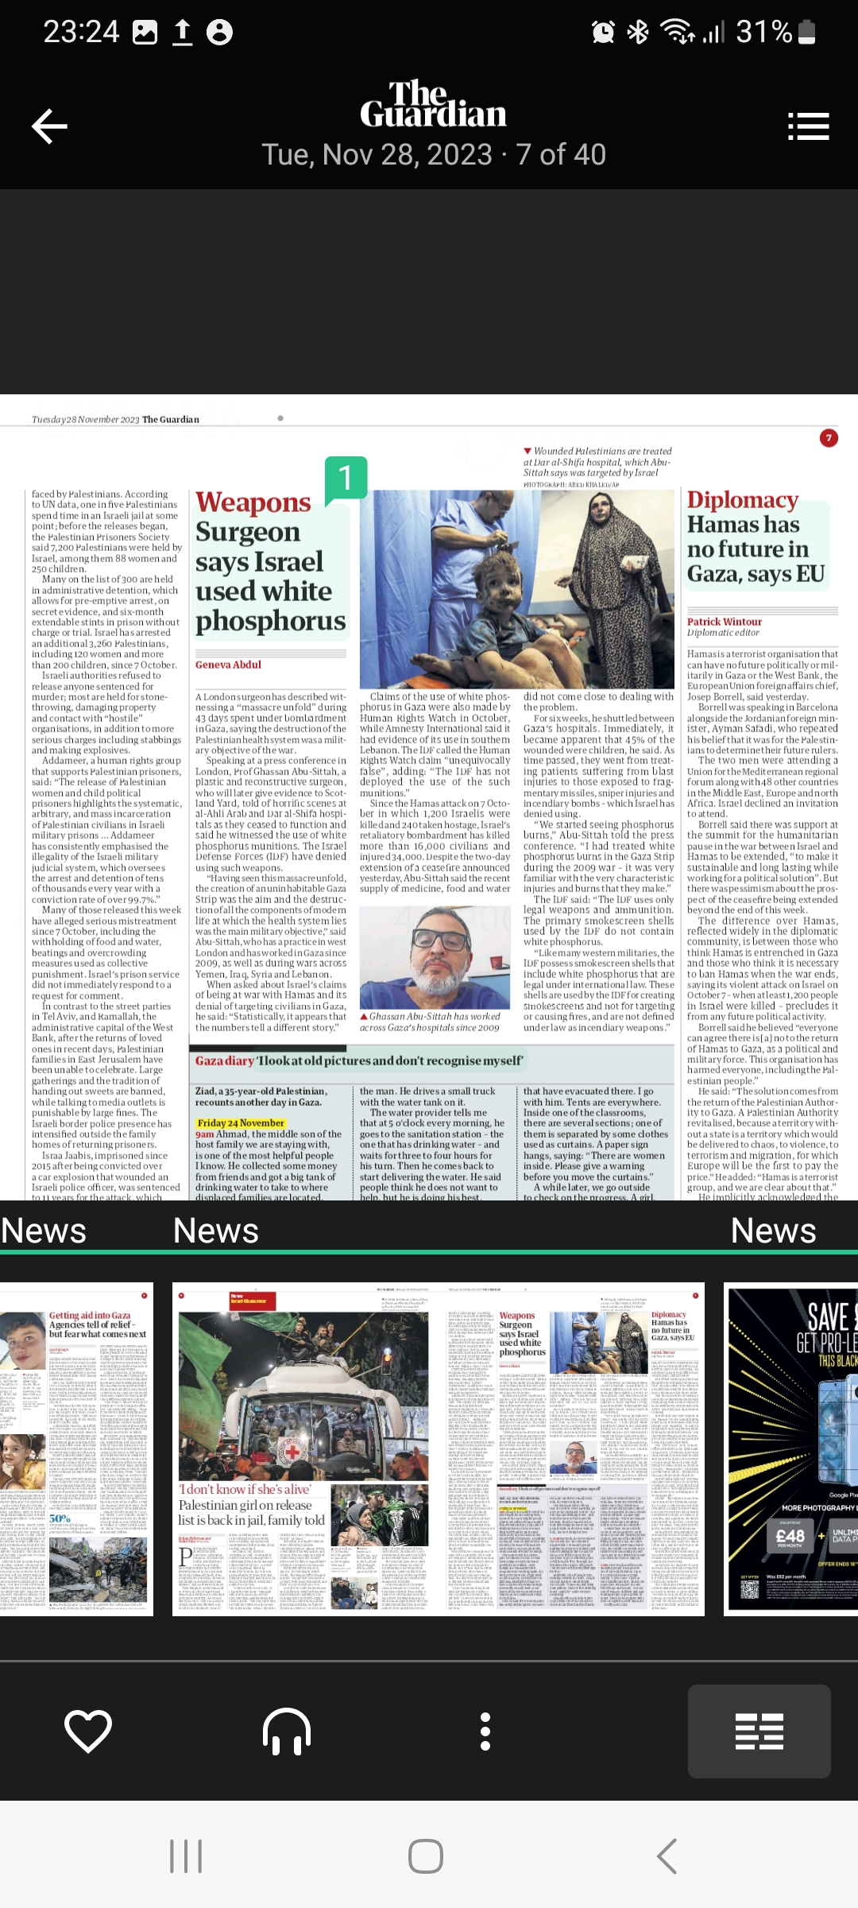
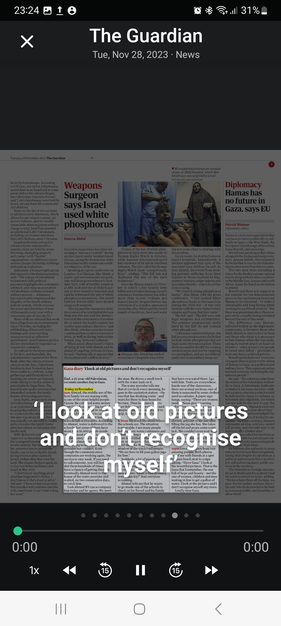
Main features
Notes:
A familiar voice. Less data.
PressReader now offers the option to use your own device's speech engine to read articles out loud. Just open the app, download your favorite newspaper or magazine, and enable Text-to-Speech. When you tap Listen to start your session, you'll be able to use the arrows to skip ahead in the issue, or back to the previous article at any time. The radio mode in PressReader will instantly acquire all of the audio preferences from your device.

Slide 33
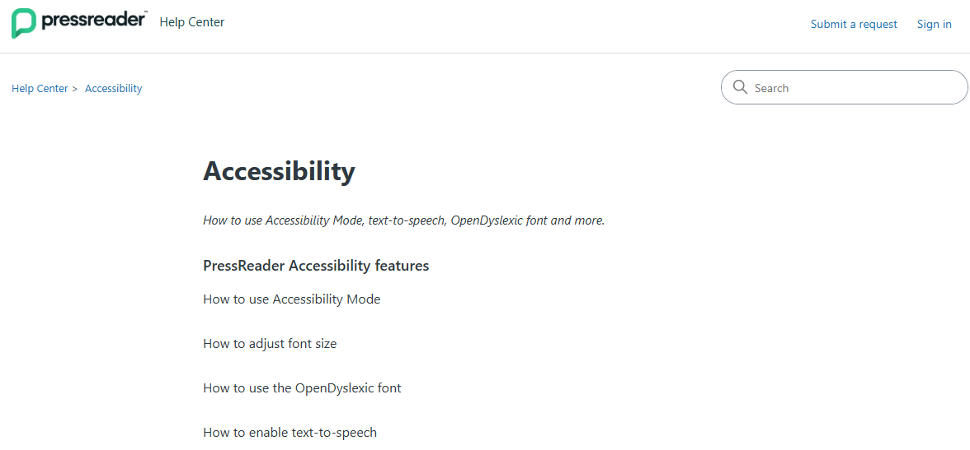
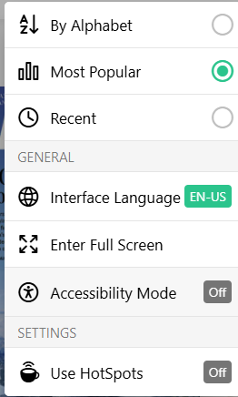
Accessibility
https://help.pressreader.com/hc/en-us/categories/39734268278548-Accessibility
Notes:
Accessibility Mode provides enhanced reading features including keyboard navigation and screen reader compatibility. ”Currently only available on desktop and not in PressReader app.
Font size: When reading articles on PressReader, you can adjust the font size to make the text more comfortable for your eyes.
OpenDyslexic font is an open-source font created to support readers with dyslexia. It can be enabled
The text-to-speech feature reads content on PressReader out loud for you to listen to. You can enable text-to-speech (or “Listen” mode) from “Text View” or “Page View.”

Slide 34

Financial Times
Access FT via the Catalogue link
Create an account associated with your @eui.eu email
The first login to the App can be done from anywhere
This Photo by Unknown Author is licensed under CC BY-SA

Slide 35
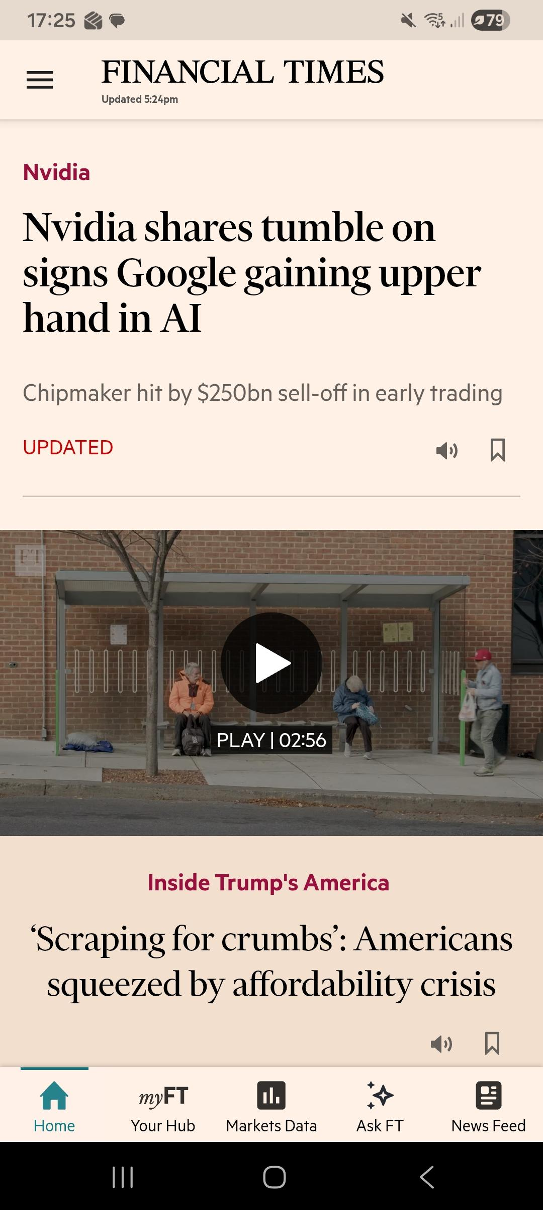
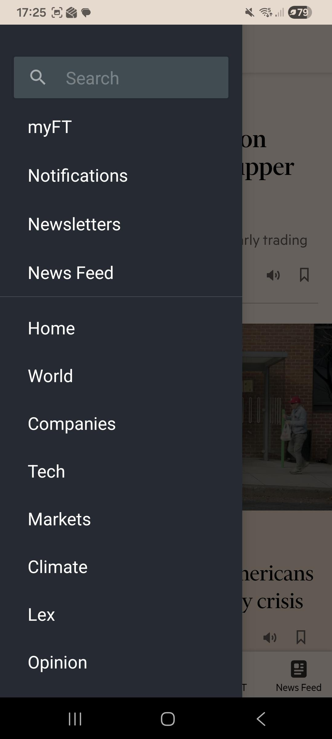
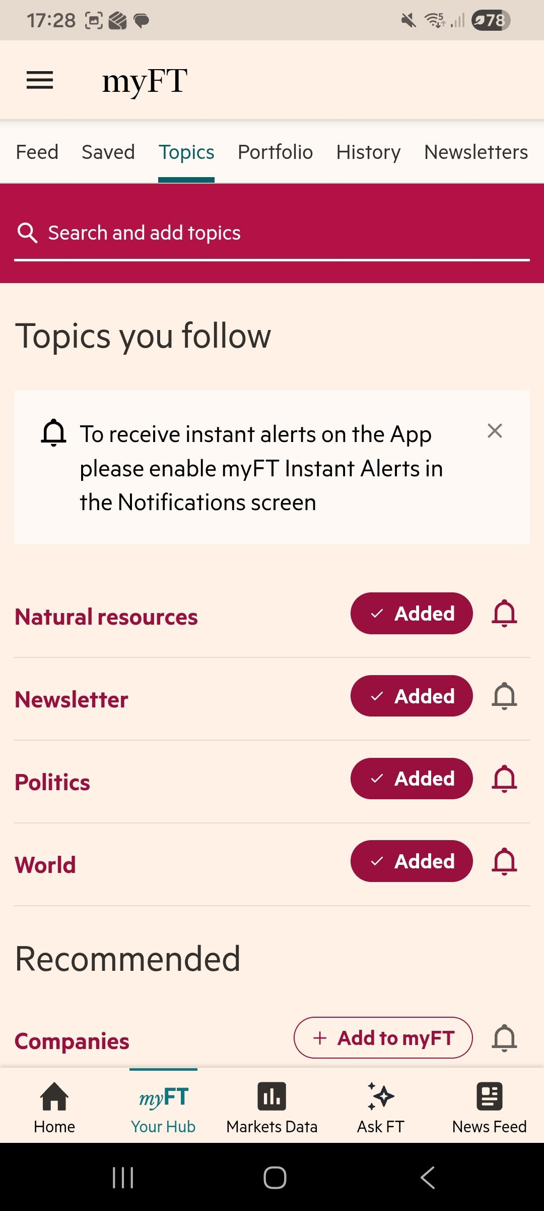
This Photo by Unknown Author is licensed under CC BY-SA

Slide 36
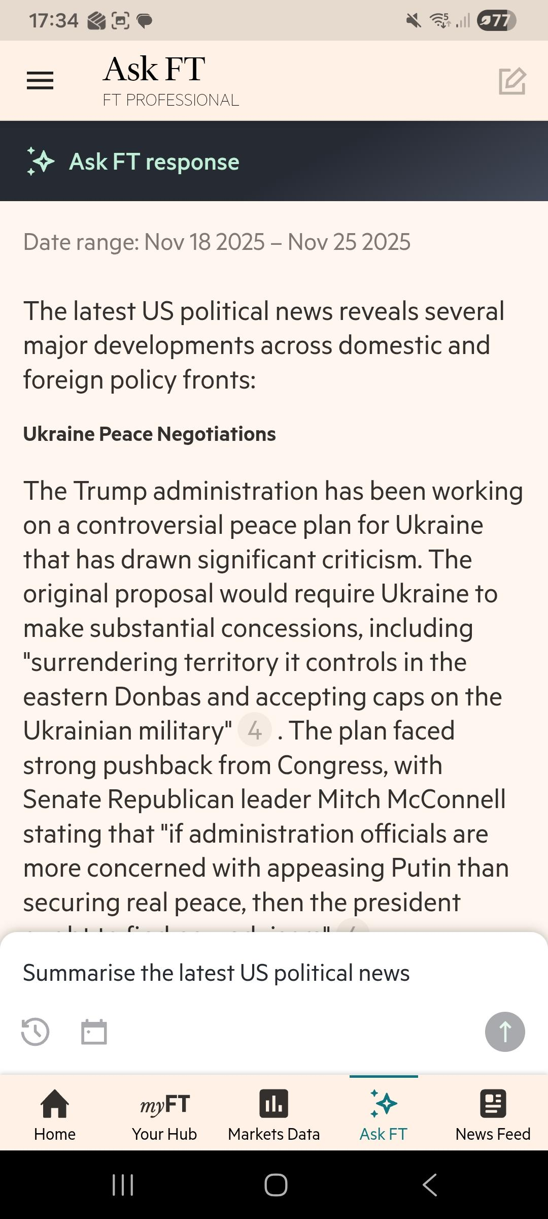
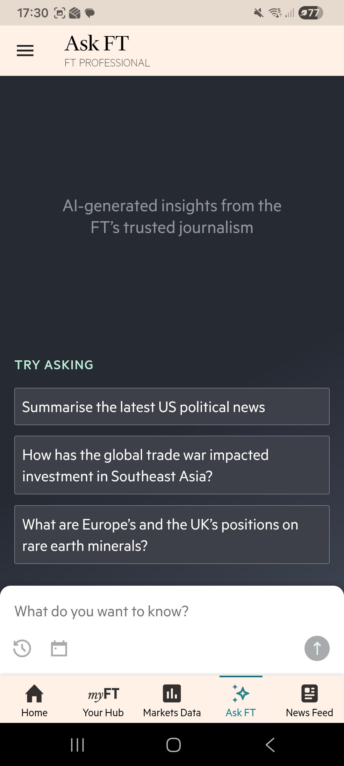
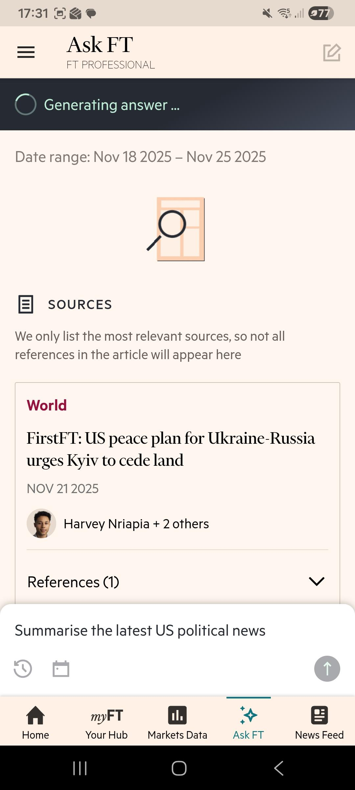
This Photo by Unknown Author is licensed under CC BY-SA

Slide 37
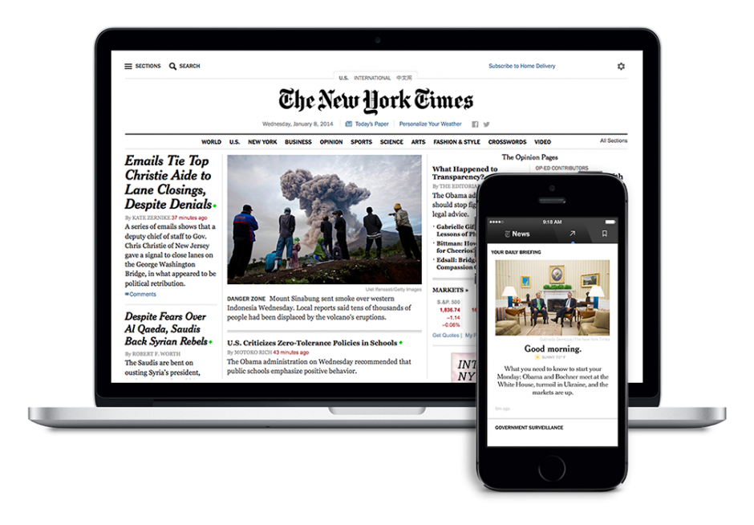
New York Times
Register to connect to NYT International via Catalogue link
Use the same credentials to set up the App
The first login to the App can be done from anywhere
With NYTimes.com Passes users have full access to the extensive breaking news, world news, and multimedia of The New York Times. On & off campus access, plus smartphone/mobile and Tablet NYT Apps is provided.

Slide 38
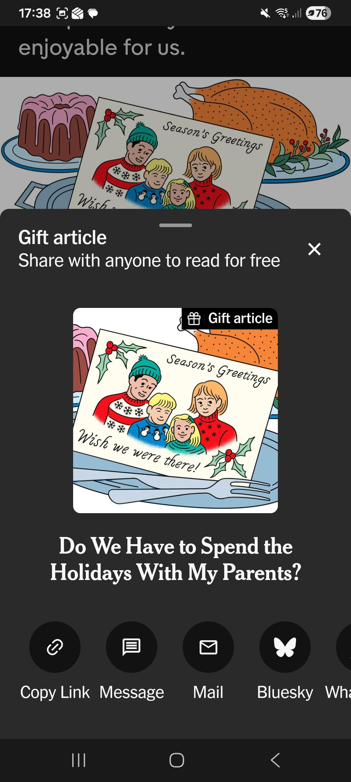
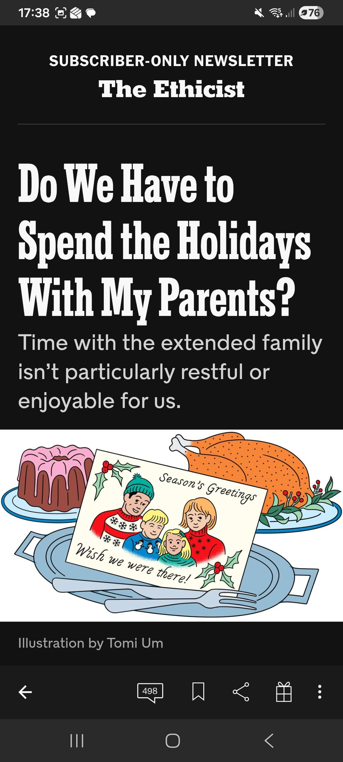
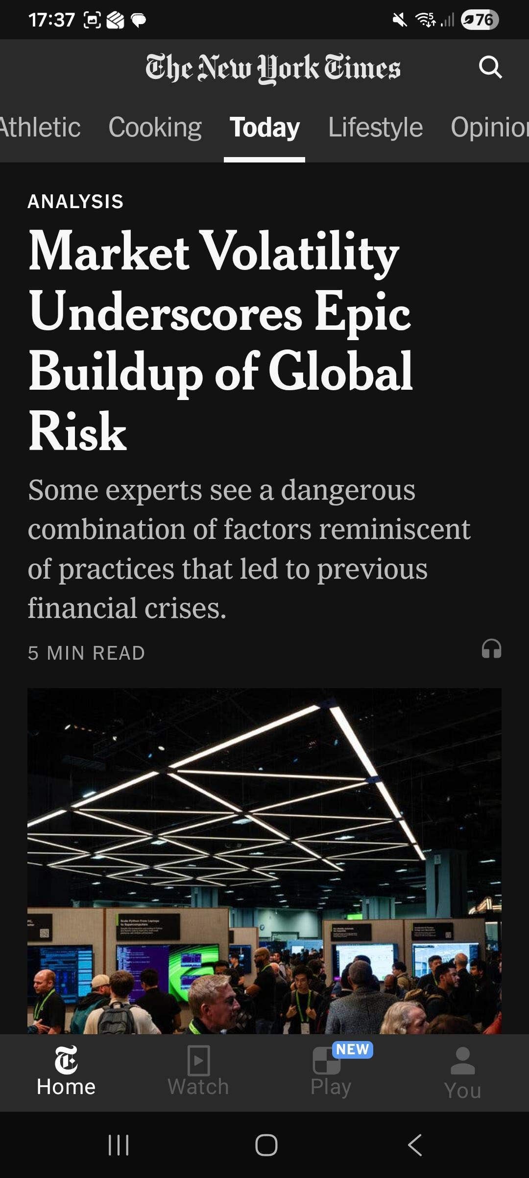
New York Times
Notes:
Very straight forward
Nice 10 gift articles option

Slide 39

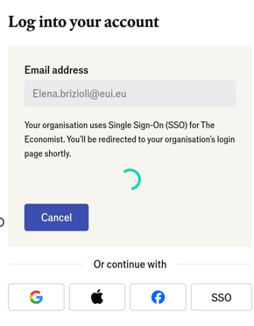
To register:
  Go to https://www.economist.com/
  Enter your @eui.eu email account
  WAIT (without entering any password)
  You will be asked to authenticate with your EUI credentials (first time only)
Future access: automatic redirect to the Economist homepage
Download the App on your phone or tablet and enter with your @eui.eu credentials
The first login to the App can be done from anywhere
Notes:
The Economist is the only one which is using the SSO

Slide 40

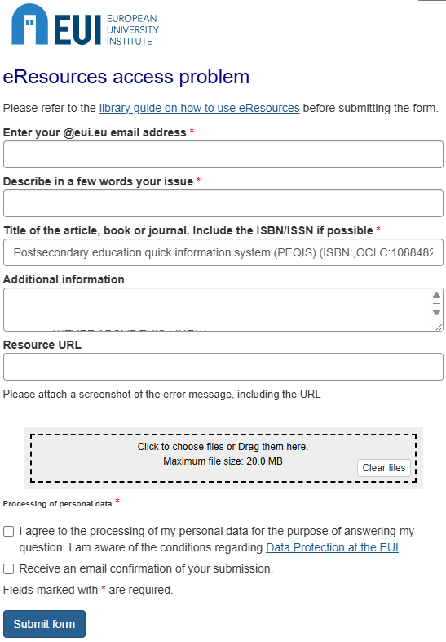
Use the REPORT AN ACCESS PROBLEM link to contact us for any problems you may encounter accessing Library electronic resources
Any issues accessing eResources?

Slide 41

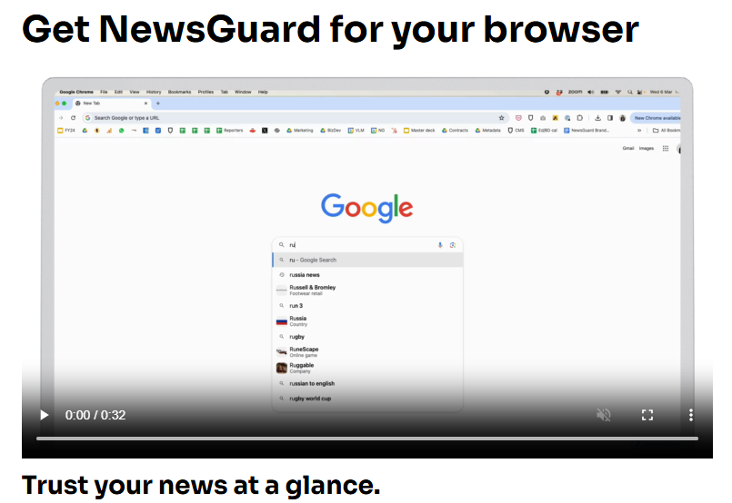
NewsGuard
Browser extension available for EUI users on campus only.
Extensions available for any browser.!
https://www.newsguardtech.com/how-it-works/
Notes:
https://biblio.eui.eu/permalink/39EUI_INST/138qr/alma991005135846608406
EUI users have access to the NewsGuard browser extension which gives access to the Reliability Ratings. Install NewsGuard to see ratings as you browse news on social platforms, search engines, or websites.
Misinformation Fingerprints is with individual accounts only. It needs to be requested and is for limited number of users. NB! Fingerprints data only allowed access for EUI research projects. Users need to give description of use of data, justifying need to access, which we need to transmit to NewsGuard when asking to create account.
https://www.newsguardtech.com/how-it-works/

Slide 42
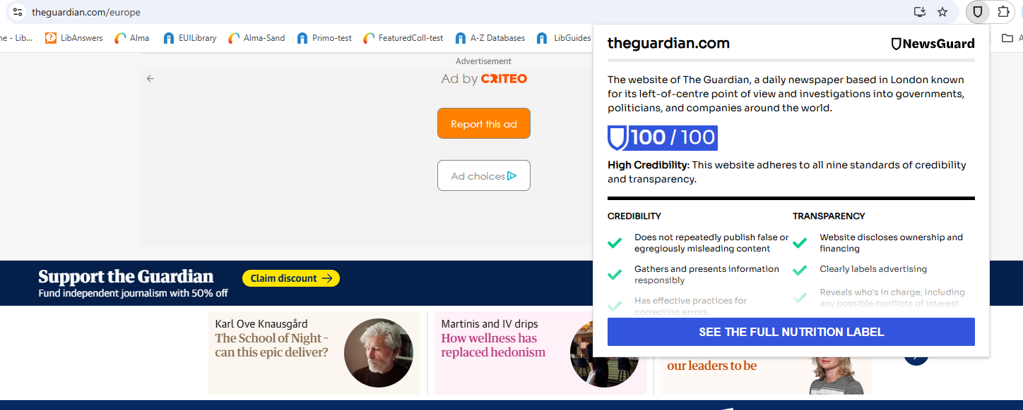
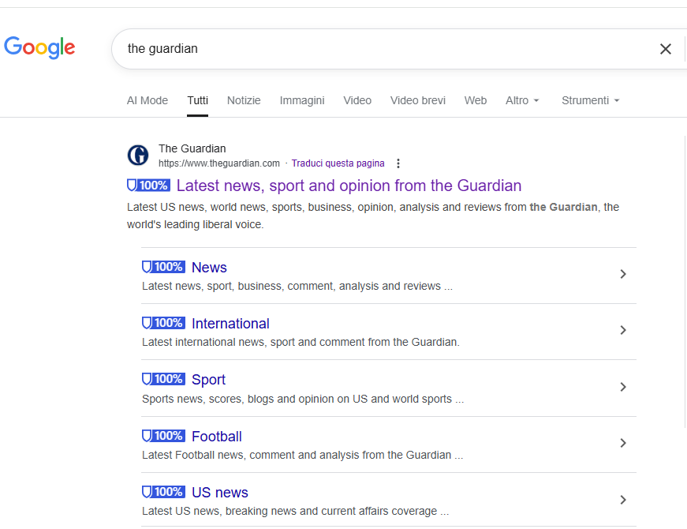
Notes:
Browser extension
Results available at search level

Slide 43


Slide 44

Notes:
MEDIA INTELLIGENCE>>Misinformation Fingerprints is with individual accounts only. It needs to be requested and is for limited number of users. NB! Fingerprints data only allowed access for EUI research projects. Users need to give description of use of data, justifying need to access, which we need to transmit to NewsGuard when asking to create account.

Slide 45

Early Stage Researcher resource funding

Slide 46
EUI Library News Resources
Thomas.Bourke@EUI.eu
Elena.Brizioli@EUI.eu
Federica.Signoriello@EUI.eu
26 November 2025

