Slide 1



Publishing Your First Book
11 December 2024
thomas.bourke@eui.eu

Slide 2


Frankfurter Buchmesse 2024

Slide 3


Slide 4



Slide 5

Frankfurt Fair 2024
Publishers / Authors / Editors / Translators / Agents / Rights agents &c.
4,300 companies
115,000 trade visitors from 153 countries
100,000+ general visitors
3,300 events
7,500 media accreditations
16–20 October 2024
Academic & Science publishers

Slide 6

University Presses
Specialist, academic & research publishers
Trade publishers

Slide 7


Slide 8

Thesis completion
Completed manuscript
Seek advice of supervisor and examiners
Book ask about potential publishers
Article WPs
Data reposit with a DOI

Slide 9




Slide 10
Thesis
PhD thesis is designed to pass an examination: “Discussion of the doctoral thesis before the Examining Board”
Thesis “… should reveal the ability to formulate a problem or research question, analyse and interpret information, demonstrate knowledge of the literature relating to the subject, describe the methods and procedures used, report the results, and display the researcher’s ability to discuss fully and coherently the meaning of the outcome of his/her research.” [9.1]
“…Alternatively, a series of papers, with an introduction, critical discussion and conclusion, may be submitted instead of a conventional thesis provided that such a format is permitted by the guidelines issued by the researcher’s department… The part played by the candidate in any work done jointly with the supervisor(s) and/or fellow researchers must be clearly stated.” [9.1]
“At all stages of its production, the thesis shall remain the intellectual property of the researcher.” [9.2]

Slide 11
Book
The potential readership for a book will be wider and less expert
Most books are commercial products, requiring investment by publishing companies
Content, style and structure important

Slide 12


Thesis versus book

Slide 13
Languages
                Translation
Macroeconomics | Microeconomics | Econometrics | Statistical theory
Political theory | Sociology | Int’l relations | National politics
Jurisprudence | EU law | Public int’l law | National law
Historiography | Global history | Cultural history | National history

Slide 14
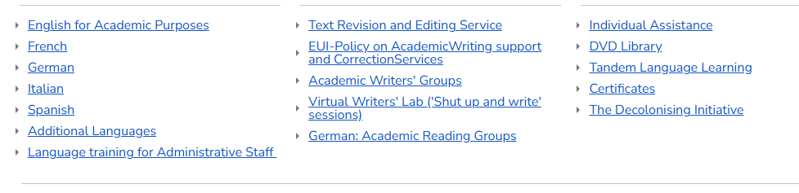
Centre for Academic Literacies and Languages

Slide 15
Publishing sector
University Presses
Academic and specialist publishers
Trade publishers

Slide 16













University Presses

Slide 17















Academic and specialist publishers

Slide 18







Trade publishers

Slide 19


Imprints
Lagardère Group

Slide 20
Deciding which publishers to approach
Speak to Supervisor and jurors
NYRB, LRB, Sole 24 Ore (Domenica)
Check Library Catalogue / Amazon / Bookshops
Check Cadmus > sort by discipline > published theses
There is ‘cross-over’ in these categories
    University Presses
    Academic and specialist publishers
    Trade publishers

Slide 21
Simultaneous submissions
Acceptable to send a short proposal to multiple publishers asking if they are interested in receiving a full proposal
Most commissioning editors assume simultaneous preliminary proposals
Not acceptable to send a full proposal to multiple publishers expecting them to start the reader evaluation process
If acting on a recommendation – avoid simultaneous submissions
Always check submission guidelines.

Slide 22
Contacting publishers
Check publishers’ web sites
Locate the editor’s email address, or the generic submissions’ email
  Sometimes a series editor
Usually addressed to a Commissioning Editor / Submissions Editor
Contact one person at the publishing house / one imprint / one office of a publisher
Approach should be tailored for different publishers.

Slide 23
Submission package (proposal package)
When Commissioning Editor requests more information
Send concise email with one Word attachment:
    Letter: 1–1½ pp – including the book’s working title
    Author biography, in style of blurb (but slightly longer)
    One-page CV
    Project description
    Chapter synopses
    Writing sample.

Slide 24
Proposal to commissioning editor
Describe the expected reading public
Explain how book will attract readers
Present a clear, central argument and theme
Emphasise ‘real-world’ implications, if possible
Don’t over-emphasise current trends
Don’t include too much theory and methodology
State contribution to existing literature
List some comparable titles, to help position the book.

Slide 25
Project description (3–4pp)
State the book’s central proposition (‘hook’) and conclusions
  The 20-minute viva voce opening statement can be the basis, and revised
The general structure and arc of the book
The discipline and sub-discipline
The market segment
Originality and contribution
Discuss how the argument contributes to scholarly debates and ‘public intellectual’ conversation
The evidence and methods you used to build the book’s argument
Target audience
Provide project status and timeline to completion of book MS.

Slide 26
Chapter summaries (3–4 pp)
Table of contents
  (Re)consider the MS. table of contents and change chapter order if necessary
Chapter summaries.

Slide 27
Writing sample
A key chapter
Probably not introduction
  The contents of the introduction will likely be included in the project description

Slide 28
While waiting for response
Reconsider structure of thesis
Rephrase difficult technical / disciplinal terminology
Reduce discursive treatments of other scholarship
Reconsider writing style.

Slide 29
Invitation to submit MS.
Check the publisher’s submission guidelines
Provide the commissioning editor with word count including notes and appendices (not number of pages)
Social sciences word length 65,000-75,000 | Humanities can be c.100,000
List tables, maps, graphs, illustrations
Provide details of previously published text. Indicate copyright clearance
  Book publishers indicate not normally more than approx. 20% – varying by discipline
Open access theses generally not a problem.

Slide 30
Publishers’ criteria
Is the book a good ‘fit’ for the publisher’s current list?
What is the extent of the potential market?
Does it fit a publisher’s series?
Is the proposal convincing?
What is the reputation of the institution?
Are there good examiner reports?

Slide 31
Reader reports
Commissioning editor usually sends proposal to external readers for evaluation
Some publishers have in-house committees and faculty boards
Commissioning editor may request PhD MS to send to for evaluation
Author can suggest the categories of readers who might be suitable
  eg. multi-disciplinary, or independent scholars.
Even if reports are positive – author will be expected to address suggestions.

Slide 32
Contract
Most boiler-plate (‘standard’) publishers’ contracts can be negotiated
Read contract carefully. There may be a provisional (or ‘option’) contract – pending approval of final MS.
Enquire about division of costs and division of labour
  Indexing
  Copy editing
  Who obtains permission to (re)publish any copyrighted material (eg. from a journal publisher)
  These services are frequently deducted from royalties
Advances are rare
Ask if an advance is available for MS-related development, eg: infographics, data visualisation, illustrator, cartographer, external development editor &c.

Slide 33
Contract II
Provide estimated date of full MS. delivery
Publisher normally retains final decision on title and cover
Ask about royalty rates for hbk. and pbk.
Ask about translation territories and royalties
Retail price usually not negotiable
Open access contribution (if applicable).

Slide 34
Manuscript delivery and production
After commitment from a publisher there are months of work to refine the MS.
Once the MS is approved, the publisher will provide instructions on format, including how to submit tables, graphs, images &c.
Some secondary material may fall under the fair use/research provisions of copyright law; seek advice
Large publishing houses have production editors to liaise with copy editors, typesetters, and designers
Check proofs carefully (including acknowledgements, preface &c.)
Time to publication: at least 18 months after submission of book MS.

Slide 35
Marketing
Author questionnaire (internal)
Copy that will appear on the back cover and flaps of the book, and in the publisher’s web catalogue, and online book retailers’ sites (public)
Summaries (50-word; 100-word; 500 word) and, possibly, key-terms and bullet-points for social media
Look at books in the Library (eg. flap-copy) and visit bookshops
Provide names of people who could write blurb
Suggest journals for review
Some publishers ask for concise narrative about the origins and gestation of the work
Offer to present. Suggest venues
Colleagues at other universities (your ex-cohort) might invite you to speak about your work
Web site of faculty and/or author’s web site
Write a journalistic article or op-ed or blog post from a side ‘angle’ – not a synopsis of the book
Contact the Communications Service at the EUI
Contact the Library.

Slide 36
Print and electronic
Contracts cover both printed books and ebooks
Almost never an opt-out from electronic version
eBooks important for sales to libraries
Kindle versions
Print-on-demand
Derivative works.

Slide 37
Open access eBooks
Book Processing Charges (BPCs) not covered by current agreements (Journals included)
Growth of OA eBooks is expected.
CEU Press
MIT Press
UCL Press
Open Book Publishers
HathiTrust
OAPEN

Slide 38

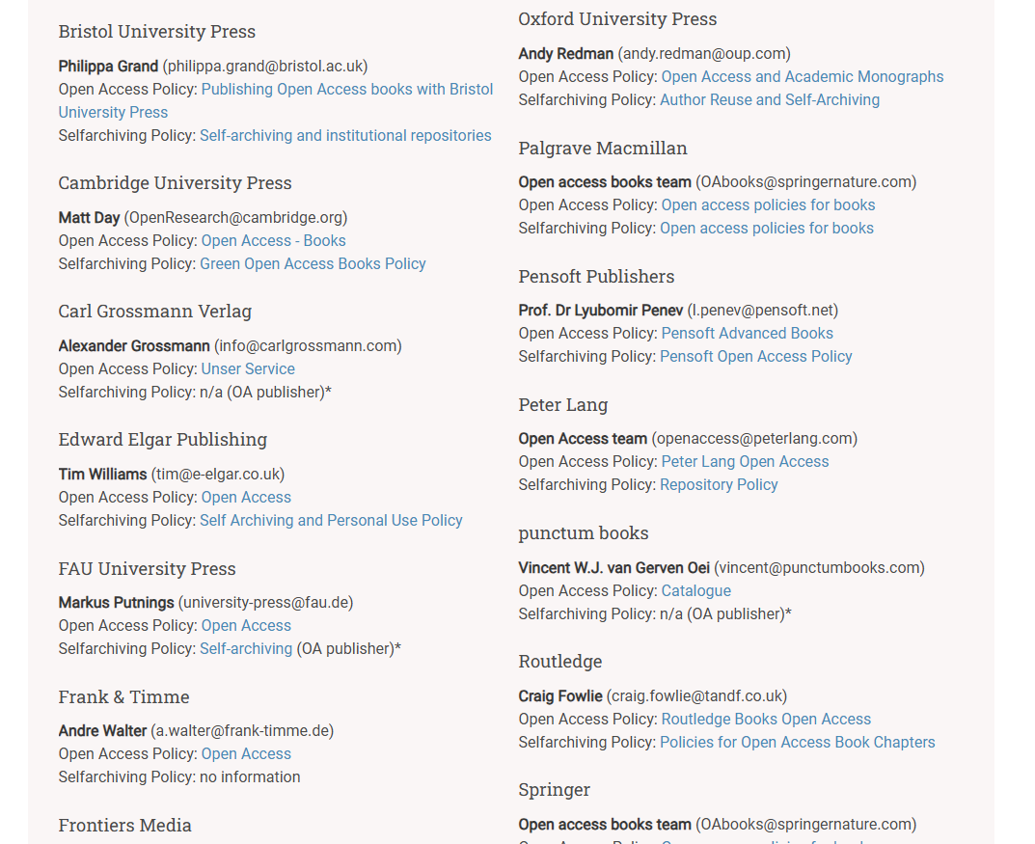

Slide 39
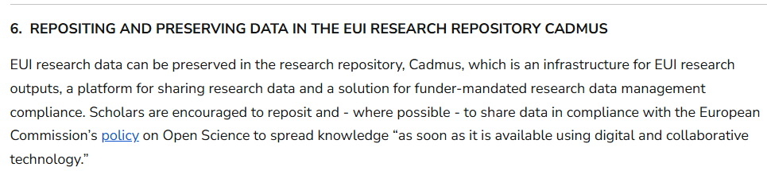
Preserve supporting data & Link to DOI

Slide 40
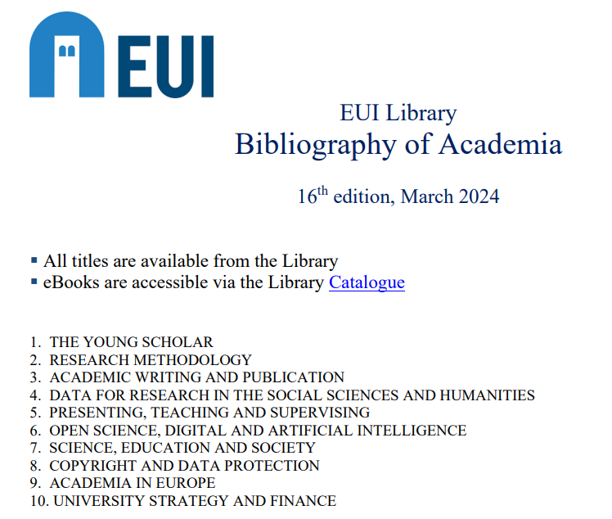

Slide 41

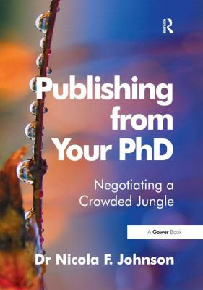
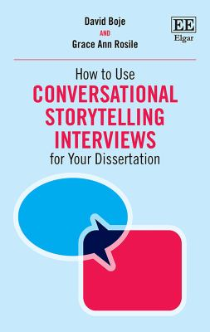




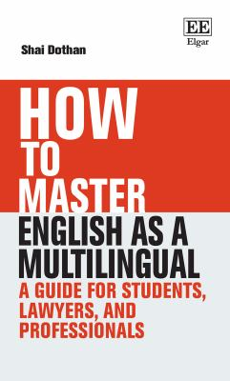
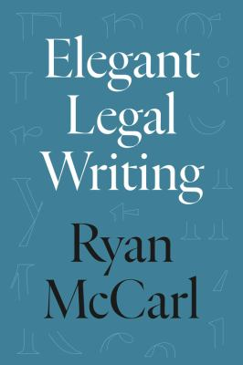



Slide 42
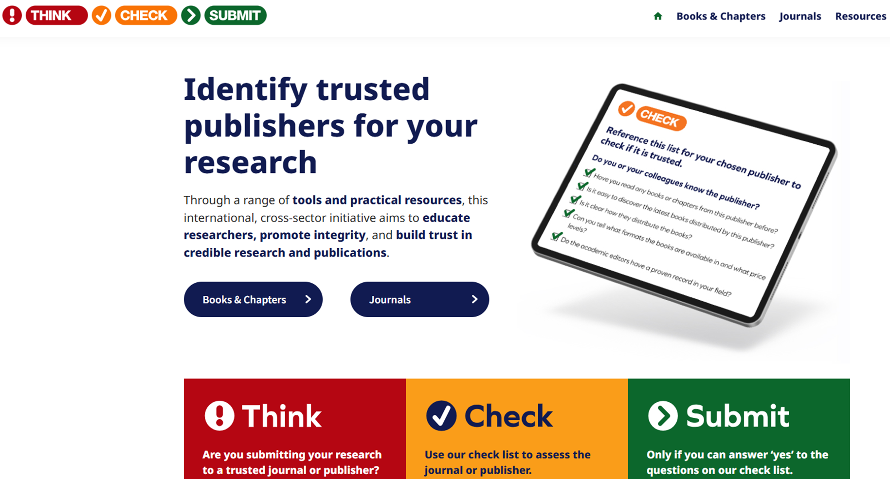

Slide 43
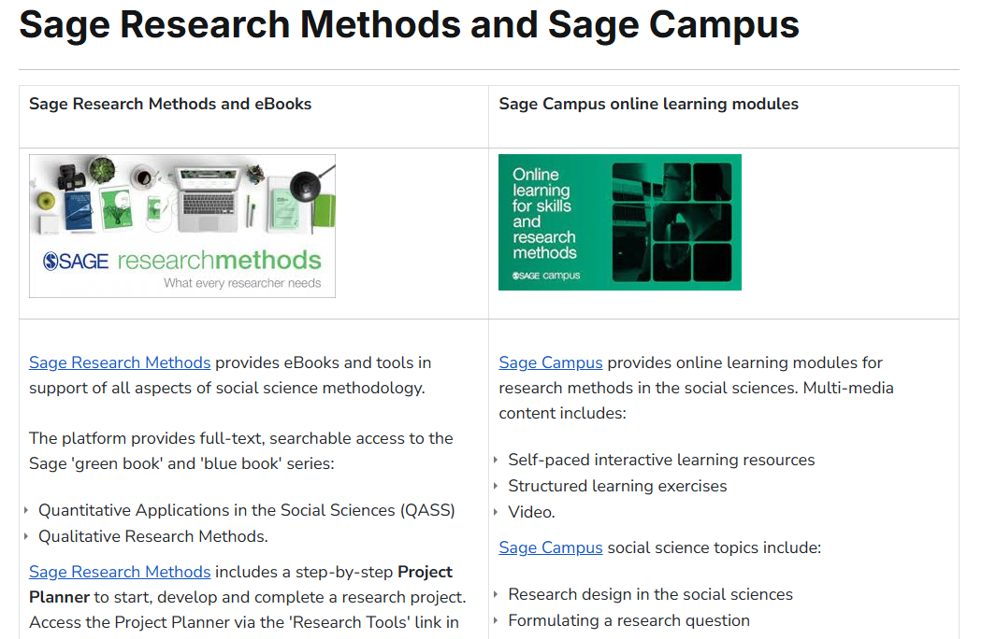

Slide 44



Join an author’s society in your country or language group

Slide 45
Publishing Your First Book
11 December 2024
thomas.bourke@eui.eu

