Slide 1
Title
The labour market in higher education in the Netherlands
Herman van de Werfhorst (SPS)

Slide 2
The Dutch landscape
15 universities (research universities).
6 broad universities (UvA, VU, RUG, UL, UU, RUN)
3 technological universities (Eindhoven, Delft, Twente). Also with some soc sci.
3 more on humanities/law/soc sci/econ/life sciences: EUR, Maastricht, Tilburg
1 university focused on agriculture, development, also with social science (Wageningen)
1 University of Humanistic Studies
1 Open University
(some theological universities )
University colleges.
KNAW institutes
NWO institutes
Universities of Applied Science (HBO). (no PhD programme, mostly bachelors programmes in applied fields; teaching, nursing, IT, business, engineering, etc.).

Slide 3
One collective labour agreement for all universities
Standardized pay scales, career lines.
Teaching plus research:
Assistant professor: Universitair Docent UD. (level 2 or 1). Can be with tenure!
Associate professor: Universitair hoofddocent UHD (level 2 or 1).
Full professor: Hoogleraar HGL (level 2 or 1).
Teaching jobs become more common:
Docent 4, Docent 3, Docent 2, (Docent 1). Risky option if you want to go for an academic career as UD/UHD/HGL. Sometimes interesting combinations though, of Docent & Postdoc.
Research jobs: mostly temporary (postdoc)

Slide 4
The typical contract for tenure-track / tenured faculty
60/40: 60 % teaching, 40% research. (sometimes 70/30).
Teaching includes hours for lectures, preparation, examination, marking exams, etc. All very precisely specified.
Committee work often comes with ’hours’ and therefore reduce teaching time.
External funding can reduce teaching time.
External funding is interesting to scholar and to university.
NL is very successful in ERC’s, support system.

Slide 5
Career lines
Not uncommon to stay at the same place after PhD…
Postdocs mostly externally funded.
UD: typically open hirings
UHD: often promotions from pool of internal UD’s.
Professor: fixed number of chairs, there is no career policy in most places. Open hirings usually.

Slide 6
Recognition & Rewards policy
Away from impact factors, competition, number of publications.
Try to reduce precarious employment arrangements.
“Narrative”
Reward on four types of performance: research, teaching, outreach, service.
BKO: Basic Teaching Qualification will be demanded within the first year or two.
Tenure as Docent (without research)
Tenure clock very short (18 months!). But besides that ‘tenure track’ can still exist.
https://recognitionrewards.nl/

Slide 7
Debate about Dutch language use
Many programmes are in English, even at the bachelor level.
Steep increase in foreign students. Low tuition, good quality.
Concern about work pressure, limited options for Dutch students
”Wet Internationalisering in balans” (Law on a balance in internationalization).
If More than 2/3 of a programme is taught in language other than Dutch, Minister will test if needed.
Dutch language as part of curriculum in non-Dutch programmes
Numerus fixus on non-Dutch tracks separately.
Universities complain about the law but it may happen.

Slide 8
Veni, Vidi, Vici scheme (National funder: NWO, www.nwo.nl).
Veni: post PhD: 3-4 years, funding for own time
Vidi: 5 years, own time plus first research group (2-3 PhDs/PD). Typically UHD-level
Vici: 5 years, own time plus extended research group (3-5 PhDs / PD). Typically UHD/professor level.
You need ‘embedding’ at a university (department): but they may be willing to offer this to you. As external new Veni researcher, no tenure clock.
Somewhat similar to ERC starting, consolidator, advanced grants, but ERC StG seems usually a bit later in the career than Veni.

Slide 9
More and more earmarked funding…
NWA: Dutch Research Agenda
National Growth Fund
NRO (National Initiative for Education Research)
…

Slide 10
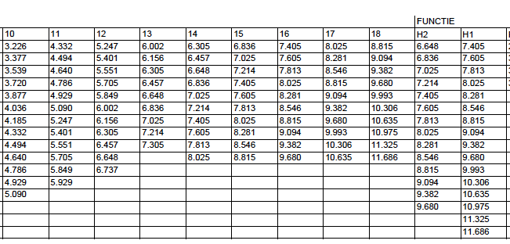
Salary scales (plus holiday money 8%, plus 13th month; total ~ 14 salaries)
UD2
UD1
UHD2
UHD1

