Slide 1
The EUI Counselling and
Wellbeing Service
September 5th 2019

Slide 2
Definition of Wellbeing
‘A state in which the individual realises his or her own abilities, can cope with the normal stresses of life, can work productively and fruitfully, and is able to make a contribution to his or her community.’
World Health Organization (2001)

Slide 3
Laying the foundations of wellbeing
Look after your body and see a Doctor when necessary
Think about your diet and don’t skip meals
Think about your alcohol consumption
Try to get the amount of sleep that makes you feel good
Do some sort of exercise everyday
Try to do at least one thing a day to make yourself feel competent and in control

Slide 4
Wellbeing in your academic work
Take your time to adjust to the new environment
Find your own working rhythm and routine
Be aware of the cultural differences
Establish boundaries between your work and your personal life

Slide 5
Wellbeing in your academic work
Identify and adjust your approach to work:
what do you do well?
what traps (e.g. imposter syndrome, procrastination, avoidance, compare and despair) have you fallen into in the past?
Find your best work setting:
when?
where?
for how long?

Slide 6
Wellbeing in your academic work
Set yourself realistic goals
Build-up a positive supervisory relationship
Plan your breaks/time off/holidays
Pace yourself
Don’t avoid or put things off

Slide 7
Different spheres of Personal wellbeing
Emotional wellbeing
Psychological wellbeing
Physical wellbeing
Social wellbeing

Slide 8
The Counselling and
Wellbeing Service:
We aim to provide timely support to researchers, staff and partners.
The best way to contact us is to send an email. All our contact details are on the Counselling and Wellbeing page of the EUI website.
We provide support to people on a wide range of issues including support to people who are struggling with mental health difficulties.
We believe that it is far better to come and see us as soon as something is worrying you rather than leaving the issue to grow arms and legs!

Slide 9
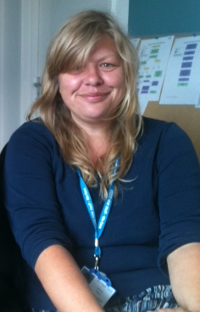
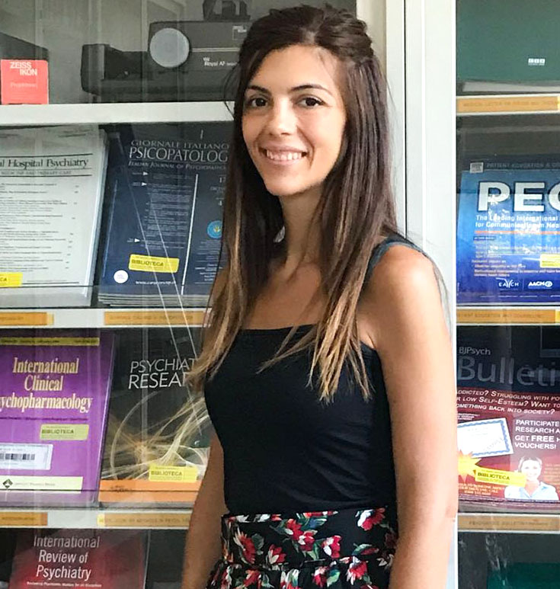
The Counselling and Wellbeing Team:
Gemma Fenton
Languages:
English and Italian
Office in the Badia
Elisabetta Miglietta
Languages:
English and Italian
Office in the badia

Slide 10
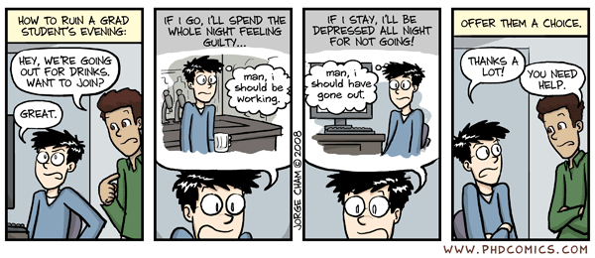
Enjoy your new life at the EUI!
We’re here for you!

