Slide 1
Presenting the 365 Mail Move
ICT Service presentation, June 2012

Slide 2
Overview
Microsoft upgrades its Exchange Mail Server infrastructure.
Our mailboxes, physically located in Dublin and Amsterdam, will get migrated from MS Exchange 2007 (BPOS) to MS Exchange 2010 (Outlook 365) infrastructure.
From Thu, 14 June, to Tue, 19 June, changing passwords will be particularly cumbersome and therefore users are discouraged from doing so.
On Friday evening, 15 June, migration will start: users may continue to use their email as always.
In the course of the weekend users – if active – will get informed that they cannot continue as their mailbox will have moved entirely.
After the move users will have to close their mail clients and re-connect again, OWA and Windows-based Outlook clients are redirected, others will have to be re-configured.
On Monday morning, 18 June, all users will connect to the new infrastructure; re-configuration and – where necessary – troubleshooting will be performed.

Slide 3
What changes, what remains?
Infrastructure and Outlook Web Access (OWA) are upgraded from Exchange 2007 to Exchange 2010.
In particular:
OWA’s functionality doesn’t differentiate any more between Internet Explorer and third party browsers.
OWA now offers integrated additional mailboxes, send-on-behalf-of rights for them, and attaching mail items by drag-and-drop.
Mobile devices are better supported.
Reading mail via IMAP becomes available.
Dedicated Windows-based mail client profiles remain usable, and Outlook should re-configure automatically, other browsers or platforms will need manual intervention.
Information and/or help?
ICT has detailed documentation on the EUI Web pages, including frequently asked questions, all continuously updated.
A mailbox dedicated to the migration process has been created: MailMove@EUI.eu
FAQ: http://www.eui.eu/ServicesAndAdmin/ComputingService/EMail/365MoveFAQ.aspx

Slide 4
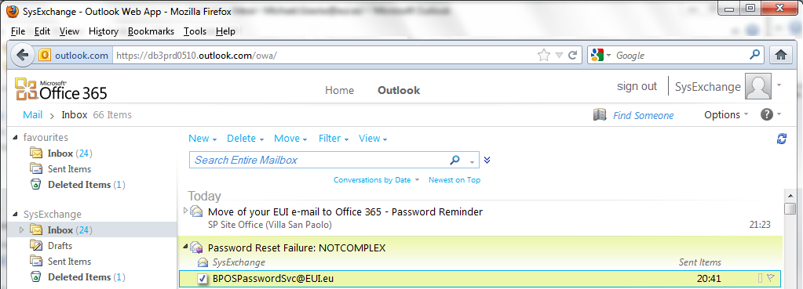
User experience after the move #1 (OWA)
You continue to use the WebMail hyperlink on our Web pages.
After successful login you get automatically redirected to the new OWA page (http://mail.office365.com), where you’ll have to login again.
After your first login you are asked to select your time-zone and preferred language (which can also be changed later).
You may have to set some folder views, you continue to work as always.

Slide 5
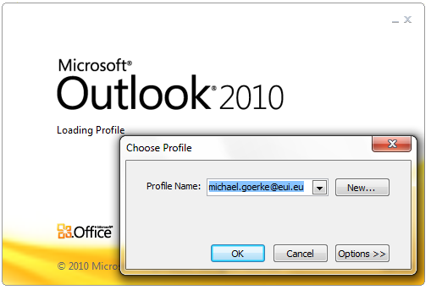
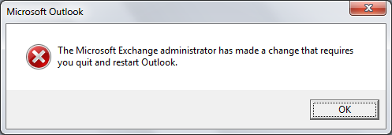
User experience after the move #2 (Outlook on Windows)
The first time you login using Sign-In as before.
If Outlook doesn’t start automatically you launch Outlook manually, selecting the profile you want to use.
You’ll be asked to accept re-configuration of your profile; you confirm.
You quit and re-start Outlook, and you’ll have to be patient as re-configuration may take a long time (up to about 20 minutes).
You continue to work as always, and every time from then on you start up Outlook directly and forget about the Sign-In tool (which will be removed by us at a later date).

Slide 6
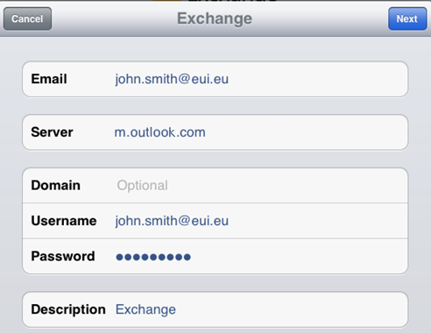
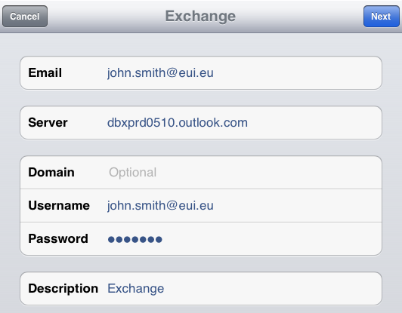
User experience after the move #3 (mobiles)
Attention! EUI BlackBerry users should not try to re-configure their BES (BlackBerry Enterprise Service). Individual re-configuration following data backup will be performed by technicians on individual appointments.
You re-configure your mobile device according to our Web page
http://www.eui.eu/ServicesAndAdmin/ComputingService/EMail/365MailClientConfigurationSettings.aspx#MobileDevices
You start using it.
I-Phone example:

Slide 7
And at the end
Please have patience! And don’t panic!
Whoever wants to use his/her email immediately after the move without delays has to change the password before Thu, 14 June.
It’s a rolling transition, we don’t know when single mailboxes will be moved, and all have to be processed together.
It may happen that some features temporarily won’t work on Monday, 18 June, but we’ll do our best to fix them as soon as possible.
On-site support for portables (laptops and mobile devices) is offered from 9 a.m. to 5 p.m. at the Badia, Room 2.
In other buildings please contact your local IT User Support (Site Office).
EUI Blackberry devices are treated separately (by individual appointments).
And don’t forget, you can always contact
MailMove@EUI.eu
or consult the FAQ:
http://www.eui.eu/ServicesAndAdmin/ComputingService/EMail/365MoveFAQ.aspx

